Slide 1
Linear lest squares method (lLSQ) 線形最小自乗法

Slide 2
Approximation of many sample points: Minimization (Optimization) (多数の標本点の近似: 最小化問題)
How to determine most plausible parameters a and b if observed data (x₁, y₁), ・・・ (x_{n}, y_{n}) follow f(x) = a + bx, ※ Error ε_{i} should be considered: y_{i} = f(x_{i}) + ε_{i}
Fundamental idea: Determine a and b so as to minimize (maximize) a target function S (e.g., error residual function (残差関数))
Minimax method (ミニマックス法) : S = Σ|f(x_{i}) – y_{i} |
Least-squares (LSQ) method (最小自乗法): S = Σ(f(x_{i}) – y_{i})²
S = Σ(a + bx_{i} – y_{i})²
dS/da = 2Σ(a + bx_{i} – y_{i}) = 2an + 2bΣx_{i} – 2Σy_{i} = 0
dS/db = 2Σx_{i}(a + bx_{i} – y_{i}) = 2aΣx_{i} + 2bΣx_{i}² – 2Σx_{i}y_{i} = 0
$$\left(\begin{matrix}n & \sum{x_{i}} \\ \sum{x_{i}} & \sum{x_{i}^{2}}\end{matrix}\right)\left({a \atop b}\right)=\left({\sum{y_{i}} \atop \sum{x_{i}y_{i}}}\right)$$
Even for f(x) = a + bx + cx² +・・・, only one matrix operation can give a final solution

Slide 3
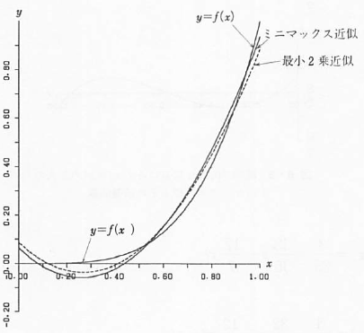
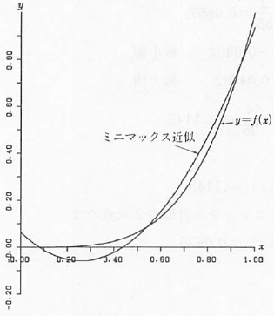
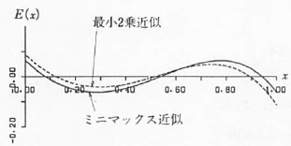
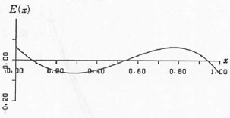
Minimax approximation (ミニマックス近似)
Minimize
入門 数値計算
minimax
LSQ
minimax
LSQ
minimax

Slide 4
lLSQ: Polynomial 線形最小二乗法: 多項式
(l = 0, 1,･･･, N)

Slide 5
lLSQ: General functions 線形最小二乗法: 一般関数の場合
If f(x) is linear with respect to fitting parameters, final solution is obtained by one matrix operation 係数に関して線形であれば、１度の行列計算で最終解が得られる
ex.

Slide 6
Ex of lLSQ: Lattice spacing of triclinic lattice (三斜晶結晶の面間隔)
The form of d_{hkl}⁻² is a linear function with respect to S_{ij}. 1. S_{ij} is obtained by lLSQ 2. S_{ij} => Reciprocal lattice parameters (a*, b*, c*, α*, β*, γ*) 3. => Lattice parameters (a, b, c, α, β, γ)

Slide 7
Transcendental equation 超越方程式の解法

Slide 8
Newton-Raphson method
Solve f(x) = 0
y = f(x)
f(x₀+dx) = f(x₀) + dx f’(x₀) ~ 0
=> x₁ = x₀ + dx = x₀ – f(x₀) / f’(x₀)
f’(x₀)
f’(x₀) can be substituted with finite diffrence
f(x₀)
Secant method (割線法, はさみうち法):
f’(x) = (f(x_{n}) – f(x_{n-1})) / (x_{n} – x_{n-1}) Save calculation of f(x)
Variation to suppress divergence
x_{k+1} = x_{k} – f(x_{k}) / (f’ (x_{k}) + λ)
λ: Dumping Factor
x₁ = x₀ – f(x₀) / f’(x₀)
x₀

Slide 9
Effect of dumping factor (収束過程の比較)
f(x) = exp(x) – 3x = 0 (initial x = 0) Exact 0.619061
Newton-Raphson (Dumping factor = 0)
1 0.5
2 0.610059654958962 0.110059654958962
3 0.61899677974154 0.00893712478257794
4 0.619061283355313 6.4503613773092e-005
5 0.619061286735945 3.38063244722622e-009
6 0.619061286735945 -1.94296000199483e-016
Newton-Raphson (Dumping factor = 0.1)
0.476190476190476
2 0.597901649246081 0.121711173055605
3 0.617090542717403 0.0191888934713221
4 0.618900291486661 0.00180974876925825
5 0.619048316423879 0.000148024937217564
6 0.619060243007723 1.19265838440254e-005
7 0.619061202754359 9.59746635487409e-007
8 0.619061279978579 7.72242198569211e-008
9 0.619061286192231 6.21365241490959e-009
10 0.619061286692197 4.99965669237101e-010
11 0.619061286732425 4.0228535713285e-011
Newton-Raphson (Dumping factor = 1.0)
0.333333333333333
2 0.485235618882813 0.15190228554948
3 0.556317491275292 0.0710818723924794
4 0.589692022113926 0.0333745308386341
5 0.605333177012923 0.0156411548989961
6 0.612649553494255 0.00731637648133212
7 0.616067929129785 0.00341837563553035
8 0.617664103982484 0.00159617485269905
9 0.618409199563502 0.00074509558101794
10 0.618756961315507 0.000347761752005284
11 0.618919262817103 0.000162301501596124
12 0.618995007056658 7.57442395542543e-005
13 0.619030355500237 3.53484435796756e-005
14 0.619046851855444 1.64963552070255e-005
15 0.619054550323461 7.69846801636556e-006
16 0.619058143015321 3.59269186005107e-006
17 0.619059819637962 1.67662264164844e-006
18 0.619060602077057 7.82439094491156e-007
19 0.619060967222337 3.65145279621982e-007
20 0.619061137626738 1.70404401849186e-007
21 0.619061217150316 7.95235781565464e-008
22 0.61906125426203 3.71117137244393e-008
23 0.619061271581161 1.73191312594282e-008
24 0.619061279663577 8.08241600165667e-009
25 0.619061283435444 3.77186631653624e-009
26 0.619061285195682 1.76023798493846e-009
27 0.619061286017142 8.21460096532513e-010
28 0.619061286400497 3.83355443989238e-010
29 0.6190612865794 1.78902585357646e-010
30 0.619061286662889 8.34894067972632e-011
Newton-Raphson (数値微分 (dx = 0.1), Dumping factor = 0)
1 0.500417222909252 0.500417222909252
2 0.61033946558968 0.109922242680428
3 0.619023693448297 0.00868422785861678
4 0.619061387723266 3.76942749687479e-005
5 0.619061286461533 -1.01261732612169e-007
6 0.619061286736691 2.75157452514368e-010
7 0.619061286735943 -7.473446448191e-013
セカント法 (dx 初期値 = 0.1, Dumping factor = 0)
1 0.513270395837659 0.413270395837659
2 0.593526578177693 0.0802561823400344
3 0.617155820423378 0.0236292422456848
4 0.6190229584543 0.00186713803092184
5 0.619061227524883 3.82690705827075e-005
6 0.619061286734101 5.92092186576008e-008
7 0.619061286735945 1.84386895032945e-012
二分法
0 0.5 1
1 0.5 0.75 1 : f=-0.132999983387325
2 0.5 0.625 0.75 : f=-0.00675404256777767
3 0.5 0.5625 0.625 : f=0.0675546569602985
4 0.5625 0.59375 0.625 : f=0.0295160721193872
5 0.59375 0.609375 0.625 : f=0.0111564885417808
6 0.609375 0.6171875 0.625 : f=0.00214465204643433
7 0.6171875 0.62109375 0.625 : f=-0.00231889329475243
8 0.6171875 0.619140625 0.62109375 : f=-9.06632034327615e-005
9 0.6171875 0.6181640625 0.619140625 : f=0.00102610964135863
10 0.6181640625 0.61865234375 0.619140625 : f=0.00046750191590883
11 0.61865234375 0.618896484375 0.619140625 : f=0.000188364016966425
12 0.618896484375 0.6190185546875 0.619140625 : f=4.88365702602245e-005
13 0.6190185546875 0.61907958984375 0.619140625 : f=-2.09167759241957e-005
14 0.6190185546875 0.619049072265625 0.61907958984375 : f=1.39590323600114e-005
15 0.619049072265625 0.619064331054688 0.61907958984375 : f=-3.47908798747909e-006
16 0.619049072265625 0.619056701660156 0.619064331054688 : f=5.23991813539126e-006
17 0.619056701660156 0.619060516357422 0.619064331054688 : f=8.80401561209609e-007
18 0.619060516357422 0.619062423706055 0.619064331054688 : f=-1.29934659121034e-006
19 0.619060516357422 0.619061470031738 0.619062423706055 : f=-2.09473359547019e-007
20 0.619060516357422 0.61906099319458 0.619061470031738 : f=3.35463889777898e-007
21 0.61906099319458 0.619061231613159 0.619061470031738 : f=6.29952121578015e-008
22 0.619061231613159 0.619061350822449 0.619061470031738 : f=-7.32390867952404e-008
23 0.619061231613159 0.619061291217804 0.619061350822449 : f=-5.12194064938853e-009
24 0.619061231613159 0.619061261415482 0.619061291217804 : f=2.89366350880726e-008
25 0.619061261415482 0.619061276316643 0.619061291217804 : f=1.19073468862752e-008
26 0.619061276316643 0.619061283767223 0.619061291217804 : f=3.39270322946561e-009
27 0.619061283767223 0.619061287492514 0.619061291217804 : f=-8.64618820983765e-010
28 0.619061283767223 0.619061285629869 0.619061287492514 : f=1.26404220424092e-009
29 0.619061285629869 0.619061286561191 0.619061287492514 : f=1.99711802650882e-010
30 0.619061286561191 0.619061287026852 0.619061287492514 : f=-3.32453398144139e-010
31 0.619061286561191 0.619061286794022 0.619061287026852 : f=-6.63709087689313e-011

Slide 10
Effect of dumping factor: Convergence process
f(x) = exp(x) – 3x = 0 (initial x = 0) Exact 0.619061
iteration
iteration
dx
(numerical diff.)
Secant
(num. diff.)
Bisection
Secant
Bisection
NR: Newton-Raphson method
df: Dumping Factor

Slide 11
Case Newton method fails
f(x) = tan⁻¹(10x) initial x = 0.1
Case for convergence
f(x)
x
x₀
x₂
x₁

Slide 12
Case Newton method fails
f(x) = tan⁻¹(10x) initial x = 0.15
Diverged (λ = 0)
f(x)
x₀
x₀
x₂
x_{k+1} = x_{k} – f(x_{k}) / (f’ (x_{k}) + λ)
λ: Dumping Factor
x₃
x₁
Stabilize convergence by choosing λ(λ = 1)
x
x₁

Slide 13
Non-linear (NL) optimization 非線形最適化

Slide 14
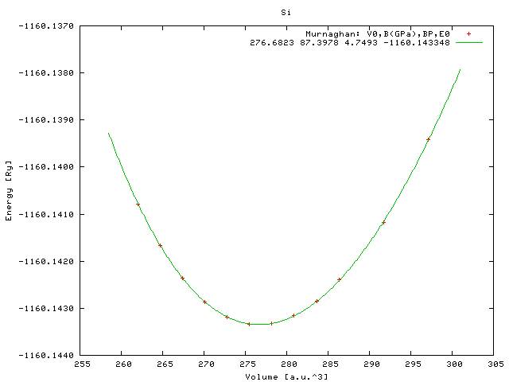
NL optimization of crystal structure: Illustrative approach 安定構造: 図解による解法
Calculate total energy by quantum calculations by varying a lattice parameter
ex. Si
-1160.137
-1160.138
Exp.(RT) a_{C} = 0.5431 nm
V_{R} = 270.5 a.u.³ (primitive cell)
-1160.139
Energy / Ry
-1160.140
-1160.141
Opt.
a_{C} = 0.5472 nm
V_{R} = 276.67 a.u.³
-1160.142
-1160.143
-1160.144
260
270
280
290
300
Volume / a.u.³
B₀ (GPa) = 87.57 GPa (exp: 97.88 GPa)
Equation of state: EOS2 (PRB52,8064) info 7
a,b,c,d -1165.272359 148.586322 -1283.092254 3470.894733
V0,B(GPa),BP,E0 276.6867 87.5714 4.6917
Exp. B=0.9788x10¹² dyn/cm² = 0.9788x10¹¹ N/m² = 97.88 GPa

Slide 15
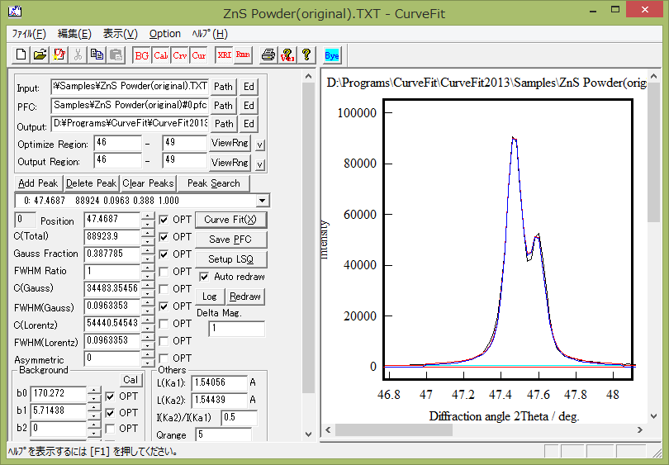
Ex.: Deconvolution of powder XRD peak
Incorporate the intensity ratio from Kα₁ and Kα₂ at 2:1

Slide 16
Profile models used for spectroscopy
Lorentz function
w: half width at half maximum
Gauss function
Voigt function: E.g., observed is convolution of sample spectrum I_{L}(x) and apparatus function I_{G}(x)
f_{G} = 0, 0.3,
0.5, 0.7, 1
Pseudo-Voigt function: Simplified Voigt function
f_{G}: Gauss fraction

Slide 17
Multiple parameter Newton-Raphson method
Extend to multiple parameters： Minimize F(x_{ｌ})
$f_{k}\left(x_{l}\right)=∂F\left(x_{l}\right)/{∂x}_{k}$ = 0
Iteration:
$f_{k}\left(x_{l}+δx_{l}\right)\sim f_{k}\left(x_{l}\right)+\sum_{k′}{{δx_{k′}∂f}_{k}\left(x_{l}\right)/{∂x}_{k′}}$= 0
x_{l,1} = x_{l,0} – (${∂f}_{k}\left(x_{l}\right)/{∂x}_{k′}$)⁻¹(f_{k}) = x_{l,0} – (F’’_{kk’})⁻¹(F’_{k})
Hessian matrix (ヘッセ行列) (ヘッセ行列の固有値をヘッシアンと呼ぶ)
Hessian matrix is not always positive definite (正定値であるとは限らない) (Maximum, Saddle point 極大値、鞍点)
=> F’’ dose not always gives decreasing direction
Convert F’’ to positive definite and suppress divergence
x_{l,1} = x_{l,0} – (F’’_{kk’} + λI)⁻¹(F’_{k})
λ: Dumping Factor

Slide 18
Steepest Descend (SD) method (最急降下法)
矢部博, 工学基礎 最適化とその応用, 数理工学社 (2006)
Search minimum only by first derivatives. Simplest one among differential methods
・ SD: S² would decrease in the vector –(df / dx_{i})dx_{i}
x_{i} ^{(i+1)} = x_{i} ^{(i)} – α(df / dx_{i})
α_{k} may be a small constant step or determined by a line search method
ex. in right figure:
S² = f(x_{i}) = 5x₁² + x₂², initial x₁ = 0.7, x₂ = 1.5
・ Newton method One cycle calculation provides the final solution for quadratic problems 楕円問題の場合は一度目の計算で最適値に到達
・ SD method
α = 0.3: Diverged (not shown in the graph)
0.2， 0.15: Converged, but oscillated
0.1: Reach final solution by one cycle calculation 0.01: Not oscillated, but slowly converged
Problem: If S² is highly anisotropic, the SD direction would be different largely from the minimization direction S² が大きく非対称な場合、最急勾配方向は最小値方向とは
大きく異なることがある
=> Conjugate Gradient (CG) method (共役勾配法)
0.1
0.15
Newton
k=0.2
0.01

Slide 19
Steepest Descend method
矢部博, 工学基礎 最適化とその応用, 数理工学社 (2006)
Effective way: α is determined by line search (直線探索法)
Without direct search
By direct search
0.1
0.15
Newton
k=0.2
0.01

Slide 20
SD method in Deep Learning
・ All batch data are divided to mini batches, and apply SD to each mini batch
Right example:
S² = f(x_{i}) = ax₁² + bx₂², a = 5, b = 1 1000 batch data are generated with random num (note: the data were re-generated for different runs)
Initial a = 0, b = 0
DL: SD method
DL: SD法
k = 0.1, n_{MB} = 10
k=0.05, nMB=1
k=0.01, nMB=1
k=0.05, nMB=10
SD (Repeat for all batch data)
DL: SD法+直接探索
k=0.1
Direct search
k = 0.05, n_{MB} = 100
k=0.01 nMB=10
k=0.01
k = 0.1 n_{MB} = 100
k=0.01 nMB=100

Slide 21
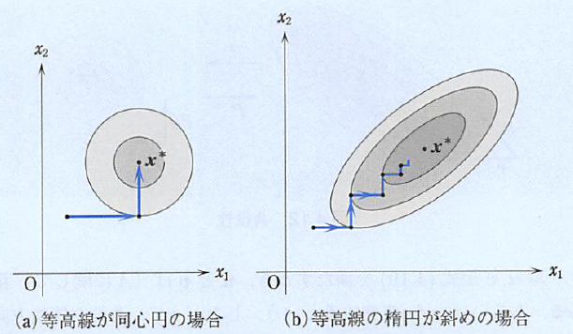
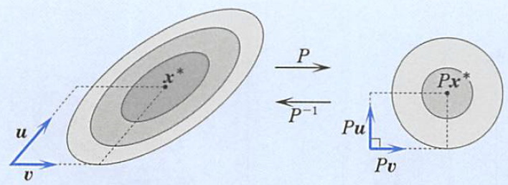
Conjugate Gradient method (共役勾配法)
矢部博, 工学基礎 最適化とその応用, 数理工学社 (2006)
Vectors u and v satisfy u^{t}Av = 0 for a matrix A: u and v and conjugate with each other
・ For quadratic function, repetition of the conjugate direction will find the minimum in finite cycles if exact line search is employed 共役な探索方向に沿って正確な直線探索を実行 => 有限回の反復で2次関数の最小解に到達
Case contour is a circle, one cycle calculation reaches the minimum 等高線が円の場合、一回の探索で最小値に到達できる
Give initial value x₀
Initial direction d is determined by SD
Find x_{k+1} using appropriately chosen α_{k} x_{k+1} = x_{k} + α_{k}d_{k} α_{k} may be a small constant step or determined by a line search method
Search direction is updated by
5. Repeat 3 – 4 to reach convergence As the freedom of cg directions is the number of parameters (n_{param}), need to go back to 2 to reset d_{k} at some interval (typically n_{param}, necessary for n_{param} = 2).
Note: Independent d_{k} and the possible cycle number are limited to the parameter number d_{i} (i = 1, …, k-1) => d_{k} must be reset at some cycles
Conjugate vectors and ellipsoido – circle conversion u^{T}P^{T}Pv = u^{T}Av = 0

Slide 22
Marquart method (マーカート法)
Minimize a square sum of m functions f_{j}(x_{i}) with N parameters
Approximate by
Gauss-Newton method
Levenberg-Marquart method
λ: dumping factor
e.g. chosen proportional to diagonal sum of A^{t}A

Slide 23
Features of NL optimization
Newton-Raphson method: Use second derivatives (Hessian matrix) Fast convergence, easily diverged, complex program
Steepest Descent: Use first derivatives only Simple program, Slower convergence than NR and CG
Conjugate Gradient: Use conjugate direction for efficient search Better convergence than NR, faster than SD, complex program
Marquart: Use first derivatives of f_{j}(x_{i}) Simple program, Slower convergence than NR
Simplex: Trial and error with a pre-determined selections of next candidate parameters Very slow but good convergence

Slide 24
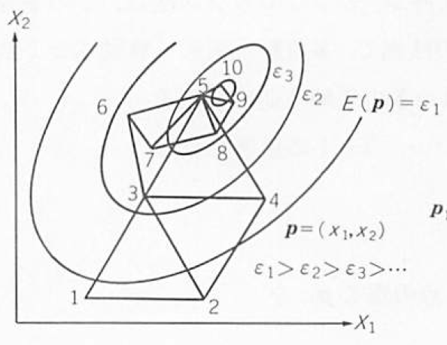
Simplex method (単体法, Amoeba法)
服部力、名取亮、小国力 監修、Fortranによる数値計算ソフトウェア、丸善株式会社 （１９８９年）
Simplex: Polyhedron formed by (n+1) vertexes in n-dimension space
(単体: n次元空間で (n+1) 個の頂点が作る多面体)
Minimize F(x_{i})
(n+1) initial values x_{i} (i = 1, 2,･･･, n+1) => Sort F(x_{i}) so that F(x_{i}) > F(x_{i’}) (i < i’) x_{h} = x₁, x_{l} = x_{n+1}
Average except the maximum vertex x_{i}
New x will be examined along the line x₁ – x_{G} by the following selections
Reflection (鏡映) : x_{R} = (1+ α)x_{G} – αx₁ (α > 0, ex. 1.0)
(ii) Expansion (拡大) : x_{E} = γx_{r} + (1 – γ)x_{G} (γ > 0, ex. 2.0)
(iii) Contraction (収縮) : x_{C} = βx₁ + (1 – β)x_{G} (0 < β < 1, ex. 0.5)
(iv) Reduction (縮小) : x_{RD} = (x₁ + x_{l}) / 2
4. Replace x₁ with the x in (i) – (iv) that firstly satisfies F(x) < F(x₁)
5. Repeat 2 - 4

Slide 25
Simplex method (単体法, Amoeba法)
南茂夫 編著、科学計測のための波形データ処理、CQ出版 (1986年)
Simplex: Polyhedron formed by (n+1) vertexes in n-dimension space
(単体: n次元空間で (n+1) 個の頂点が作る多面体)
Minimize F(x_{i})
(n+1) initial values x_{i} (i = 1, 2,･･･, n+1) => Sort F(x_{i}) so that F(x_{i}) > F(x_{i’}) (i < i’)
Average except the maximum vertex x_{i}
New x will be examined along the line x₁ – x_{G} by the following selections
Reflection (鏡映) : x_{R} = x₁ + α(x_{G} – x₁) (ex. α = 2)
(ii) Expansion (拡大) : x_{E} = x₁ + β(x_{G} – x₁) (ex. β > 2)
(iii) Reduction-Reflection (縮小鏡映) : x_{CR} = x₁ + γ(x_{G} – x₁) (ex. 1.0 < γ < 2.0)
(iv) Reduction : x_{CW} = x₁ + δ(x_{G} – x₁) (ex. 0 < δ < 1.0)
4. Replace x₁ with the x in (i) – (iv) that firstly satisfies F(x) < F(x₁)
5. Repeat 2 - 4

Slide 26
Notes for NL optimization
・ Solutions may be more than one
・ Final solution is not obtained by one step calculation
・ Convergence must be confirmed
・ Confirm the solution is the global minimum (大域最小値) ⬄ Often fall in a local minimum (局所極小値)
Residual error
parameter

Slide 27
Features of NL optimization algorisms
Convergence | A | B
Speed | × | ○
Stability | ○ | ×
Region | ○ | ×
For: | Initial cycles | Later fast convergence
A: Simplex (単体法)
A,B: Conjugate Gradient (CG, 共役勾配法)
B: Steepest Descent (SD, 最急降下法)
B: Newton-Raphson method, Quasi Newton methods
・ Davidson-Fletcher-Powell (DFP)
・ Broyden-Fletcher-Goldfarb-Shanno (BFGS)

