Slide 1
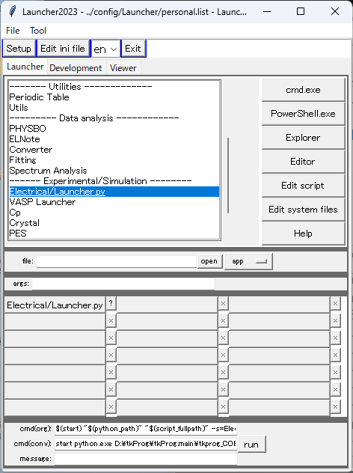
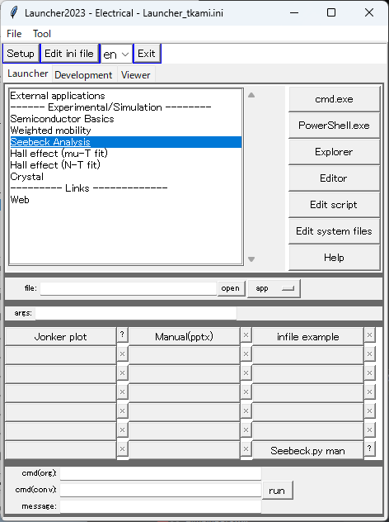
Seebeck analysis

Slide 2
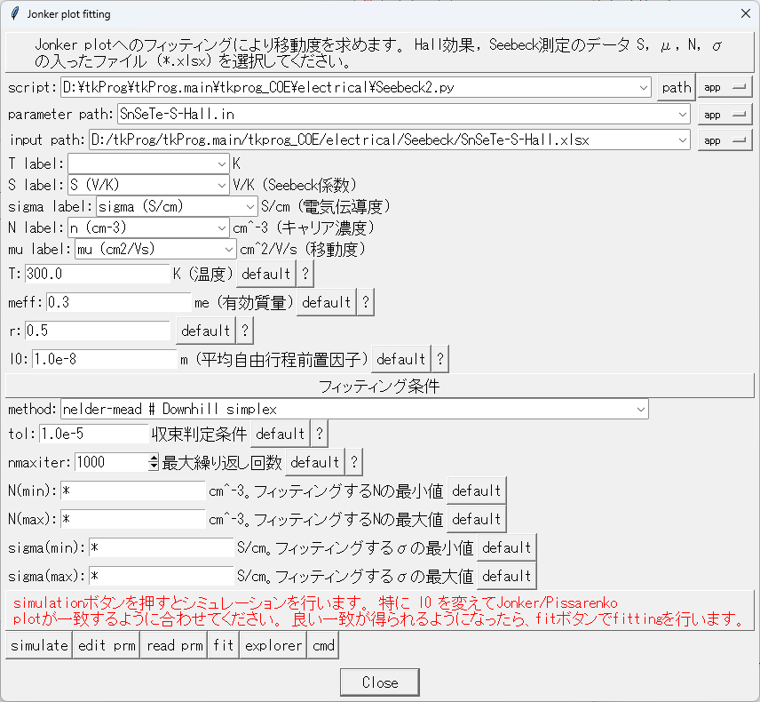
Seebeck analysis
[tkprog_X_path]\electrical\Seebeck\SnSeTe-S-Hall.xlsx\

Slide 3
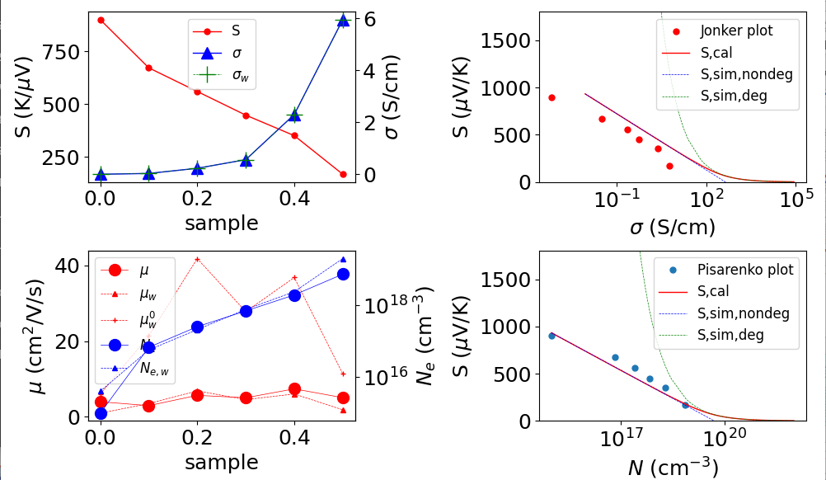
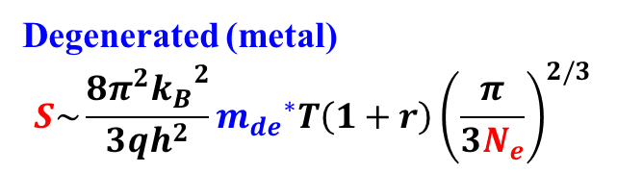
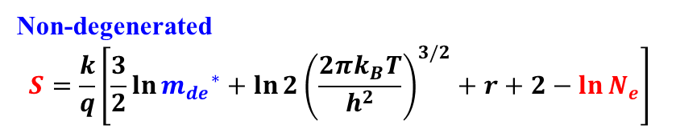
Simulate
[tkprog_X_path]\electrical\Seebeck\SnSeTe-S-Hall.xlsx\
Non-degenerated
$$S=\frac{k}{q}\left[\frac{3}{2}\ln{{m_{de}}^{∗}}+ln{2{\left(\frac{2πk_{B}T}{h^{2}}\right)}^{3/2}}+r+2−\ln{N_{e}}\right]$$
Degenerated (metal)
$$S\sim \frac{8π^{2}{k_{B}}^{2}}{3qh^{2}}{m_{de}}^{∗}T\left(1+r\right){\left(\frac{π}{3N_{e}}\right)}^{2/3}$$

Slide 4
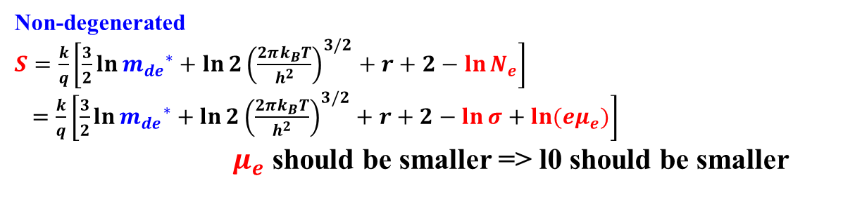
Simulate
Non-degenerated
$S=\frac{k}{q}\left[\frac{3}{2}\ln{{m_{de}}^{∗}}+ln{2{\left(\frac{2πk_{B}T}{h^{2}}\right)}^{3/2}}+r+2−\ln{N_{e}}\right]$
$=\frac{k}{q}\left[\frac{3}{2}\ln{{m_{de}}^{∗}}+ln{2{\left(\frac{2πk_{B}T}{h^{2}}\right)}^{3/2}}+r+2−\ln{σ}+\ln{({eμ}_{e})}\right]$
$μ_{e}$ should be smaller => l0 should be smaller

Slide 5
Fit
Fixed parameters:
T: Temperature
r: scattering factor
Fitting parameters:
meff: Effecitive mass
l0: Prefactor of mean free path

Slide 6
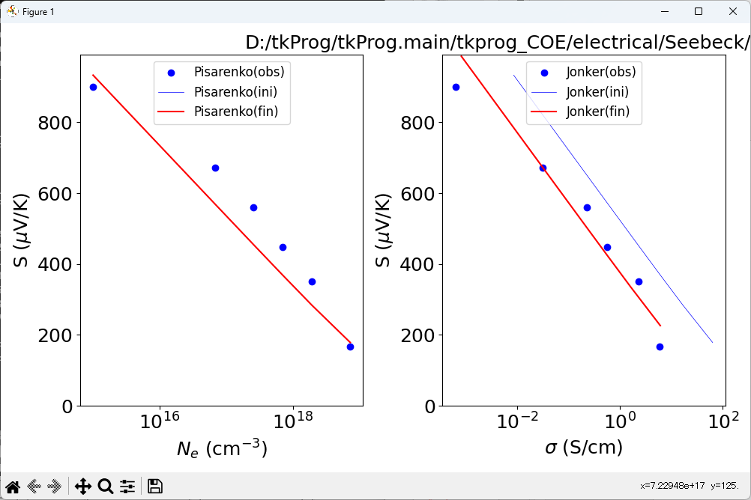
Fit

Slide 7
Edit prm
[Preferences]
infile=D:/tkProg/tkProg.main/tkprog_COE/electrical/Seebeck/SnSeTe-S-Hall.xlsx
T0=300.0
charge=1.0
rfac=0.5
EC=0.0
NC=7.655183943025066e+18
DC0=2.0781132532558804e+21
S2=0.09846196814223308
[Parameters]
meff=0.4531640625000002:1
l0=1.1855468750000088e-09:1

Slide 8
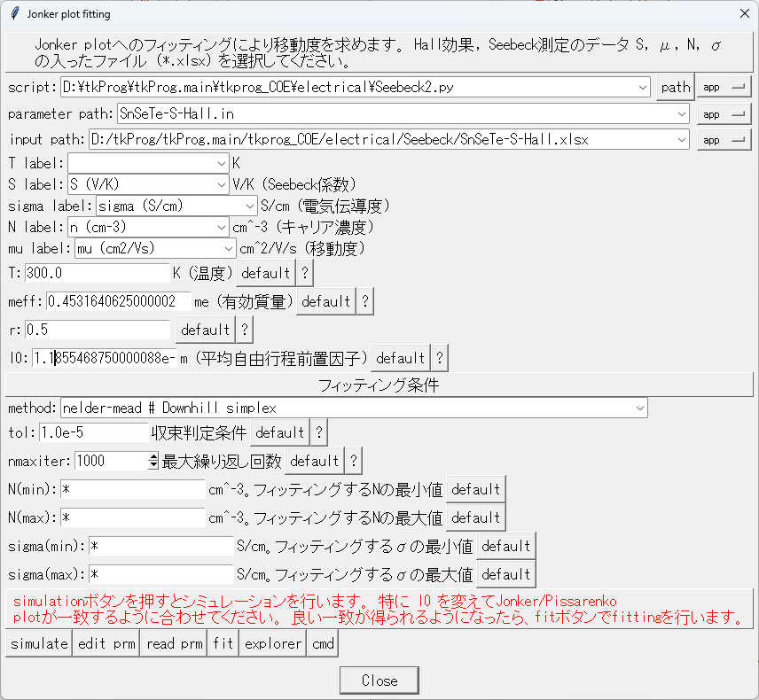
Read prm
Updated the fitting parameters

Slide 9
To get better fitting
  Edit parameter file and run ‘simulate’ to get better simulation result
  Then perform ‘fit’ for least-squares fitting
  Press ‘read prm’ to read the parameter file to the dialog
  Repeat 1 – 3 to get a good result

Slide 10
Old documents

Slide 11
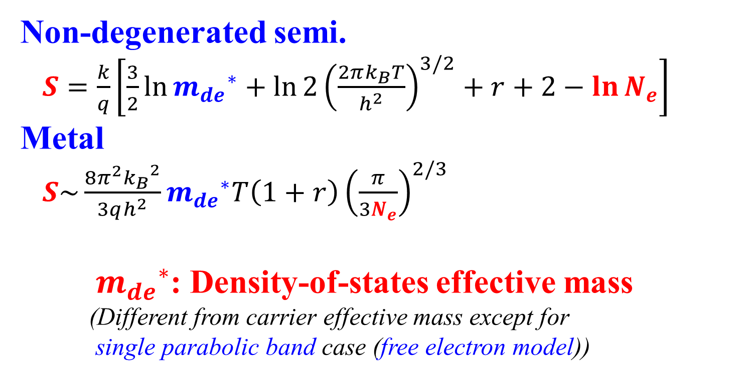
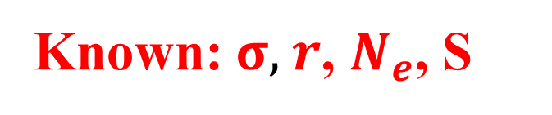
What we can know from Seebeck measurement?
Known: $σ$, $r$, $N_{e}$, S
  Non-degenerated semi.
  $S=\frac{k}{q}\left[\frac{3}{2}\ln{{m_{de}}^{∗}}+ln{2{\left(\frac{2πk_{B}T}{h^{2}}\right)}^{3/2}}+r+2−\ln{N_{e}}\right]$
  Metal
  $S\sim \frac{8π^{2}{k_{B}}^{2}}{3qh^{2}}{m_{de}}^{∗}T\left(1+r\right){\left(\frac{π}{3N_{e}}\right)}^{2/3}$
  ${m_{de}}^{∗}$: Density-of-states effective mass
  (Different from carrier effective mass except for
  single parabolic band case (free electron model))
General case: Need simulation and fitting

Slide 12
Seebeck.py
Purpose: Simulate Seebeck related properties based on free electron model
Model: Free electron model (Single parabolic band model) (electron only)
+ Boltzmann equation + relaxation time approximation
Theory: Attached in this file after usage of the program
Functions:
(i) mode = ‘basic’: For debug / development purpose.
Plot distribution functions and Fermi integrals
(ii) mode = ‘prop’: Plot Seebeck related properties. Carrier density, mobility, conductivity,
Seebeck coefficient, electron thermal conductivity, Lorentz number
(ii’) mode = ‘Hall’: Plot Hall related properties. Carrier density, mobility, conductivity,
Hall coefficient, Hall factor
(iii) mode = ‘init’: Create .in file for the following analysis
(iv) mode = ‘sim’: Calculate weighted mobility, carrier density and conductivity.
Simulate Jonker / Pisarenko plots
(v) mode = ‘fit’: Fit to Pisarenko plot to extract effective mass
(vi) mode = ‘T’: Simulate T dependences of Seebeck-related properties
(vii) mode = ‘calL’: Calculate L and κ_{e} from T, Ne data
(viii) mode = ‘calF’: Calculate F_{hall}, N_{Hall} and μ_{drift} from T, Ne_{Hall} and μ_{Hall} data

Slide 13
Seebeck.py
Program: [data-COE]\Seebeck\Seebeck.py
[Programs]\python\electrical\Seebeck\Seebeck.py
Data folder: [data-COE]\SnSeTe-S-Hall.xlsx
Input files: Data file (.xlsx / .csv)
Parameter file (.in) (created by mode = ‘init’, ‘sim’ and ‘fit’))
Output files: parameter file (.in), CSV files
(i) python Seebeck.py basic
Plot basic functions
(ii) python Seebeck.py prop T meff r l0 kappa_latt
meff in me0, l0 in m, kappa_latt in W/m/K
Plot Seebeck related properties
ex: python Seebeck.py basic 300.0 0.39111328125000017 0.5 1e-08 5.0
(ii') python Seebeck.py Hall T meff r l0
Plot Hall related properties
ex: python Seebeck.py Hall 300.0 0.39111328125000017 0.5 1e-08
(iii) python Seebeck.py init infile
Create .in file
(iv) python Seebeck.py sim infile T meff r l0
Calculate weight mobility etc from input file
Plot Jonker / Pisarenko plots
ex: python Seebeck.py sim SnSeTe-S-Hall.xlsx 300.0 0.39111328125000017 0.5 1e-08
(v) python Seebeck.py fit T meff r l0
Fit to Jonker / Pisarenko plots
ex: python Seebeck.py fit SnSeTe-S-Hall.xlsx 300.0 0.39111328125000017 0.5 1e-08
(vi) python Seebeck.py T infile Tmin Tmax nT
Simulate T dependences
ex: python Seebeck.py fit SnSeTe-S-Hall.xlsx 300.0 800.0 6
(vii) python Seebeck.py calL infile meff r l0
Calculate L and kappa,e from Ne and sigma
ex: python Seebeck.py calL SnSeTe-S-Hall.xlsx 0.39111328125000017 0.5 1e-08

Slide 14
Data file (.xlsx / .csv)
[data-COE]\Seebeck\SnSeTe-S-Hall.xlsx, SnSeTe-S-Hall.csv
The order of the data columns are arbitrary.
The data types are judged by the key words in the first line labels.
Sample specification : Any numbers.
Label must be distinguished from the other columns.
Seebeck coefficient in μV/K : Label must start from capital ‘S’
Conductivity in S/cm : Label must start from ‘sigma’
Carrier density in cm⁻³ : Label must start from ‘n’
Mobility in cm²/(Vs) : Label must start from ‘mu’
Te conc, x | S (uV/K) | sigma (S/cm) | n (cm-3) | mu (cm2/Vs)
0 | 900 | 0.000640871 | 1.00E+15 | 4
0.1 | 672 | 0.032172413 | 6.77E+16 | 2.96582
0.2 | 560 | 0.230976754 | 2.54E+17 | 5.6868
0.3 | 448 | 0.563164534 | 6.97E+17 | 5.04614
0.4 | 350.98 | 2.300066702 | 1.94E+18 | 7.4
0.5 | 168 | 5.952380952 | 7.33E+18 | 5.06769

Slide 15
Parameter file (.in)
Created by mode=‘init’, ‘sim’ and mode = ‘fit’
[Preferences]
infile=SnSeTe-S-Hall.xlsx
charge=1.0
rfac=0.5
EC=0.0
NC=7.655183943025066e+18
DC0=2.0781132532558804e+21
S2=
T0=300.0
[Parameters] key=value:opt_id
opt_id must be 1
meff=0.3:1
l0=1e-08:1

Slide 16
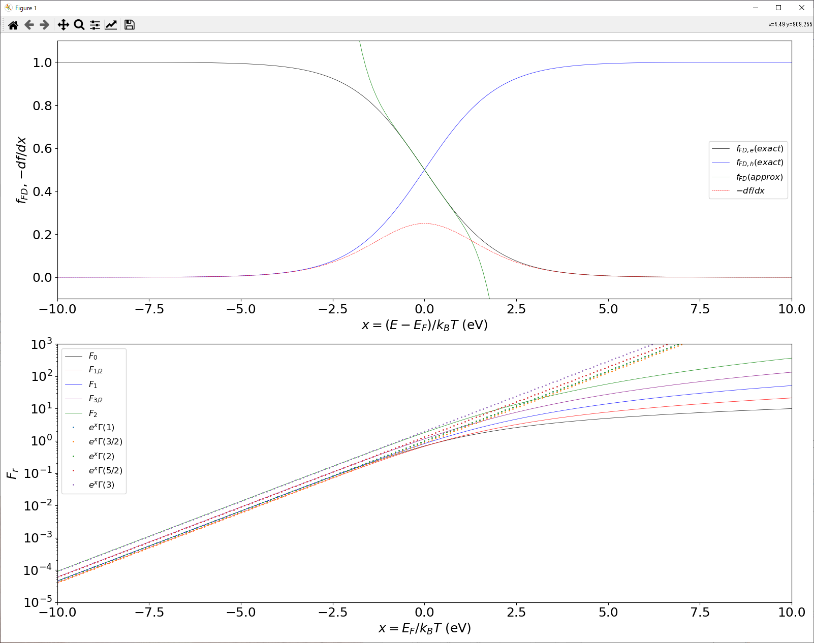
Plot distribution functions and Fermi integrals
(i) python Seebeck.py basic
Input files: None
Output files: fFD.csv: Fermi-Dirac distribution functions and their approximations
Fj.csv: Fermi integrals and their approximations

Slide 17
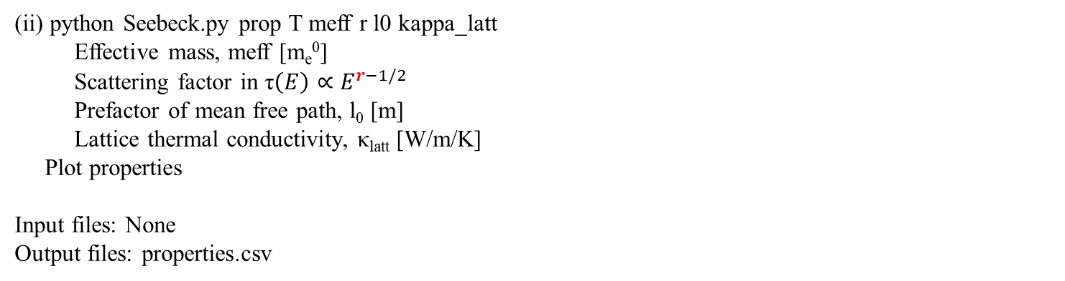
Plot Seebeck related properties
(ii) python Seebeck.py prop T meff r l0 kappa_latt
Effective mass, meff [m_{e}⁰]
Scattering factor in τ$\left(E\right)∝E^{r−1/2}$
Prefactor of mean free path, l₀ [m]
Lattice thermal conductivity, κ_{latt} [W/m/K]
Plot properties
Input files: None
Output files: properties.csv

Slide 18
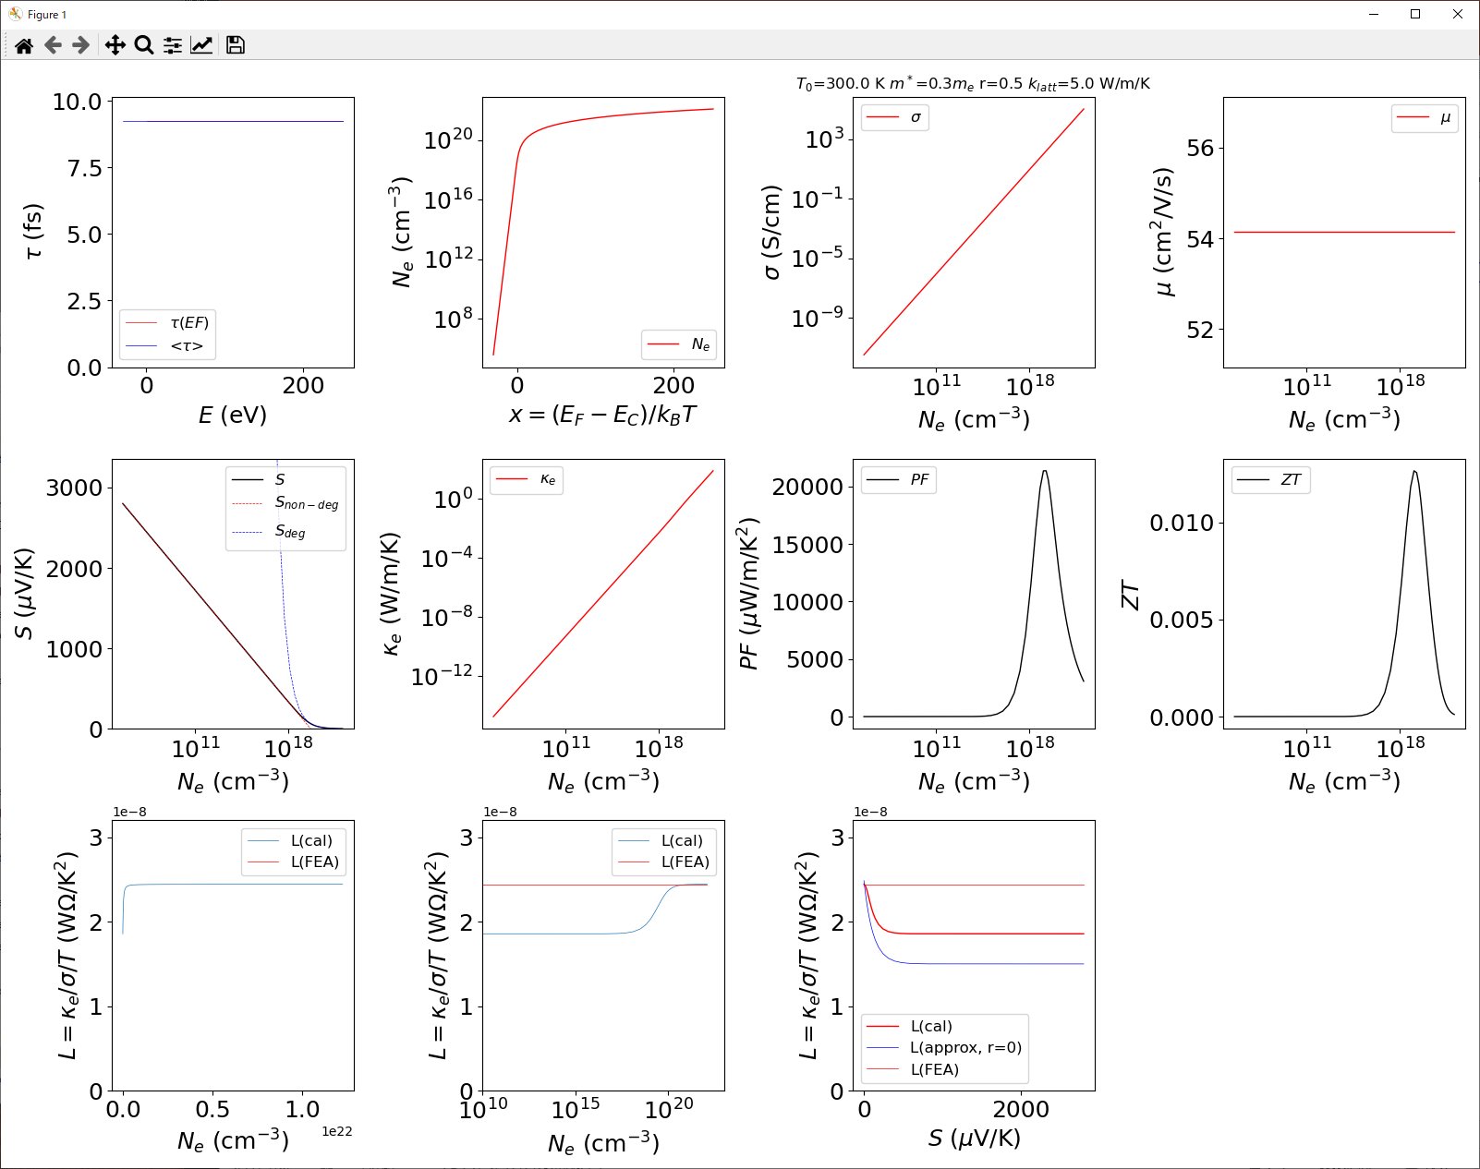
Plot Seebeck related properties: r = 0.5
python Seebeck.py prop 300.0 0.3 0.5 1e-08 5.0
Output files: properties.csv

Slide 19
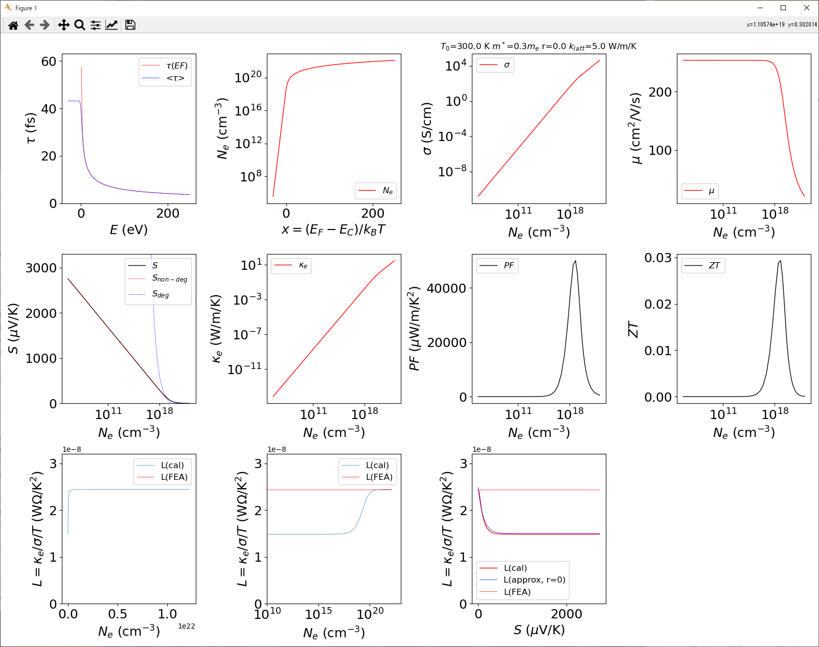
Plot Seebeck related properties: r = 0.0
python Seebeck.py prop 300.0 0.3 0.0 1e-08 5.0
Output files: properties.csv

Slide 20
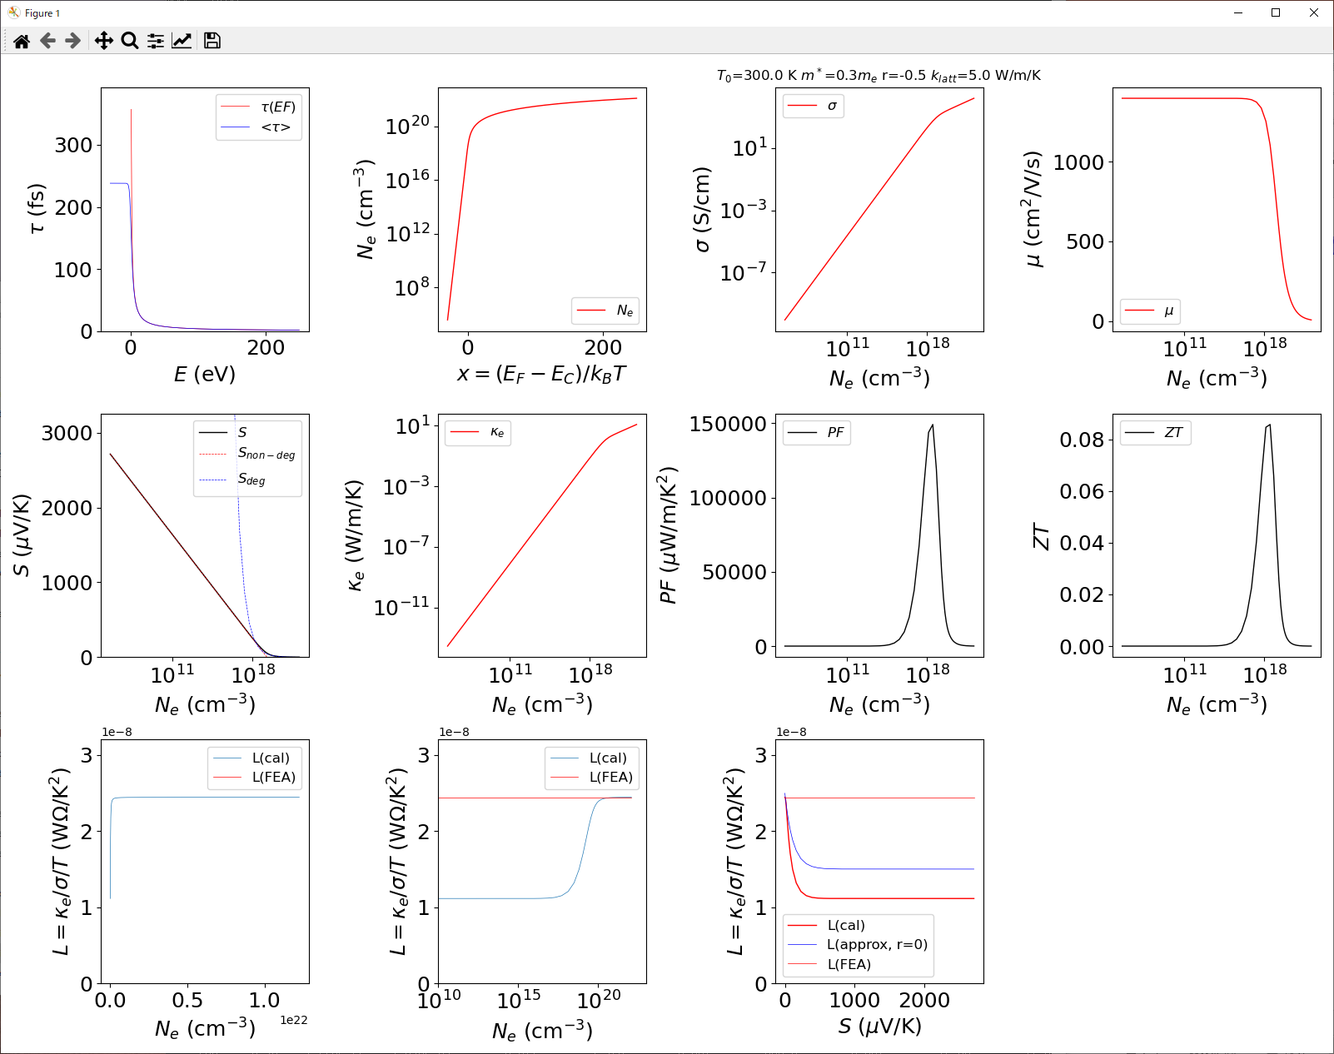
Plot Seebeck related properties: r = -0.5
python Seebeck.py prop 300.0 0.3 -0.5 1e-08 5.0
Output files: properties.csv

Slide 21
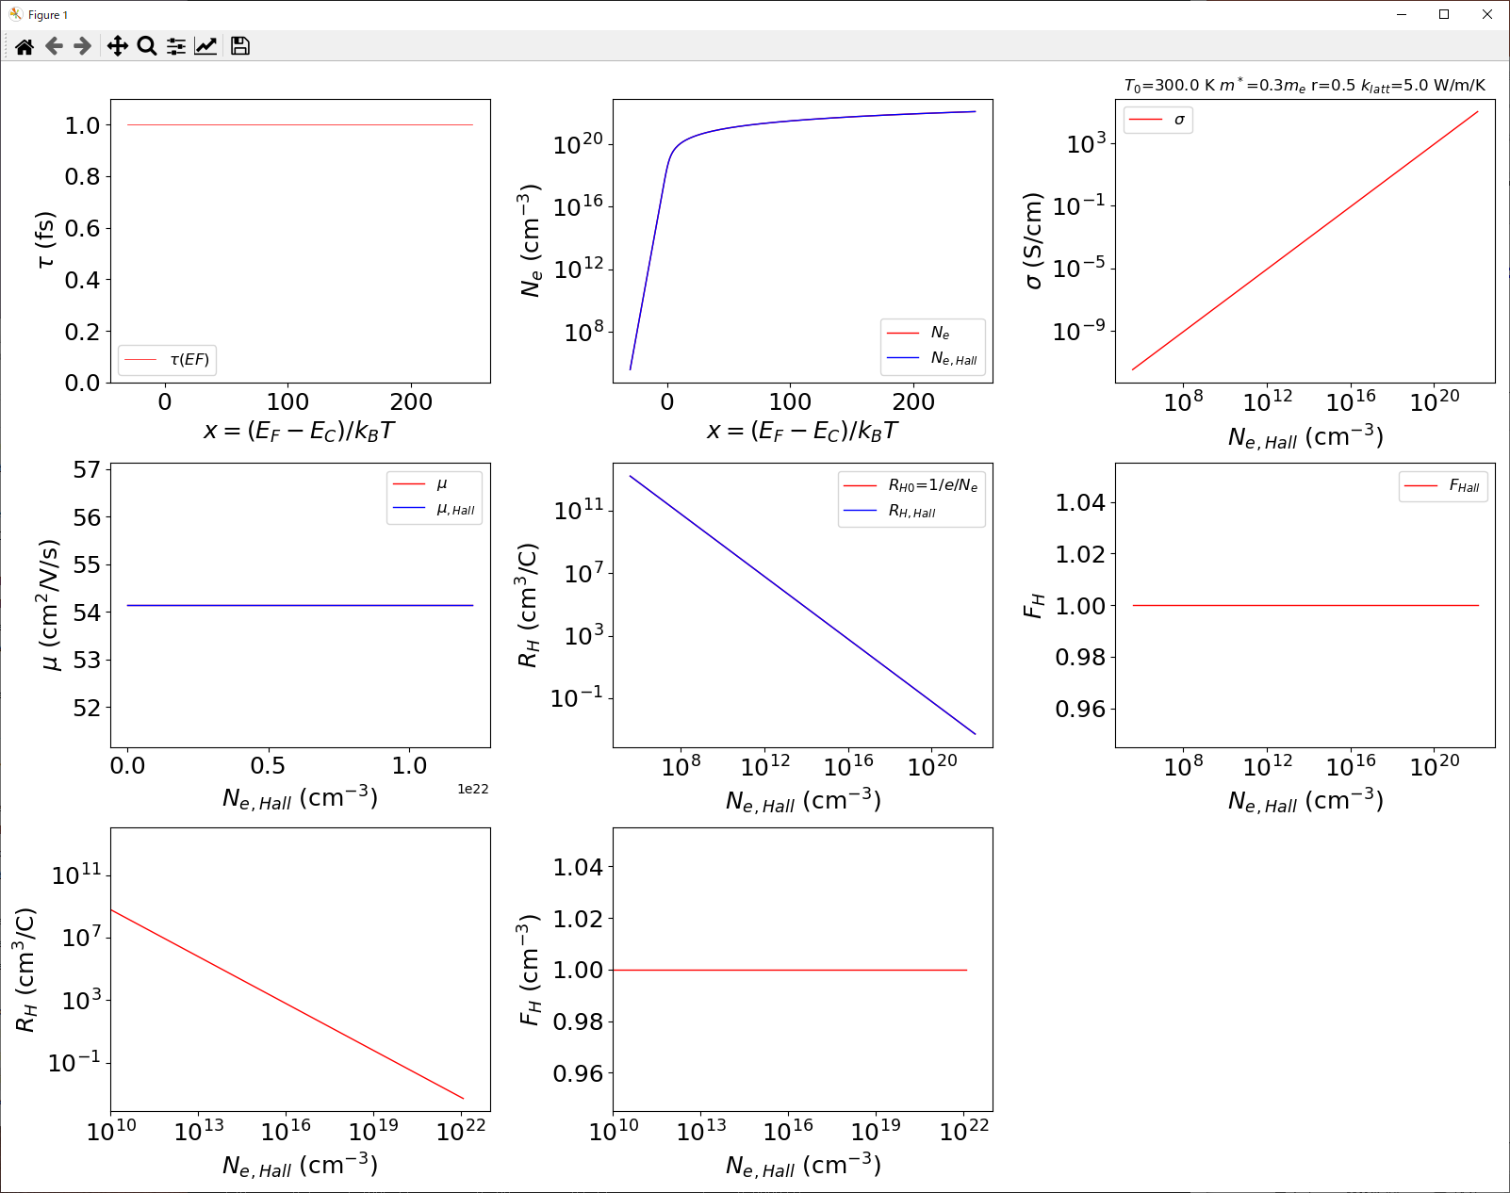
Plot Hall related properties: r = 0.5
python Seebeck.py Hall 300 0.3 0.5 1e-8
Output files: properties.csv

Slide 22
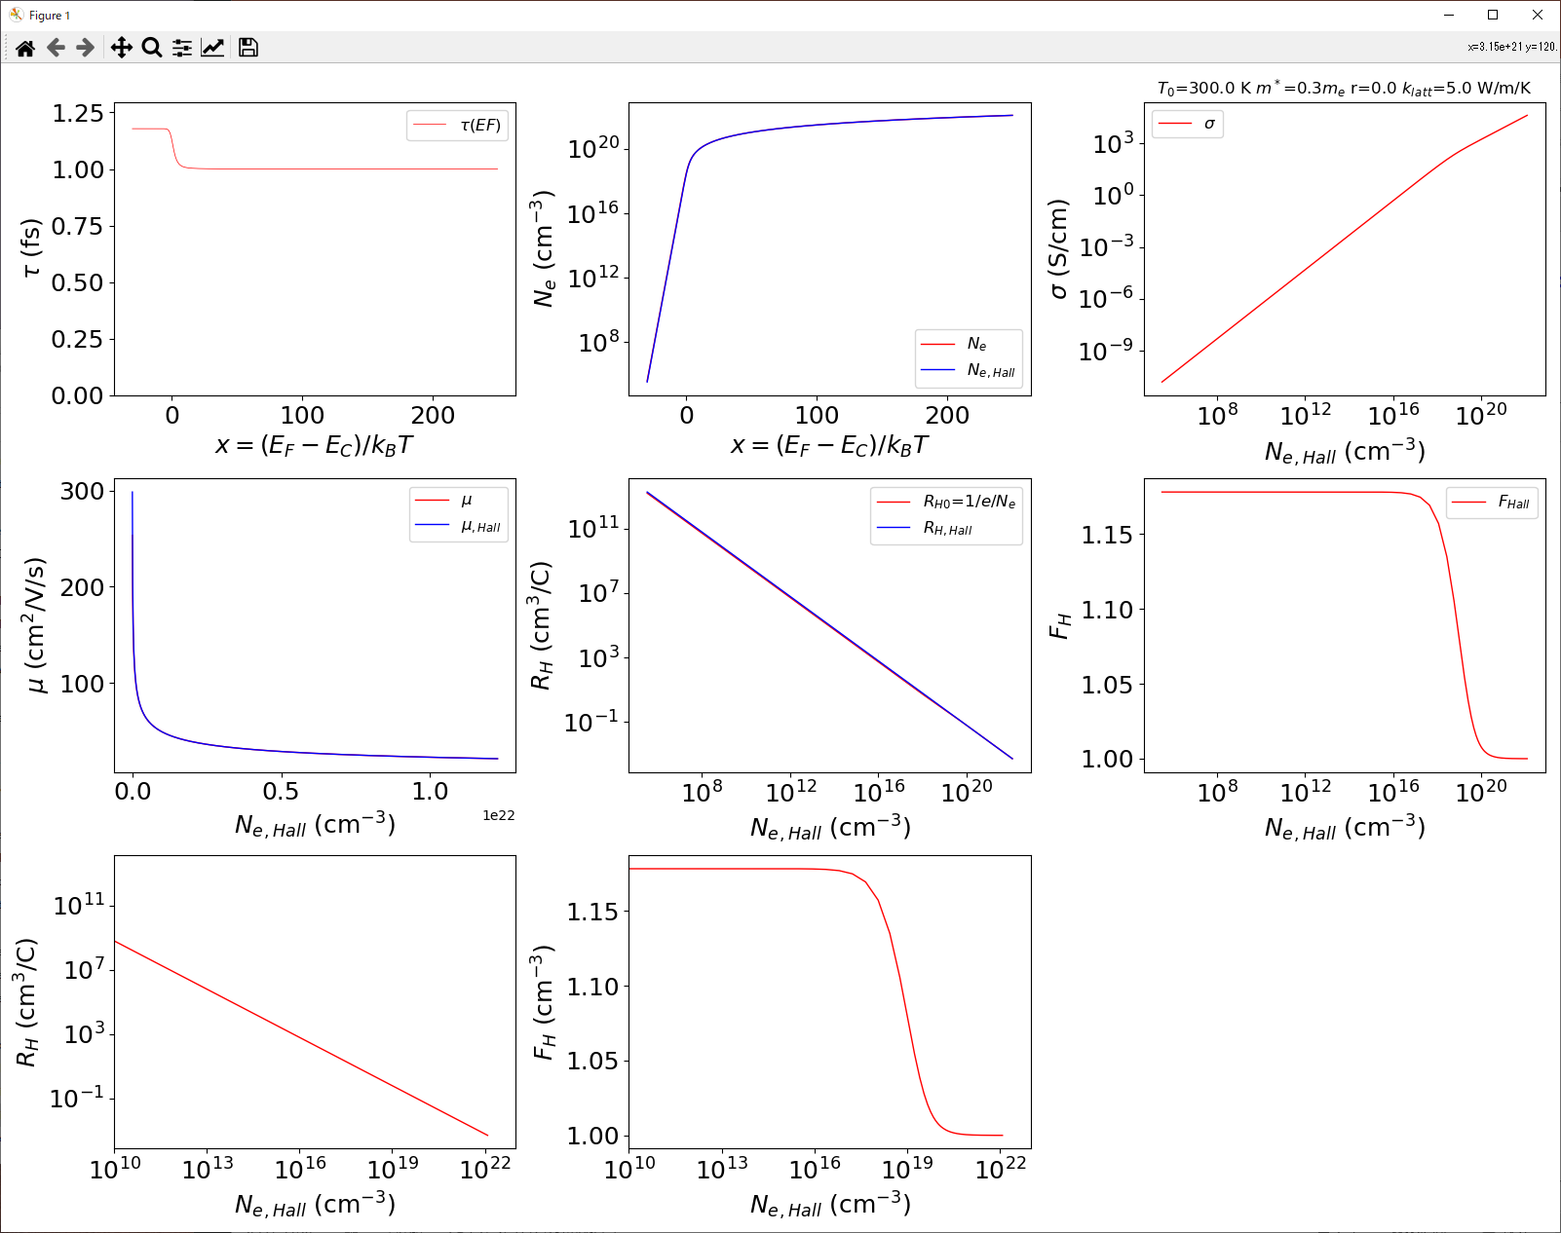
Plot Hall related properties: r = 0.0
python Seebeck.py Hall 300 0.3 0.0 1e-8
Output files: properties.csv

Slide 23
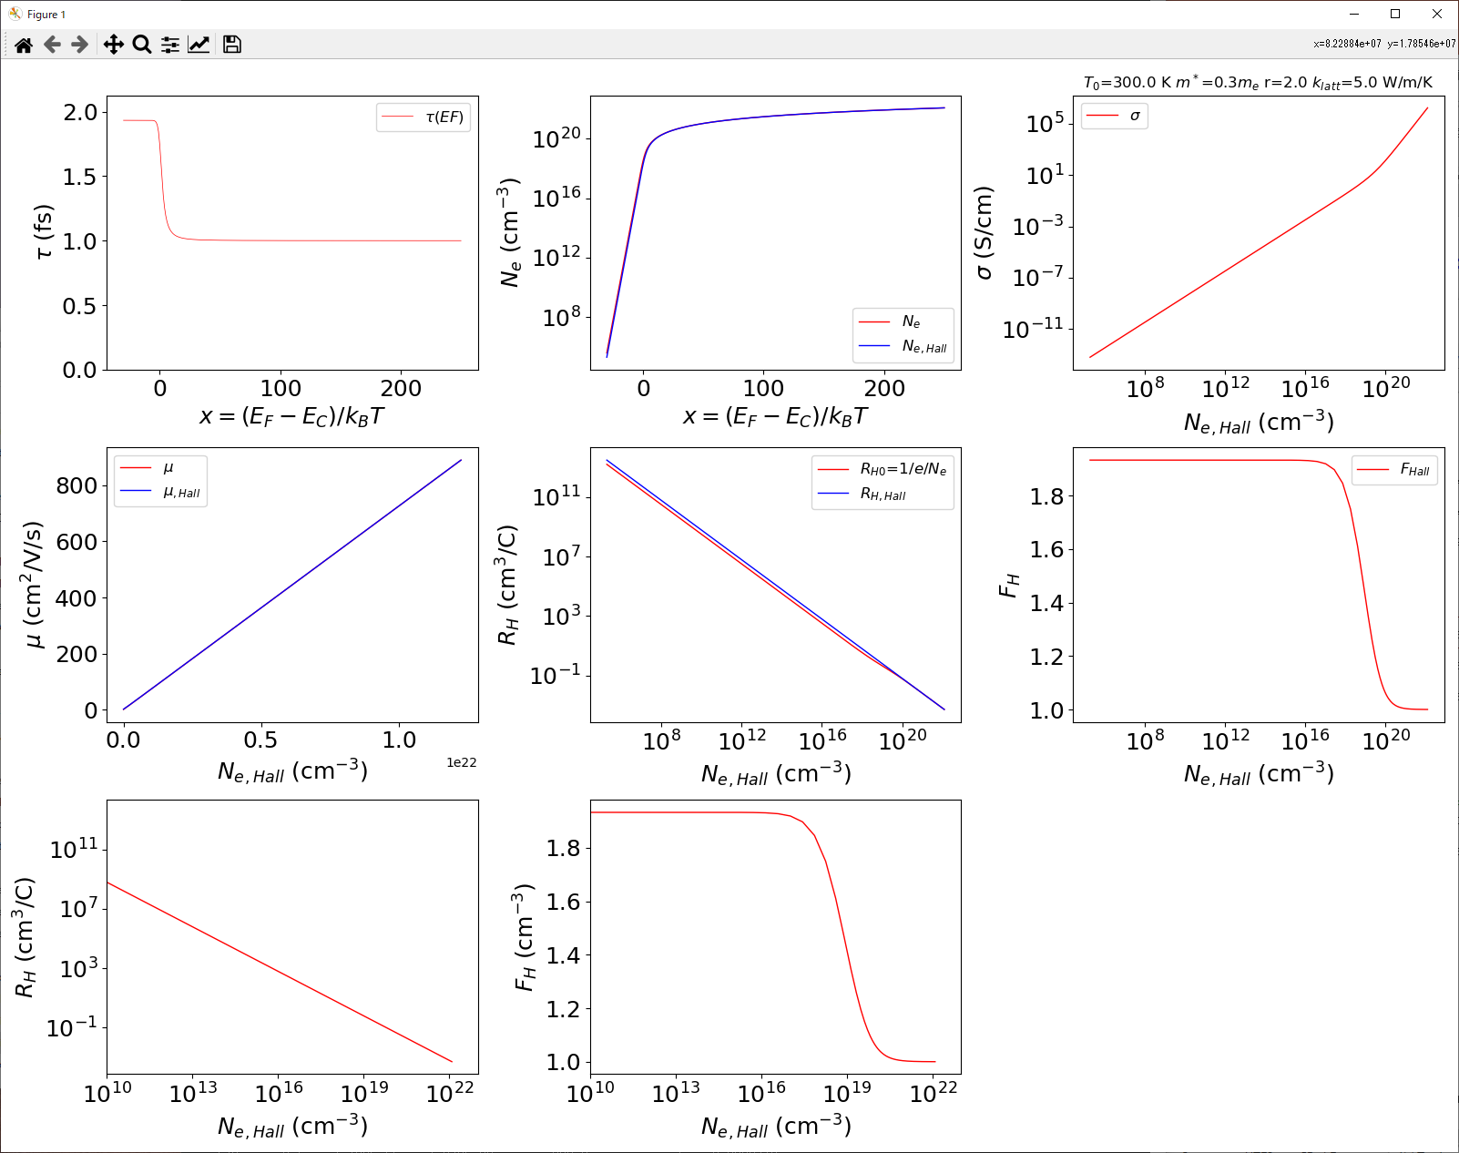
Plot Hall related properties: r = 2.0
python Seebeck.py Hall 300 0.3 2.0 1e-8
Output files: properties.csv

Slide 24
Analysis

Slide 25
Step 0’: Delete parameter file for reset
Seebeck.py reads parameters from
a parameter file (.in) if it exists.
If you restart from scratch, delete it.
C:> del Hall-SnSe.in (change the file name)

Slide 26
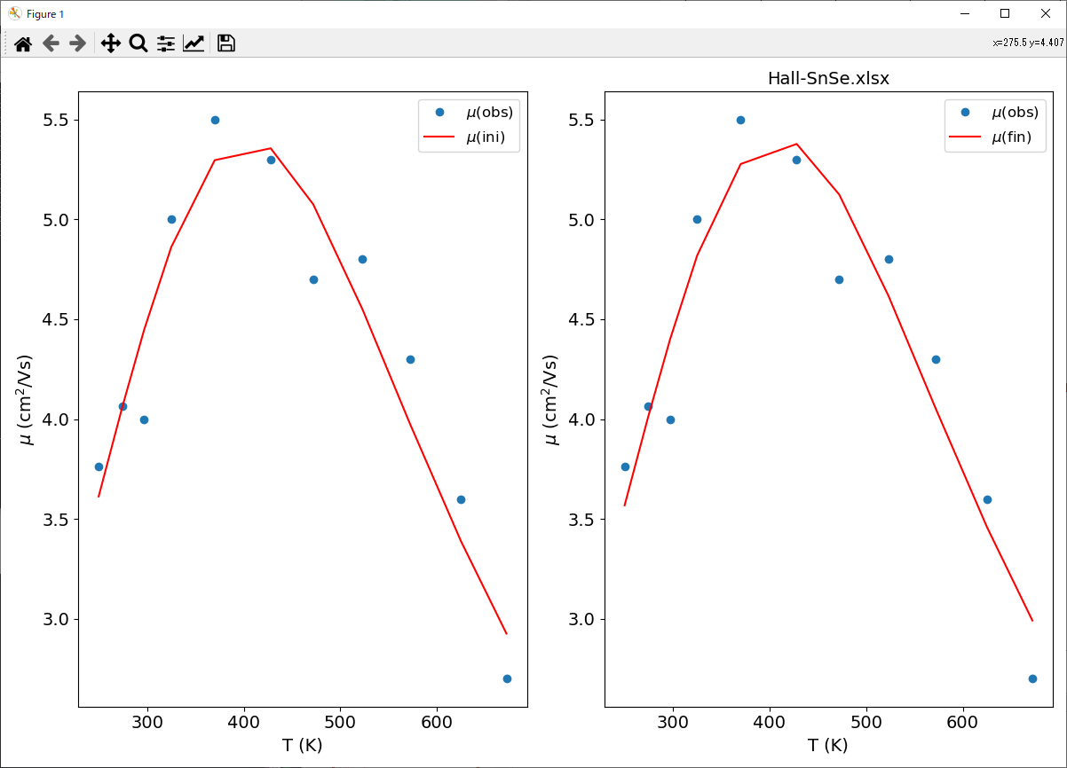
Step 0: Analyze scattering factor r if possible
See 50-02-mu-T-Fit.pptx
python ..\mu-T-Fit.py fit Hall-SnSe.xlsx
Console output:
Optimized at S2= 0.0669359:
Eb : -0.00019852912 optid=1
apolyi[0] : -0.012429574 optid=1
ppolyi[0] : 0 optid=0
apolyi[1] : 0.0058160275 optid=1
ppolyi[1] : -1.5 optid=0
apolyi[2] : 0.019690371 optid=1
ppolyi[2] : 1.5 optid=0
apolyi[3] : 0 optid=0
ppolyi[3] : -1 optid=0
apolyi[4] : 0 optid=0
ppolyi[4] : 1 optid=0
T(K) mu,obs(cm2/Vs) mu,ini(cm2/Vs) mu,fin(cm2/Vs)
249.9 3.76297 3.61235 3.5679
274.4 4.06679 4.0624 4.01455
297 4 4.44804 4.4005
325 5 4.86122 4.81963
370 5.5 5.29669 5.27746
428 5.3 5.35618 5.37808
472 4.7 5.0755 5.12468
523 4.8 4.54923 4.61726
572 4.3 3.9778 4.05157
625 3.6 3.38755 3.45877
672 2.7 2.9256 2.99088

Slide 27
File format
SnSeTe-S-Hall.xlsx

Slide 28
Step 0’: Create and edit .in file
python Seebeck.py init SnSeTe-S-Hall.xlsx
Input file: SnSeTe-S-Hall.xlsx / SnSeTe-S-Hall.csv
Output file: SnSeTe-S-Hall.in
SnSeTe-S-Hall.in:
[Preferences]
infile=SnSeTe-S-Hall.xlsx
charge=1.0 # Check polarity of S. -1.0 for electron
rfac=0.5 # Change according to the scattering mechanism
EC=0.0
NC=4.1233891183644324e+18
DC0=1.119355150572396e+21
S2=
[Parameters]
meff=0.3:1
l0=1e-08:1

Slide 29
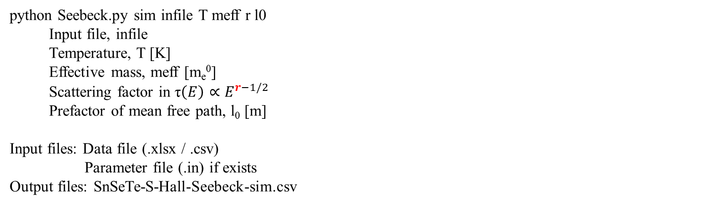
Simulate Jonker / Pisarenko plots
python Seebeck.py sim infile T meff r l0
Input file, infile
Temperature, T [K]
Effective mass, meff [m_{e}⁰]
Scattering factor in τ$\left(E\right)∝E^{r−1/2}$
Prefactor of mean free path, l₀ [m]
Input files: Data file (.xlsx / .csv)
Parameter file (.in) if exists
Output files: SnSeTe-S-Hall-Seebeck-sim.csv

Slide 30
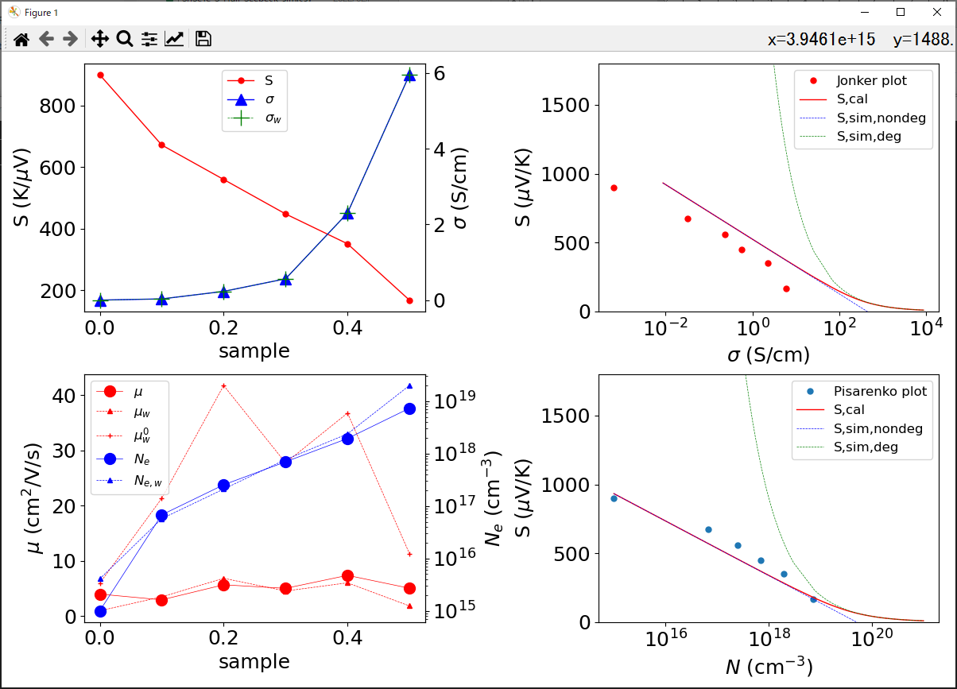
Step 1: Simulate Jonker / Pisarenko plots
python Seebeck.py sim SnSeTe-S-Hall.xlsx
Input files: SnSeTe-S-Hall.xlsx
Output files: SnSeTe-S-Hall-muT-sim.csv (including weighted mobility etc)

Slide 31
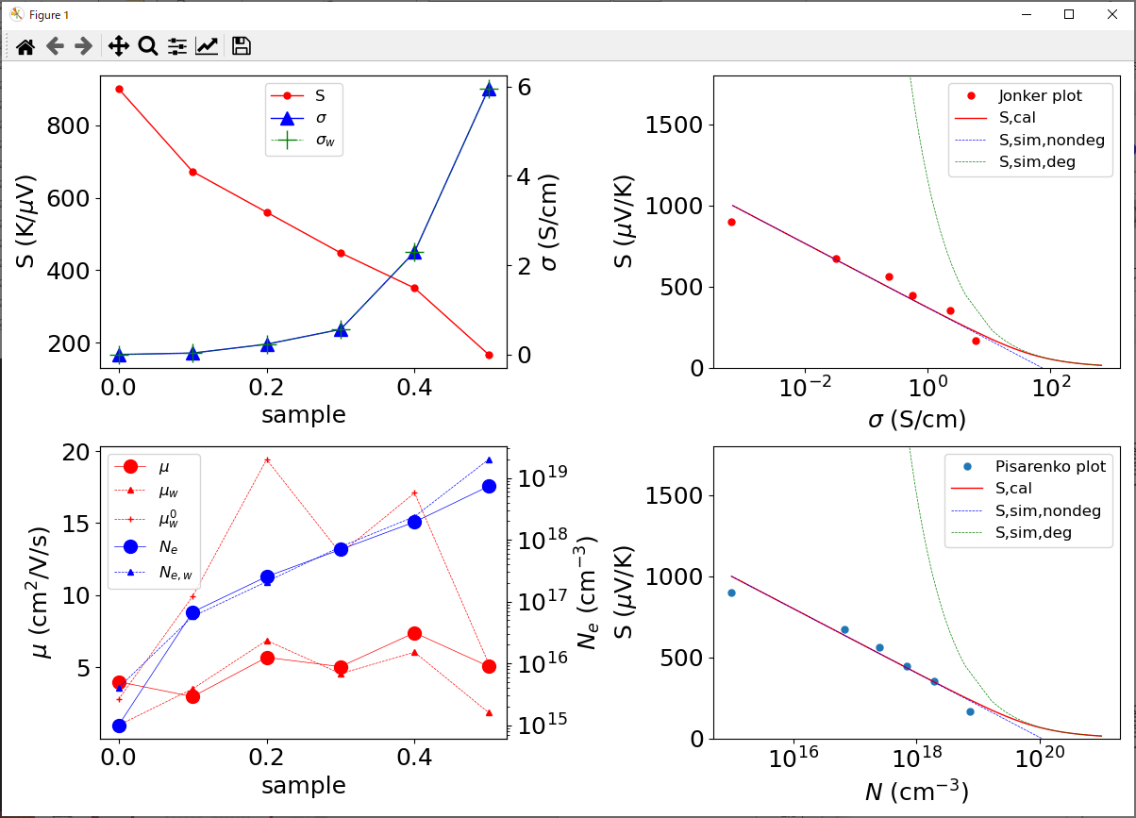
Step 2: Find better fit by changing meff and l0
python Seebeck.py sim SnSeTe-S-Hall.xlsx 300 0.5 0.5 1e-09
Input files: SnSeTe-S-Hall.xlsx
Output files: SnSeTe-S-Hall-muT-sim.csv (including weighted mobility etc)

Slide 32
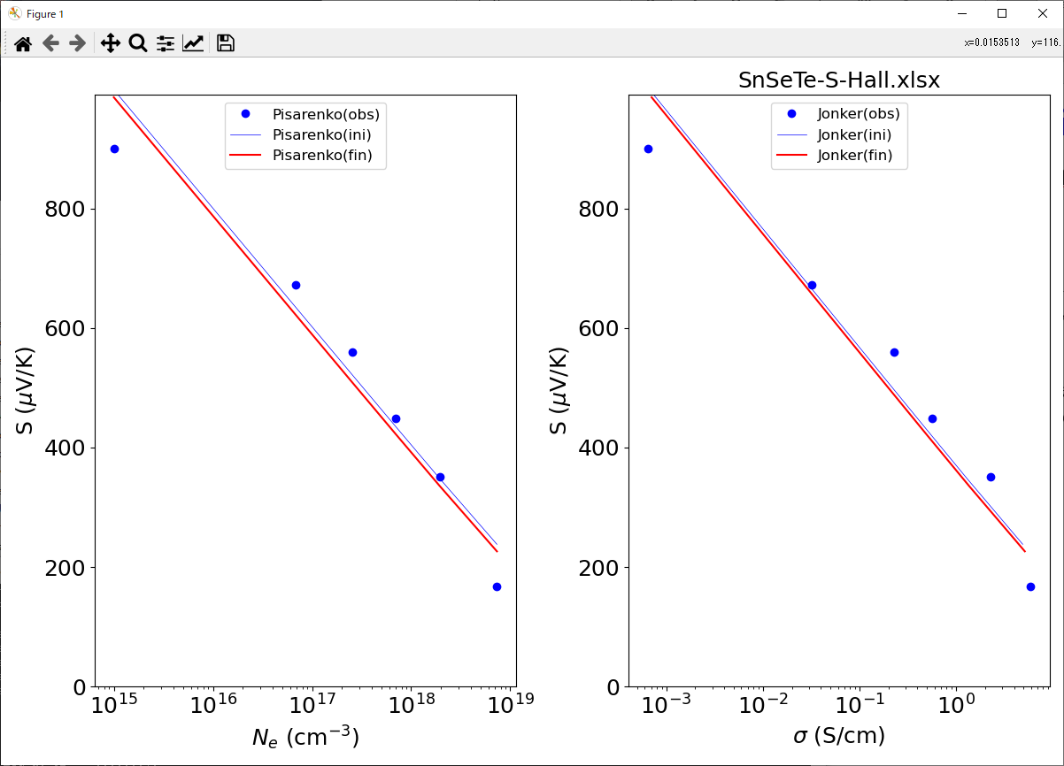

Step 3: Fit to Pisarenko plot to extract m*
Ex.: python Seebeck.py fit
Usage: python Seebeck.py fit infile T meff r l0
Input file, infile
Temperature, T [K]
Effective mass, meff [m_{e}⁰]
Scattering factor in τ$\left(E\right)∝E^{r−1/2}$
Prefactor of mean free path, l₀ [m]
Input files: Data file (.xlsx / .csv)
Parameter file (.in) if exists
Output files: SnSeTe-S-Hall-Seebeck-fit.csv
Parameter file (.in)
python Seebeck.py fit

Slide 33
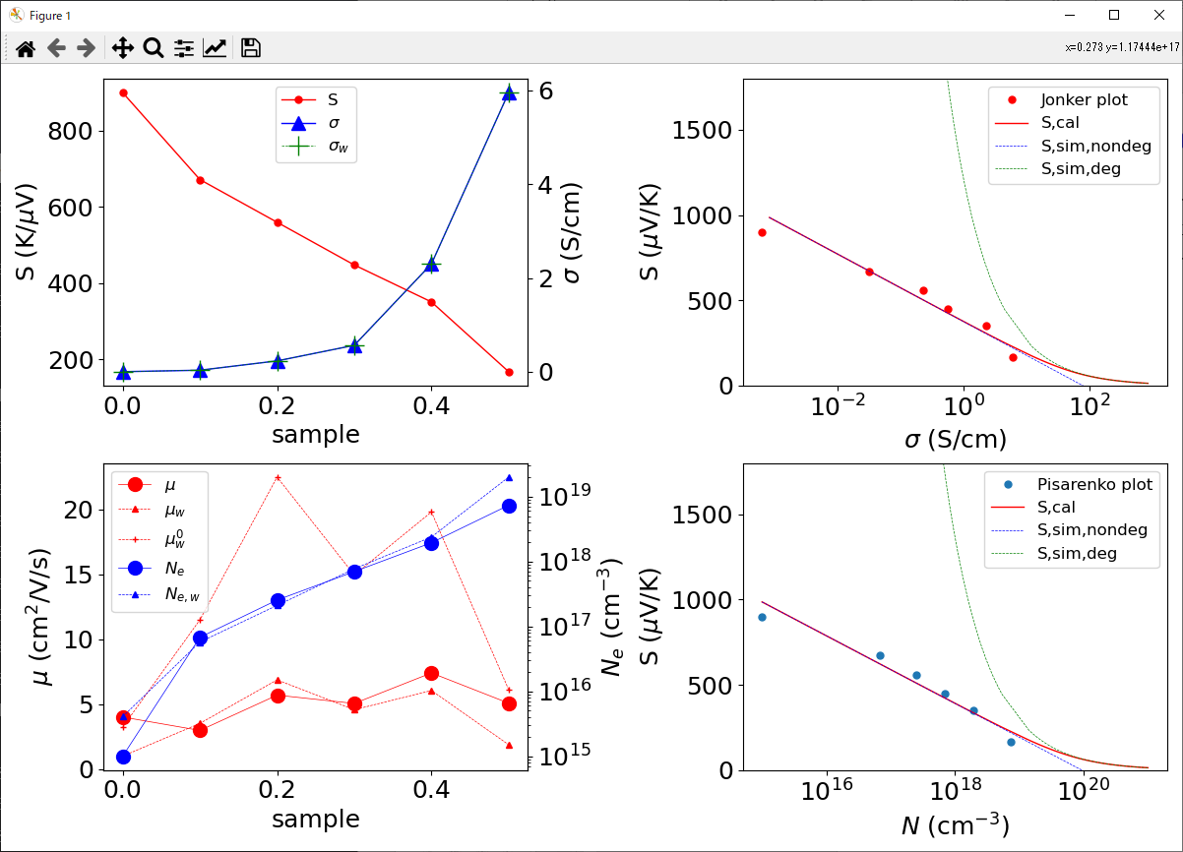
Step 4: Check mode=‘sim’ with the optimized parameters
The values of meff and l0 will be red from .in file so the are not necessary given by arguments.
python Seebeck.py sim SnSeTe-S-Hall.xlsx
Input files: SnSeTe-S-Hall.xlsx, SnSeTe-S-Hall.in
Output files: SnSeTe-S-Hall-muT-sim.csv (including weighted mobility etc)

Slide 34
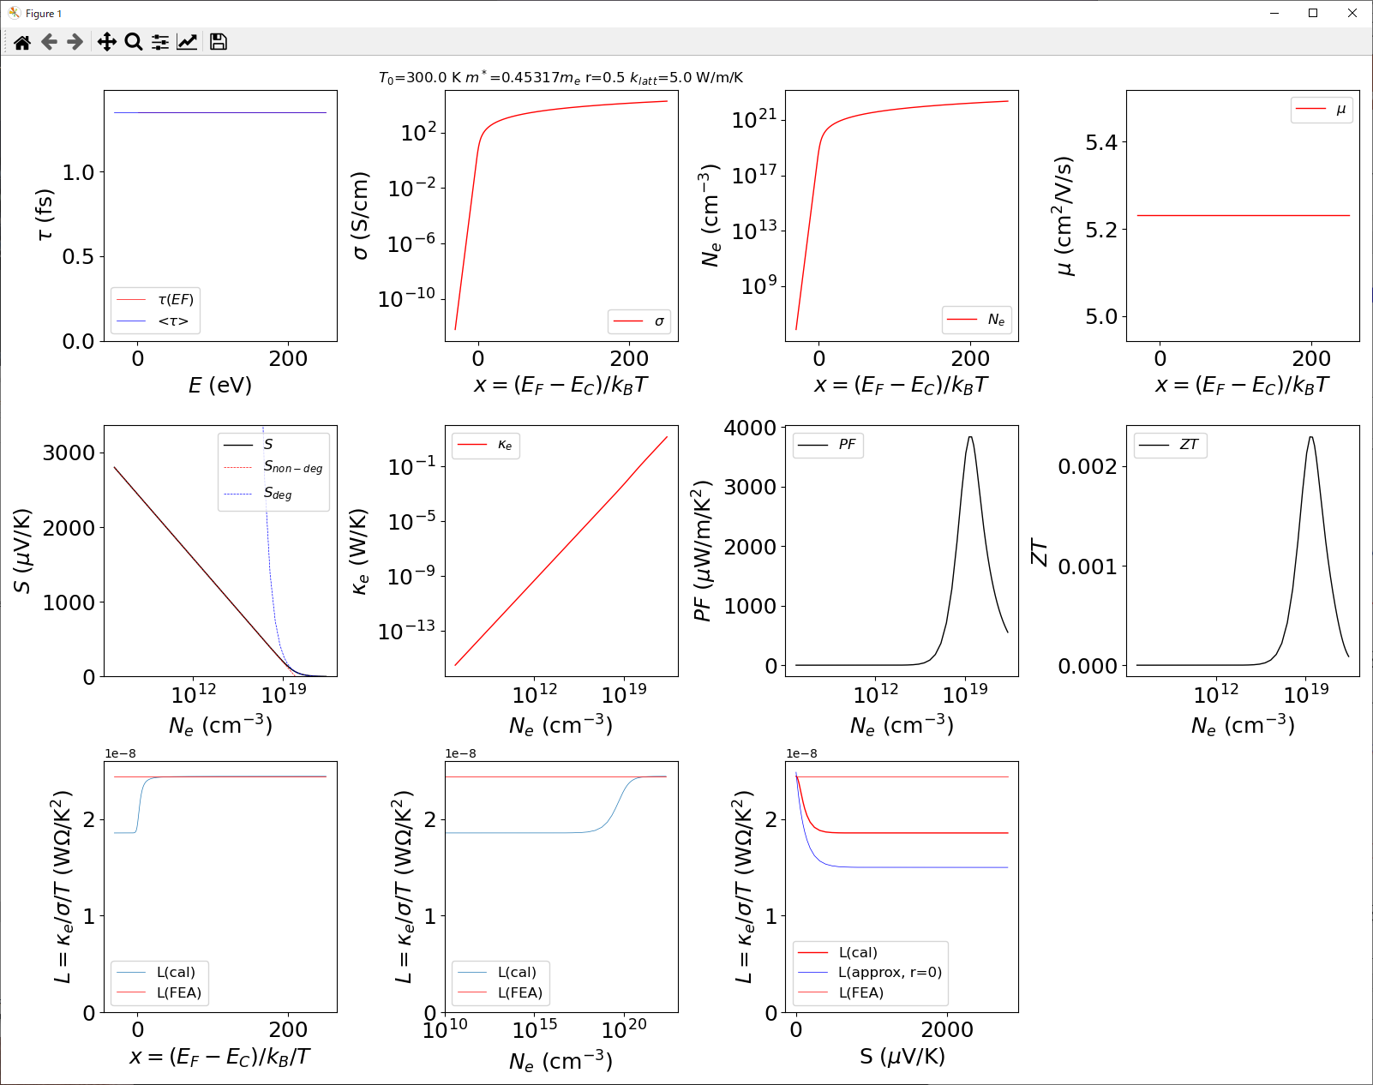
Step 5: Check properties
The values of meff and l0 will be red from .in file so the are not necessary given by arguments.
The input data file is not needed and must not be given by arguments
python Seebeck.py
Input files: SnSeTe-S-Hall.xlsx

Slide 35
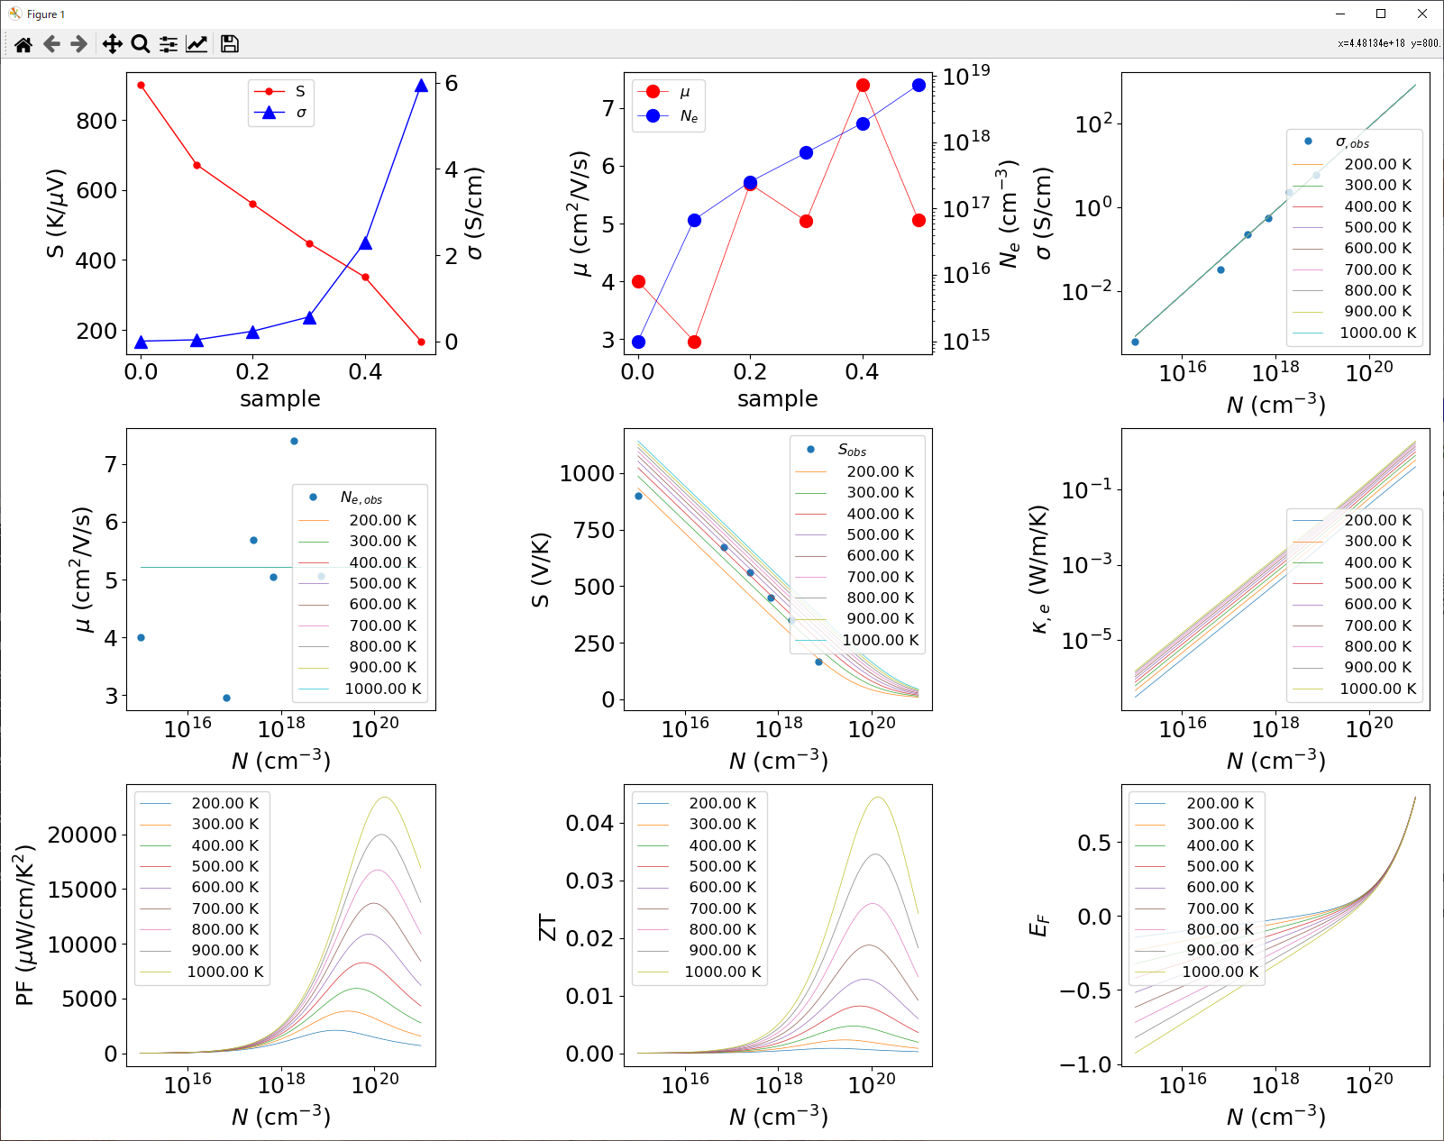
Step 6: Check properties at different T
python Seebeck.py T SnSeTe-S-Hall.xlsx 200 1000 9
Calculate properties at T from 200 to 1000 at 9 points
Input files: SnSeTe-S-Hall.xlsx
Output files: *.csv

Slide 36
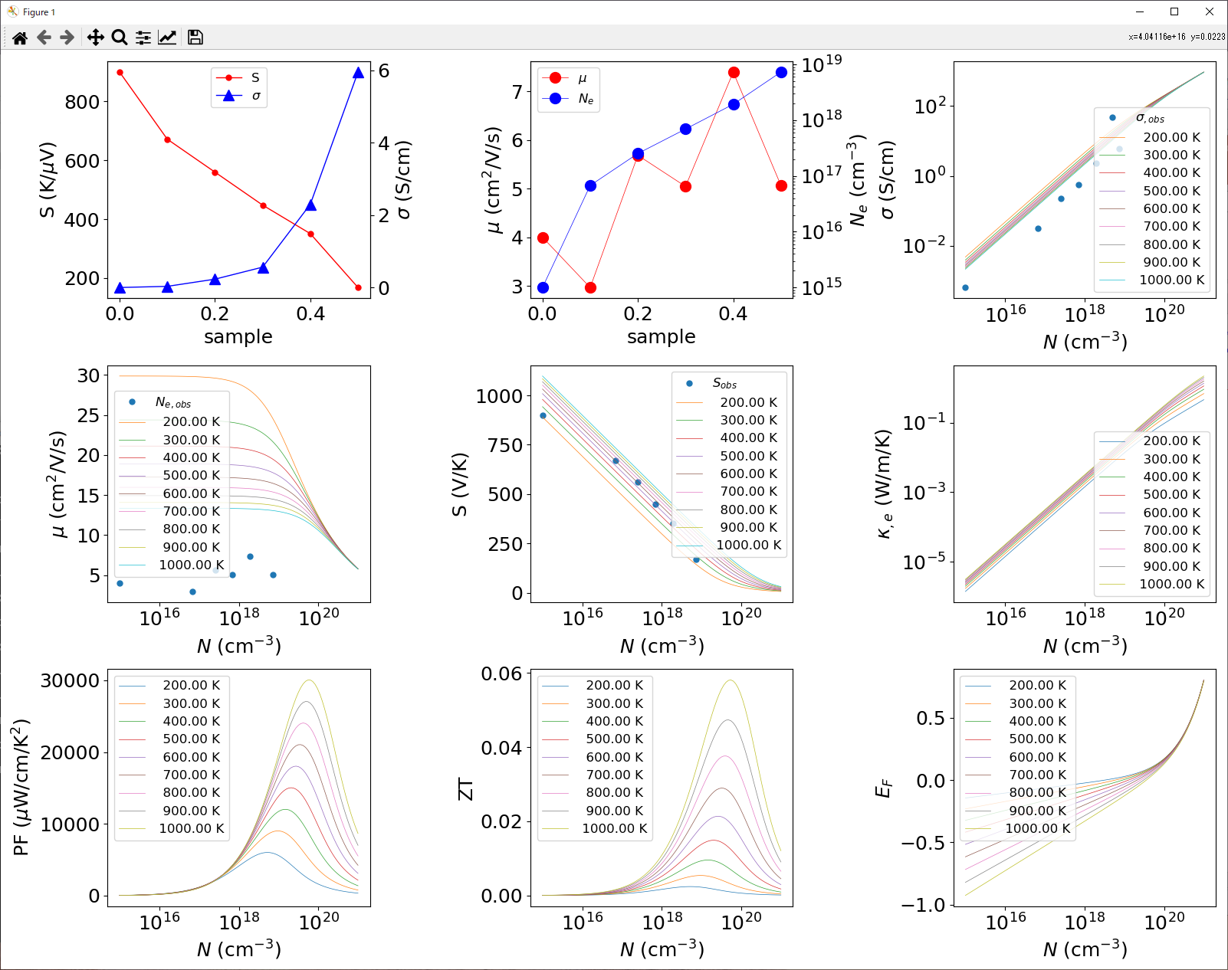
cf. Properties at different T (r = 0.0)
Note: Edit .in file to change r to 0.0 to show T dependences

Slide 37
Data file (.xlsx / .csv): Calculate L from T, Ne and σ data
[data-COE]\Seebeck\Pb05Sn05Se-T-Ne-sigma.xlsx
Require T, sigma, n data
The order of the data columns are arbitrary.
The data types are judged by the key words in the first line labels.
If more than two columns fit to the condition below, the left-most columns will be red.
Temperature in K : Label must start from T followed by [ |(|[].
Conductivity in S/cm : Label must start from ‘sigma’
Carrier density in cm⁻³ : Label must start from ‘n’
T(K) | sigma (S/cm) | T(K) | n (cm-3)
300 | 1.15075 | 299.698 | 3.69E+18
323.1785 | 2.1339 | 323.349 | 3.92E+18
347.6345 | 5.01065 | 347.8985 | 4.26E+18
373.159 | 9.87103 | 373.31999 | 5.57E+18
398.17 | 16.76255 | 398.31999 | 6.90E+18

Slide 38
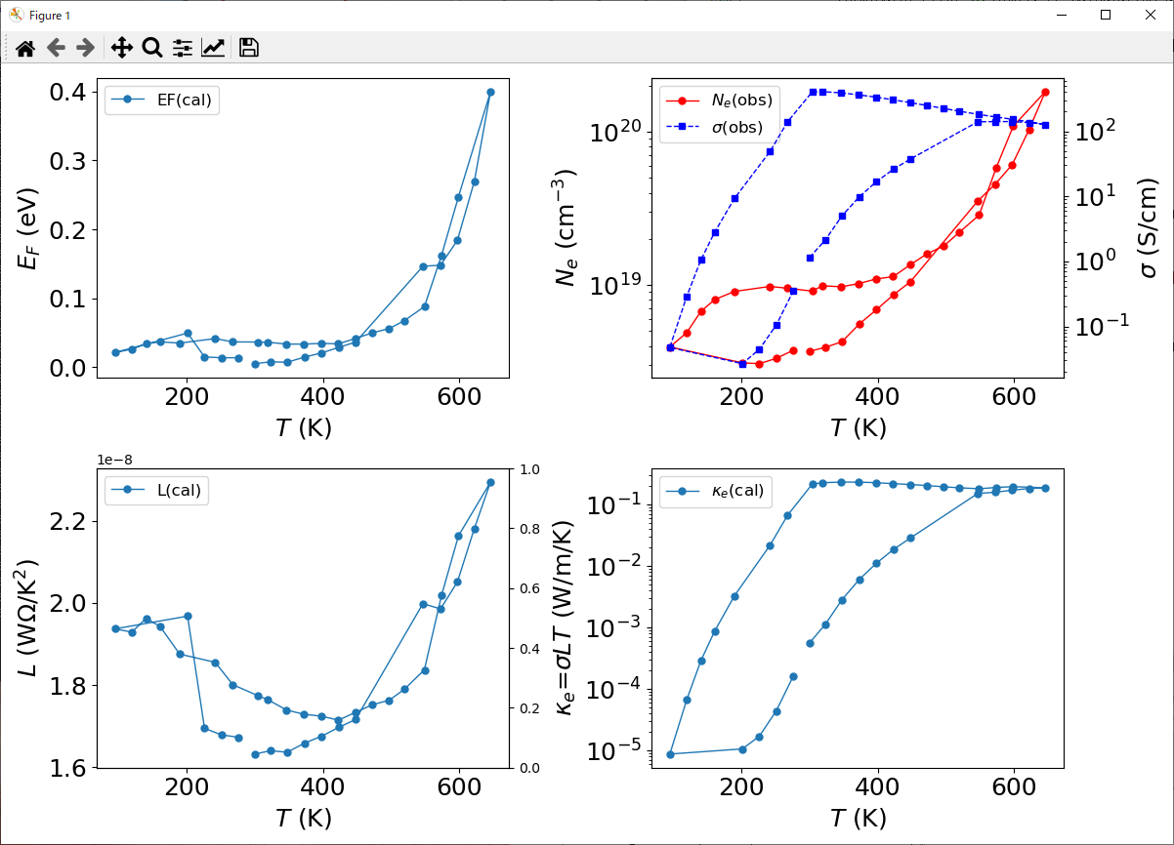
Calculate L from T, Ne and σ data
python Seebeck.py calL Pb05Sn05Se-T-Ne-sigma.xlsx 0.3 0.0 1.0e-8
Input files: Pb05Sn05Se-T-Ne-sigma.xlsx
Output files: *.csv

Slide 39
Data file (.xlsx / .csv): Calculate F_{Hall} from Hall data
[data-COE]\Seebeck\Hall-SnSe.xlsx
Require T, n, mu data
The order of the data columns are arbitrary.
The data types are judged by the key words in the first line labels.
If more than two columns fit to the condition below, the left-most columns will be red.
Temperature in K : Label must start from T followed by [ |(|[].
Conductivity in S/cm : Label must start from ‘sigma’
Carrier density in cm⁻³ : Label must start from ‘n’
Mobility in cm₂/Vs : Label must start from ‘mu’
T (K) | n (cm-3) | mu(cm2/Vs) | sigma(S/cm)
249.8715 | 1.02E+14 | 3.76297 | 1.44E+09
274.44749 | 3.66E+14 | 4.06679 | 2.26E+10
297 | 1.00E+15 | 4 | 1.89E+11
325 | 2.00E+15 | 5 | 1.76E+12
370 | 8.00E+15 | 5.5 | 3.12596E+13
428 | 3.00E+16 | 5.3 | 5.21E+14

Slide 40
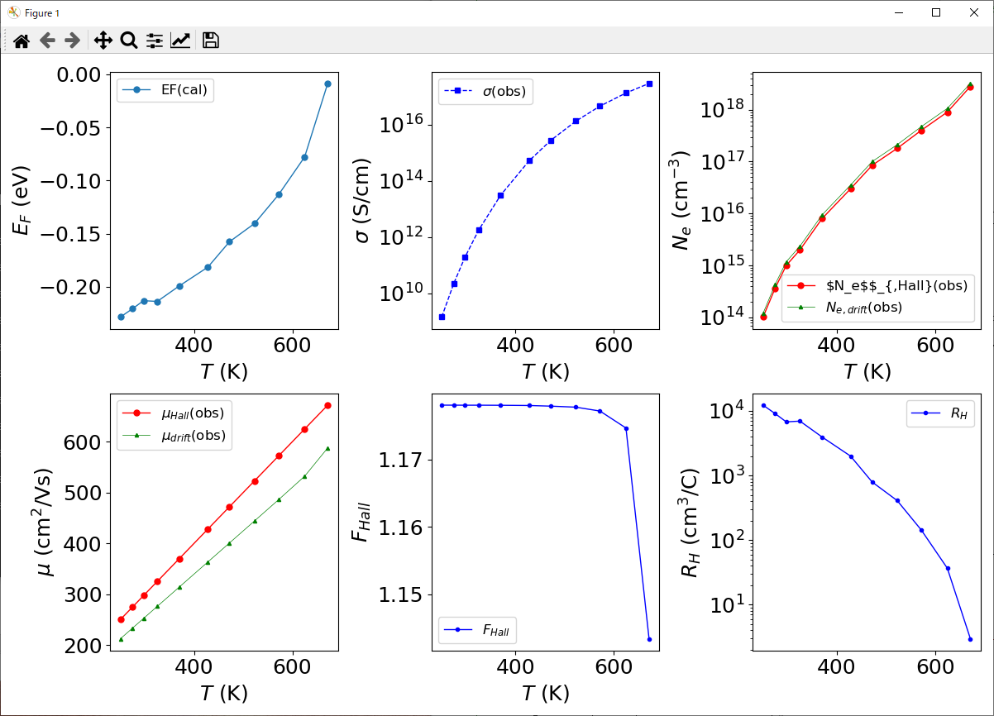
Calculate F_{Hall} from Hall data
python Seebeck.py calF Hall-SnSe.xlsx 0.3 0.0 1.0e-8
Input files: Hall-SnSe.xlsx
Output files: *.csv

Slide 41
Theory

Slide 42
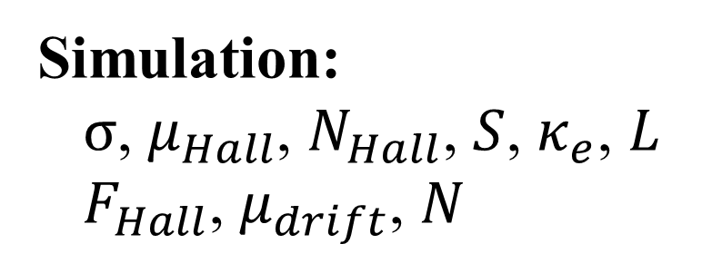
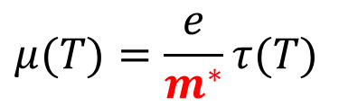
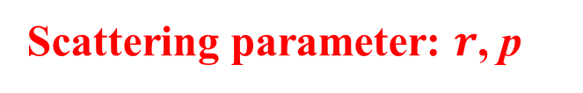
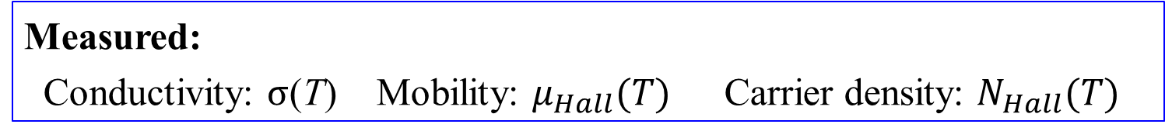


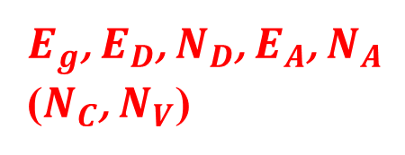
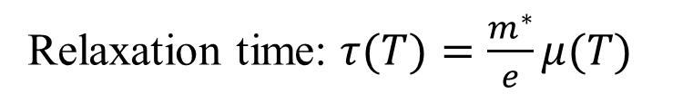
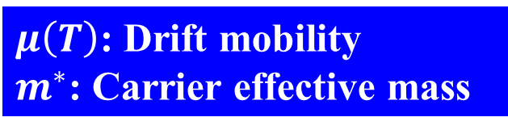
What we can know from Hall measurement?
Measured:
Conductivity: $σ$(T) Mobility: $μ_{Hall}(T)$ Carrier density: $N_{Hall}(T)$
$$μ(T)=\frac{e}{m^{∗}}τ(T)$$
Band structure
Density of states
Free carrier absorption
Relaxation time: $τ(T)=\frac{m^{∗}}{e}μ(T)$
$μ\left(T\right)$: Drift mobility
$m^{∗}$: Carrier effective mass
$$m^{∗}$$
$τ\left(E,T\right)=τ_{0}T^{p}E^{r−1/2}$
$E_{g}$, $E_{D}$, $N_{D}$, $E_{A}$, $N_{A}$
($N_{C}$, $N_{V}$)
Scattering parameter: $r$, p
$${m_{de}}^{∗}$$
Simulation:
$σ$, $μ_{Hall}$, $N_{Hall}$, $S$, $κ_{e}$, $L$
$F_{Hall}$, $μ_{drift}$, $N$

Slide 43
What we can know from Seebeck measurement?
Known: $σ$, $r$, $N_{e}$, S
  Non-degenerated semi.
  $S=\frac{k}{q}\left[\frac{3}{2}\ln{{m_{de}}^{∗}}+ln{2{\left(\frac{2πk_{B}T}{h^{2}}\right)}^{3/2}}+r+2−\ln{N_{e}}\right]$
  Metal
  $S\sim \frac{8π^{2}{k_{B}}^{2}}{3qh^{2}}{m_{de}}^{∗}T\left(1+r\right){\left(\frac{π}{3N_{e}}\right)}^{2/3}$
  ${m_{de}}^{∗}$: Density-of-states effective mass
  (Different from carrier effective mass except for
  single parabolic band case (free electron model))
General case: Need simulation and fitting

Slide 44
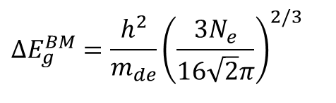
有効質量からわかる量
移動度、伝導度
状態密度 M_{C}は等価なLUMOのk点の数。
バースタイン・モスシフト
(縮退半導体のE_{F})
$$ΔE_{g}^{BM}=\frac{h^{2}}{m_{de}}{\left(\frac{3N_{e}}{16\sqrt{2}π}\right)}^{2/3}$$
有効状態密度 スピン以外の縮退のない等方的なsバンドでは、
状態密度有効質量m_{de}はキャリア有効質量m_{e}*に等しい
熱速度
フェルミ速度
Notes:
44

Slide 45
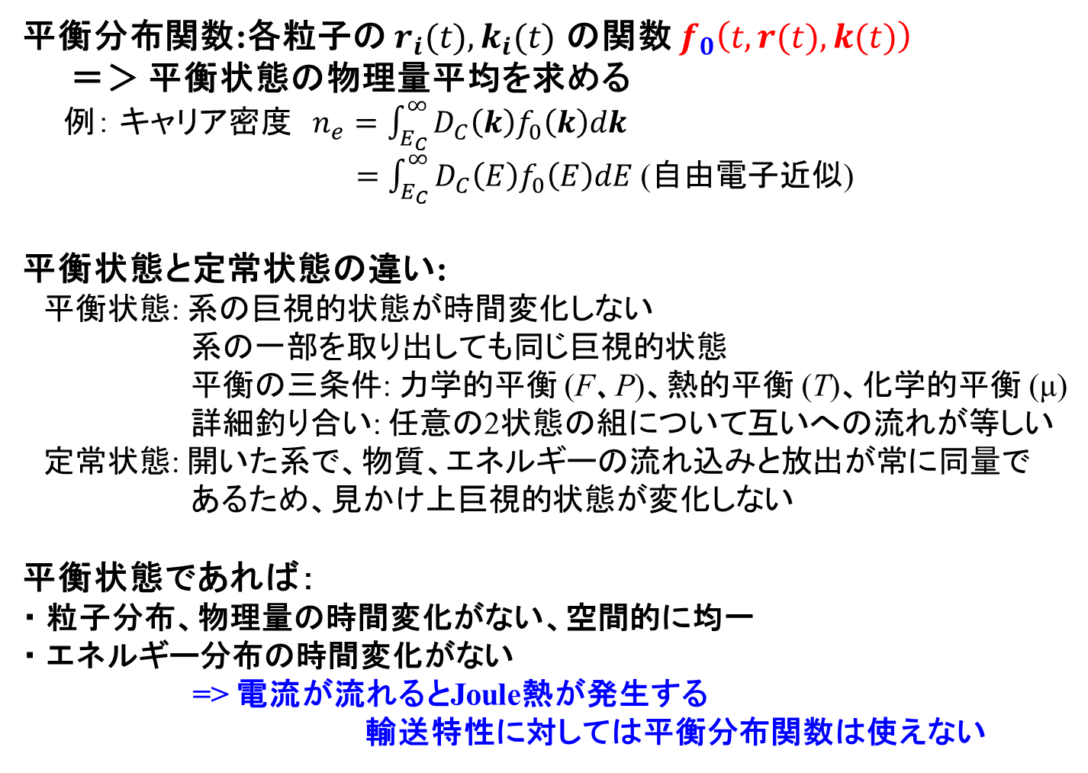
平衡統計力学
平衡分布関数:各粒子の $r_{i}(t),k_{i}(t)$ の関数 $f_{0}\left(t,r(t),k(t)\right)$
＝＞ 平衡状態の物理量平均を求める
例： キャリア密度 $n_{e}=\int_{E_{C}}^{∞}{D_{C}\left(k\right)f_{0}\left(k\right)dk}$
$=\int_{E_{C}}^{∞}{D_{C}\left(E\right)f_{0}\left(E\right)dE}$ (自由電子近似)
平衡状態と定常状態の違い:
平衡状態: 系の巨視的状態が時間変化しない
系の一部を取り出しても同じ巨視的状態
平衡の三条件: 力学的平衡 (F、P)、熱的平衡 (T)、化学的平衡 (μ)
詳細釣り合い: 任意の2状態の組について互いへの流れが等しい
定常状態: 開いた系で、物質、エネルギーの流れ込みと放出が常に同量で
あるため、見かけ上巨視的状態が変化しない
平衡状態であれば：
・ 粒子分布、物理量の時間変化がない、空間的に均一
・ エネルギー分布の時間変化がない
=> 電流が流れるとJoule熱が発生する
輸送特性に対しては平衡分布関数は使えない

Slide 46
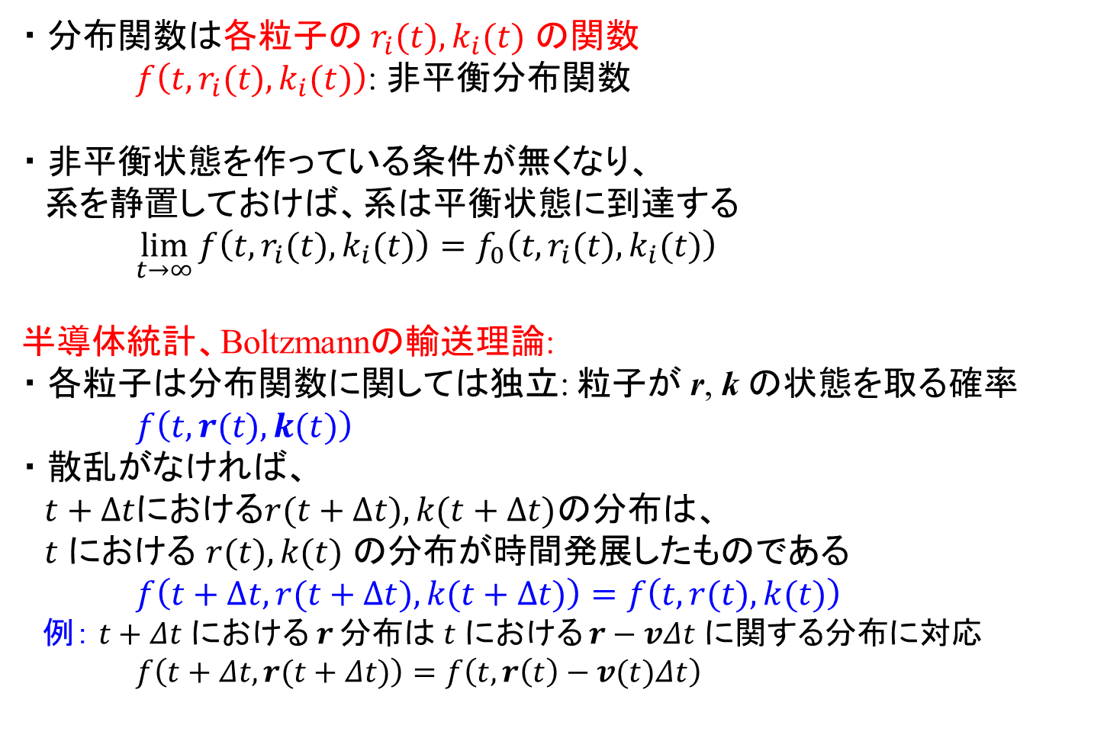
非平衡統計力学
・ 分布関数は各粒子の $r_{i}(t),k_{i}(t)$ の関数
$f\left(t,r_{i}(t),k_{i}(t)\right)$: 非平衡分布関数
・ 非平衡状態を作っている条件が無くなり、
系を静置しておけば、系は平衡状態に到達する
$\lim_{t→∞}{f\left(t,r_{i}(t),k_{i}(t)\right)}=f_{0}\left(t,r_{i}(t),k_{i}(t)\right)$
半導体統計、Boltzmannの輸送理論:
・ 各粒子は分布関数に関しては独立: 粒子が r, k の状態を取る確率
$f\left(t,r(t),k(t)\right)$
・ 散乱がなければ、
$t+∆t$における$r(t+∆t),k(t+∆t)$の分布は、
$t$ における $r(t),k(t)$ の分布が時間発展したものである
$f\left(t+∆t,r(t+∆t),k(t+∆t)\right)=f\left(t,r(t),k(t)\right)$
例： $t+Δt$ における$r$ 分布は $t$ における $r−vΔt$ に関する分布に対応 $f\left(t+Δt,r(t+Δt)\right)=f\left(t,r\left(t\right)−v(t)Δt\right)$

Slide 47
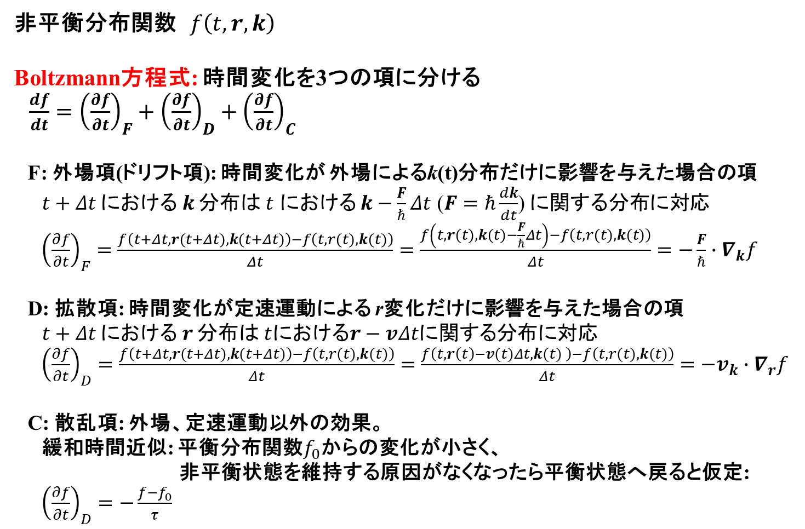
Boltzmann方程式
太田英二、坂田亮著、半導体の電子物性光学、培風館 (2005)
http://kenzou.michikusa.jp/StaDyn/kinetic_5.pdf
非平衡分布関数 $f\left(t,r,k\right)$
Boltzmann方程式: 時間変化を3つの項に分ける
$\frac{df}{dt}={\left(\frac{∂f}{∂t}\right)}_{F}+{\left(\frac{∂f}{∂t}\right)}_{D}+{\left(\frac{∂f}{∂t}\right)}_{C}$
F: 外場項(ドリフト項): 時間変化が 外場によるk(t)分布だけに影響を与えた場合の項
$t+Δt$ における$k$ 分布は $t$ における $k−\frac{F}{ℏ}Δt$ ($F=ℏ\frac{dk}{dt}$) に関する分布に対応
${\left(\frac{∂f}{∂t}\right)}_{F}=\frac{f\left(t+Δt,r(t+Δt),k(t+Δt)\right)−f\left(t,r(t),k(t)\right)}{Δt}=\frac{f\left(t,r(t),k(t)−\frac{F}{ℏ}Δt\right)−f\left(t,r(t),k(t)\right)}{Δt}=−\frac{F}{ℏ}∙∇_{k}f$
D: 拡散項: 時間変化が定速運動による r変化だけに影響を与えた場合の項
$t+Δt$ における$r$ 分布は $t$における$r−vΔt$に関する分布に対応
${\left(\frac{∂f}{∂t}\right)}_{D}=\frac{f\left(t+Δt,r(t+Δt),k(t+Δt)\right)−f\left(t,r(t),k(t)\right)}{Δt}=\frac{f\left(t,r\left(t\right)−v(t)Δt,k(t) \right)−f\left(t,r(t),k(t)\right)}{Δt}=−v_{k}∙∇_{r}f$
C: 散乱項: 外場、定速運動以外の効果。
緩和時間近似: 平衡分布関数$f_{0}$からの変化が小さく、
非平衡状態を維持する原因がなくなったら平衡状態へ戻ると仮定:
${\left(\frac{∂f}{∂t}\right)}_{D}=−\frac{f−f_{0}}{τ}$

Slide 48
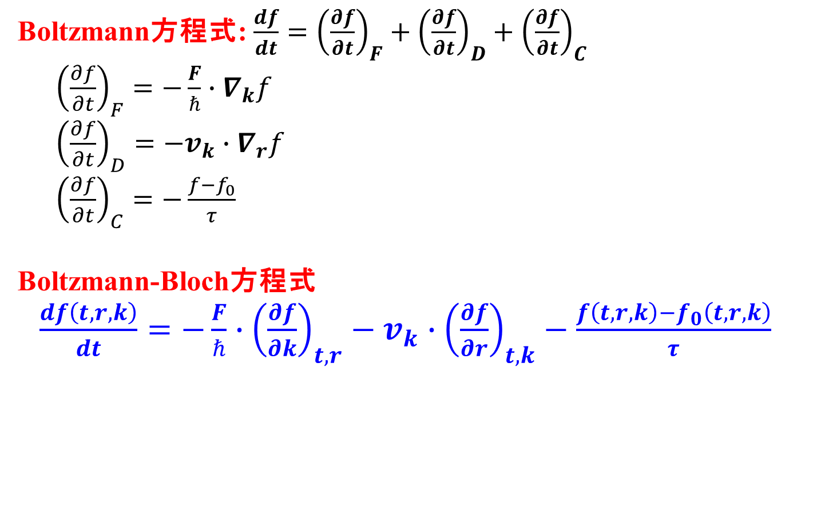
Boltzmann方程式
太田英二、坂田亮著、半導体の電子物性光学、培風館 (2005)
Boltzmann方程式: $\frac{df}{dt}={\left(\frac{∂f}{∂t}\right)}_{F}+{\left(\frac{∂f}{∂t}\right)}_{D}+{\left(\frac{∂f}{∂t}\right)}_{C}$
${\left(\frac{∂f}{∂t}\right)}_{F}=−\frac{F}{ℏ}∙∇_{k}f$
${\left(\frac{∂f}{∂t}\right)}_{D}=−v_{k}∙∇_{r}f$
${\left(\frac{∂f}{∂t}\right)}_{C}=−\frac{f−f_{0}}{τ}$
Boltzmann-Bloch方程式
$\frac{df\left(t,r,k\right)}{dt}=−\frac{F}{ℏ}∙{\left(\frac{∂f}{∂k}\right)}_{t,r}−v_{k}∙{\left(\frac{∂f}{∂r}\right)}_{t,k}−\frac{f\left(t,r,k\right)−f_{0}\left(t,r,k\right)}{τ}$

Slide 49
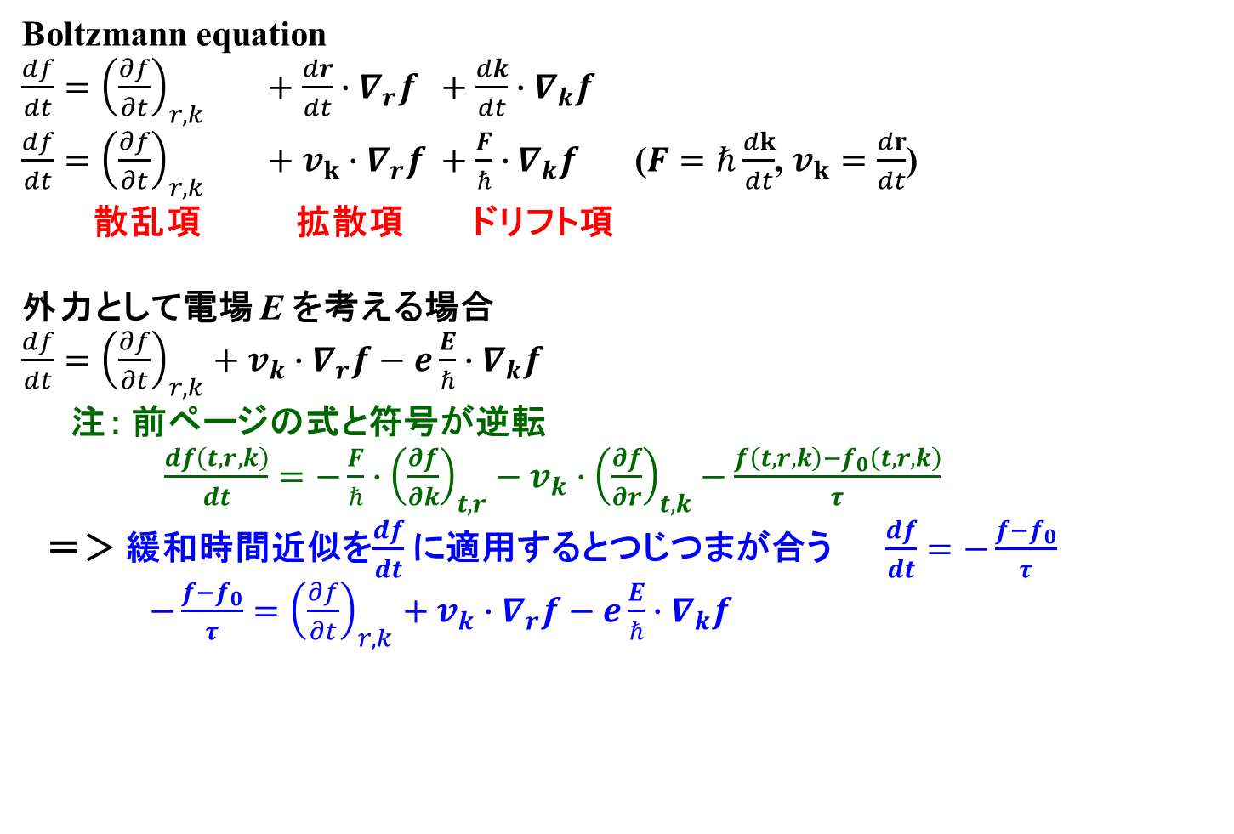
注：ボルツマンの輸送方程式: 全微分を取ると符号が逆転
Boltzmann equation
$\frac{df}{dt}={\left(\frac{∂f}{∂t}\right)}_{r,k} +\frac{dr}{dt}∙∇_{r}f +\frac{dk}{dt}∙∇_{k}f$
$\frac{df}{dt}={\left(\frac{∂f}{∂t}\right)}_{r,k} +v_{k}∙∇_{r}f +\frac{F}{ℏ}∙∇_{k}f$ ($F=ℏ\frac{dk}{dt}$, $v_{k}=\frac{dr}{dt}$)
散乱項 拡散項 ドリフト項
外力として電場 E を考える場合
$\frac{df}{dt}={\left(\frac{∂f}{∂t}\right)}_{r,k}+v_{k}∙∇_{r}f−e\frac{E}{ℏ}∙∇_{k}f$
注： 前ページの式と符号が逆転
$\frac{df\left(t,r,k\right)}{dt}=−\frac{F}{ℏ}∙{\left(\frac{∂f}{∂k}\right)}_{t,r}−v_{k}∙{\left(\frac{∂f}{∂r}\right)}_{t,k}−\frac{f\left(t,r,k\right)−f_{0}\left(t,r,k\right)}{τ}$
＝＞ 緩和時間近似を$\frac{df}{dt}$に適用するとつじつまが合う $\frac{df}{dt}=−\frac{f−f_{0}}{τ}$
$−\frac{f−f_{0}}{τ}={\left(\frac{∂f}{∂t}\right)}_{r,k}+v_{k}∙∇_{r}f−e\frac{E}{ℏ}∙∇_{k}f$

Slide 50
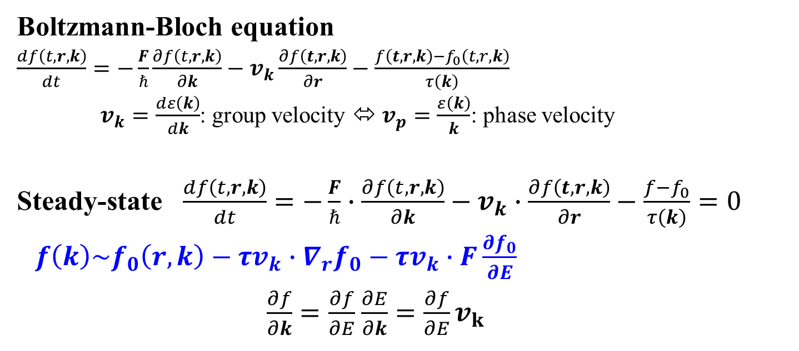
Boltzmann equation: Stead-state
太田英二、坂田亮著、半導体の電子物性光学、培風館 (2005)
Boltzmann-Bloch equation
$\frac{df\left(t,r,k\right)}{dt}=−\frac{F}{ℏ}\frac{∂f\left(t,r,k\right)}{∂k}−v_{k}\frac{∂f\left(t,r,k\right)}{∂r}−\frac{f\left(t,r,k\right)−f_{0}\left(t,r,k\right)}{τ\left(k\right)}$
$v_{k}=\frac{dε\left(k\right)}{dk}$: group velocity ⬄ $v_{p}=\frac{ε\left(k\right)}{k}$: phase velocity
Steady-state $\frac{df\left(t,r,k\right)}{dt}=−\frac{F}{ℏ}∙\frac{∂f\left(t,r,k\right)}{∂k}−v_{k}∙\frac{∂f\left(t,r,k\right)}{∂r}−\frac{f−f_{0}}{τ\left(k\right)}=0$
$f\left(k\right)\sim f_{0}\left(r,k\right)−τv_{k}∙∇_{r}f_{0}−τv_{k}∙F\frac{∂f_{0}}{∂E}$
$\frac{∂f}{∂k}=\frac{∂f}{∂E}$ $\frac{∂E}{∂k}=\frac{∂f}{∂E}v_{k}$

Slide 51
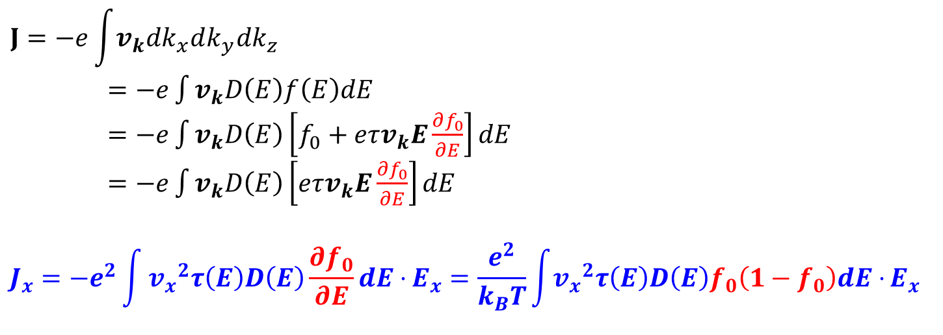
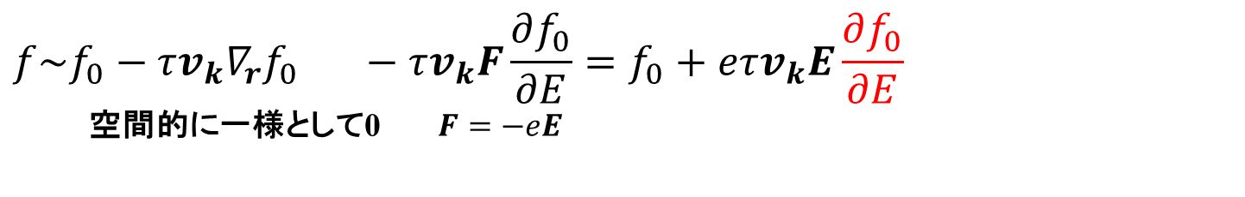
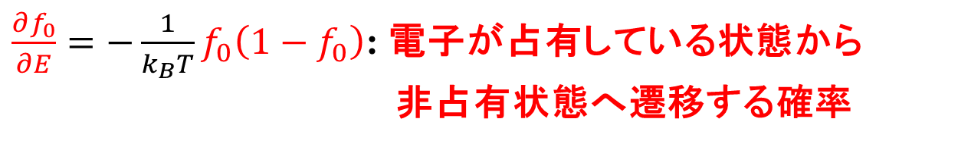
電流－電圧特性
$$f\sim f_{0}−τv_{k}∇_{r}f_{0} −τv_{k}F\frac{∂f_{0}}{∂E}=f_{0}+eτv_{k}E\frac{∂f_{0}}{∂E}$$
空間的に一様として0 $F=−eE$
$$J=−e\int{v_{k}dk_{x}dk_{y}dk_{z}}$$
$=−e\int{v_{k}D\left(E\right)f\left(E\right)dE}$
$=−e\int{v_{k}D\left(E\right)\left[f_{0}+eτv_{k}E\frac{∂f_{0}}{∂E}\right]dE}$
$=−e\int{v_{k}D\left(E\right)\left[eτv_{k}E\frac{∂f_{0}}{∂E}\right]dE}$
$$J_{x}=−e^{2}\int{{v_{x}}^{2}τ\left(E\right)D\left(E\right)\frac{∂f_{0}}{∂E}dE⋅}E_{x}=\frac{e^{2}}{k_{B}T}\int{{v_{x}}^{2}τ\left(E\right)D\left(E\right)f_{0}\left(1−f_{0}\right)dE⋅}E_{x}$$
$\frac{∂f_{0}}{∂E}=−\frac{1}{k_{B}T}f_{0}\left(1−f_{0}\right)$: 電子が占有している状態から
非占有状態へ遷移する確率

Slide 52
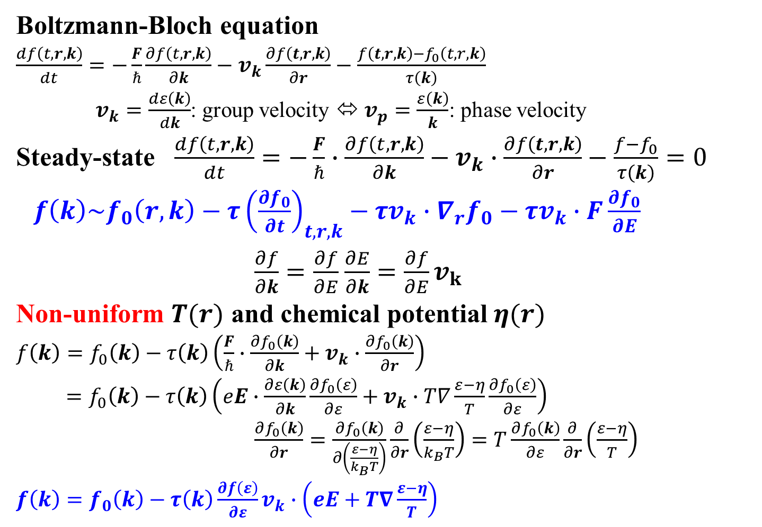
Thermoelectric properties
太田英二、坂田亮著、半導体の電子物性光学、培風館 (2005)
Boltzmann-Bloch equation
$\frac{df\left(t,r,k\right)}{dt}=−\frac{F}{ℏ}\frac{∂f\left(t,r,k\right)}{∂k}−v_{k}\frac{∂f\left(t,r,k\right)}{∂r}−\frac{f\left(t,r,k\right)−f_{0}\left(t,r,k\right)}{τ\left(k\right)}$
$v_{k}=\frac{dε\left(k\right)}{dk}$: group velocity ⬄ $v_{p}=\frac{ε\left(k\right)}{k}$: phase velocity
Steady-state $\frac{df\left(t,r,k\right)}{dt}=−\frac{F}{ℏ}∙\frac{∂f\left(t,r,k\right)}{∂k}−v_{k}∙\frac{∂f\left(t,r,k\right)}{∂r}−\frac{f−f_{0}}{τ\left(k\right)}=0$
$f\left(k\right)\sim f_{0}\left(r,k\right)−τ{\left(\frac{∂f_{0}}{∂t}\right)}_{t,r,k}−τv_{k}∙∇_{r}f_{0}−τv_{k}∙F\frac{∂f_{0}}{∂E}$
$\frac{∂f}{∂k}=\frac{∂f}{∂E}$ $\frac{∂E}{∂k}=\frac{∂f}{∂E}v_{k}$
Non-uniform $T(r)$ and chemical potential $η(r)$
$f\left(k\right)=f_{0}\left(k\right)−τ\left(k\right)\left(\frac{F}{ℏ}∙\frac{∂f_{0}\left(k\right)}{∂k}+v_{k}∙\frac{∂f_{0}\left(k\right)}{∂r}\right)$
$=f_{0}\left(k\right)−τ\left(k\right)\left(eE∙\frac{∂ε\left(k\right)}{∂k}\frac{∂f_{0}\left(ε\right)}{∂ε}+v_{k}∙T∇\frac{ε−η}{T}\frac{∂f_{0}\left(ε\right)}{∂ε}\right)$
$\frac{∂f_{0}\left(k\right)}{∂r}=\frac{∂f_{0}\left(k\right)}{∂\left(\frac{ε−η}{k_{B}T}\right)}\frac{∂}{∂r}\left(\frac{ε−η}{k_{B}T}\right)=T\frac{∂f_{0}\left(k\right)}{∂ε}\frac{∂}{∂r}\left(\frac{ε−η}{T}\right)$
$f\left(k\right)=f_{0}\left(k\right)−τ\left(k\right)\frac{∂f\left(ε\right)}{∂ε}v_{k}∙\left(eE+T∇\frac{ε−η}{T}\right)$

Slide 53
Calculation

Slide 54
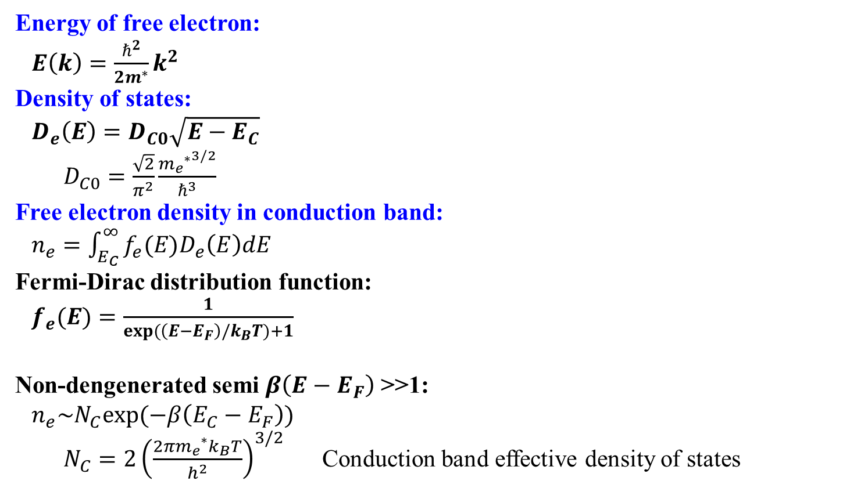
Electron-only Free electron model
E_{F}
  Energy of free electron:
  $E\left(k\right)=\frac{ℏ^{2}}{2m^{∗}}k^{2}$
  Density of states:
  $D_{e}\left(E\right)=D_{C0}\sqrt{E−E_{C}}$
  $D_{C0}=\frac{\sqrt{2}}{π^{2}}\frac{{{m_{e}}^{∗}}^{3/2}}{ℏ^{3}}$
  Free electron density in conduction band:
  $n_{e}=\int_{E_{C}}^{∞}{f_{e}(E)D_{e}\left(E\right)dE}$
  Fermi-Dirac distribution function:
  $f_{e}(E)=\frac{1}{exp(\left(E−E_{F}\right)/k_{B}T)+1}$
  Non-dengenerated semi $β\left(E−E_{F}\right)$ >>1:
  $n_{e}\sim N_{C}exp(−β\left(E_{C}−E_{F}\right))$
  $N_{C}=2{\left(\frac{{2πm_{e}}^{∗}k_{B}T}{h^{2}}\right)}^{3/2}$ Conduction band effective density of states
f_{e}(E)
状態密度
D_{C}(E)
伝導帯
E_{C}
E
1
f(E)
DOS (cm⁻³/eV)
E_{F} = 0.3 eV
E (eV)

Slide 55

公式: キャリア密度 (自由電子近似)
  状態密度: $D\left(E\right)=D_{C0}\sqrt{E−E_{C}}$
  $D_{C0}=\frac{8π\sqrt{2}}{h^{3}}{{m_{e}}^{∗}}^{3/2}$
  厳密解:
  $N_{e}\left(E_{F}\right)=\int_{E_{C}}^{∞}{D\left(E\right)f\left(E\right)dE}=D_{C0}\int_{E_{C}}^{∞}{\sqrt{E−E_{C}}f\left(E\right)dE}=N_{C}\frac{2}{\sqrt{π}}F_{1/2}\left(\frac{E_{C}−E_{F}}{k_{B}T}\right)$
  $F_{j}\left(η\right)$: Fermi積分
  $N_{C}=2{\left(\frac{{2πm_{e}}^{∗}k_{B}T}{h^{2}}\right)}^{3/2}$
  近似: 金属 $E_{C}≪E_{F}$
  $N_{e}\left(E_{F}\right)\sim {\frac{2}{3}D_{C0}E_{F}}^{3/2}$
  $E_{F}={\left(\frac{3}{2}\frac{N_{e}}{D_{C0}}\right)}^{2/3}=\frac{h^{2}}{{m_{e}}^{∗}}{\left(\frac{3N_{e}}{16\sqrt{2}π}\right)}^{2/3}$
  近似: 半導体 $E_{F}≪E_{C}$
  $N_{e}\left(E_{F}\right)\sim \int_{E_{C}}^{∞}{D\left(E\right)\exp\left(−\frac{E−E_{F}}{k_{B}T}\right)dE}=N_{C}\frac{2}{\sqrt{π}}exp\left(−\frac{E_{C}−E_{F}}{k_{B}T}\right)Γ\left(3/2\right)=N_{C}\exp\left(−\frac{E_{C}−E_{F}}{k_{B}T}\right)$

Slide 56


公式: Fermi積分 $F_{j}\left(η\right)$
  $x=\frac{e}{k_{B}T}$, $η=\frac{μ}{k_{B}T}$
  Fermi-Dirac分布関数 $f(x)=\frac{1}{e^{x−η}+1}$
  Fermi-Dirac分布関数の微分
  $f(x)=\frac{1}{e^{x}+1}$
  $\frac{d}{dx}f\left(x\right)=−\frac{e^{x}}{{\left(e^{x}+1\right)}^{2}}=−\frac{1}{e^{−x}+1}\frac{1}{e^{x}+1}=−f_{e}(x)f_{h}(x)$
  $\frac{d}{de}f\left(\frac{e}{k_{B}T}\right)=−\frac{1}{k_{B}T}f_{e}(\frac{e}{k_{B}T})f_{h}(\frac{e}{k_{B}T})$
  Fermi積分: $\int_{0}^{∞}{\frac{e^{j}}{e^{\frac{e−μ}{k_{B}T}}+1}}de={\left(k_{B}T\right)}^{j+1}\int_{0}^{∞}{\frac{x^{j}}{e^{x−η}+1}}dx={\left(k_{B}T\right)}^{j+1}F_{j}\left(η\right)$
  $F_{j}\left(η\right)=\int_{0}^{∞}{\frac{x^{j}}{e^{x−η}+1}}dx$
  計算方法、近似:
  ・$F_{j}\left(η\right)$の級数展開については「熱電変換工学」参照
  ・ x ~ 0は特異点になる(微分が発散)ので、 x = z² の置換を行うとよい。
  ただし、xが大きい領域では変数変換しないほうが速い。
  $F_{j}\left(η\right)=2\int_{0}^{∞}{\frac{z^{2j+1}}{e^{z^{2}−η}+1}}dz$
  ・ 近似 ($η≪0$)： $F_{j}\left(η\right)\sim e^{η}\int_{0}^{∞}{x^{j}e^{−x}}dx=e^{η}Γ\left(j+1\right) (η<−13で6桁の精度)$
  ガンマ関数: $Γ\left(s\right)=\int_{0}^{∞}{x^{s−1}e^{−x}}dx$
  $Γ\left(s\right)=\left(s−1\right)Γ\left(s−1\right)$
  $Γ\left(n\right)=\left(n−1\right)!$ (nが整数)
  $Γ\left(1/2\right)=\sqrt{π}$, $Γ\left(3/2\right)=\frac{1}{2}\sqrt{π}$

Slide 57

キャリアの散乱
平均自由行程 $l\left(T,E\right)=l_{0}\left(T\right)E^{r}$
非縮退半導体 $E=\frac{m^{∗}}{2}{v_{th}}^{2}$
$τ\left(E\right)\sim \frac{l\left(T,E\right)}{v_{th}\left(T\right)}\sim {\left(\frac{m^{∗}}{2}\right)}^{\frac{1}{2}}l_{0}\left(T\right)E^{r−1/2}$ で代表される
縮退半導体 キャリア輸送物性には$E\sim E_{F}$の電子だけが寄与
$E=\frac{m^{∗}}{2}{v_{F}}^{2}$
$τ\left(E\right)\sim \frac{l\left(T,E\right)}{v_{F}}\sim {\left(\frac{m^{∗}}{2}\right)}^{\frac{1}{2}}l_{0}\left(T\right){E_{F}}^{−1/2}E^{r}$ で代表される
マティーセン則 $\frac{1}{τ\left(x\right)}=\sum{\frac{1}{τ_{i}\left(x\right)}}$ $\frac{1}{μ}=\sum{\frac{1}{μ_{i}}}$

Slide 58


キャリアの散乱
$l\left(T,E\right)=l_{0}\left(T\right)E^{r}$ $τ=τ_{0}ε^{r−1/2}$ / $τ_{0}ε^{r}$ $μ=\frac{e}{m_{e}}\left\langle τ\right\rangle =μ_{0}T^{s}$
非縮退半導体 $E⇒k_{B}T$
縮退半導体 $E⇒E_{F}$ (温度に依存しない)
A model for the high-temperature transport properties of heavily doped n-type silicon-germanium alloys
JAP 69 (1991) 331 Fig. 3
Heavily doped semiconductor, P.86
 | r | τ(E,T) => τ(T)非縮退 / 縮退 | μ^{non-deg} | μ^{deg}
Intravalley acoustic phonons | 0 | E^{-1/2}T⁻¹ => T^{-3/2} / T⁻¹ | T^{-3/2} | T⁻¹
Intervalley optical phonons | 0 | E^{-1/2}T⁻¹ => T^{-3/2} / T⁻¹ | T^{-3/2} | T⁻¹
Ionized impurities | 2 | E^{3/2}T⁰ => T^{3/2} / T⁰ | T^{3/2} | T⁰
Neutral impurities | 1/2 | E⁰T⁰ => T⁰ / T⁰ | T⁰ | T⁰
Alloy disorder | 0 | E^{-1/2}T⁰ => T^{-1/2} / T⁰ | T^{-1/2} | T⁰
Optical phonon, T<<θ_{D}, high-doped & Low-doped | 1/2 | $$τ=τ_{0}ε^{0},\left\langle τ\right\rangle ∝\left[\exp\left(ℏω_{0}/kT\right)−1\right]$$
Optical phonon, T>>θ_{D} | 1 | T^{-1/2} | T⁰ | T⁰
Electron-electron scattering |  |  |  | T⁻²
Heavily doped semiconductor, P.86
A model for the high-temperature transport properties of heavily doped n-type silicon-germanium alloys, JAP 69 (1991) 331 Fig. 3

Slide 59

公式: 電気伝導度、移動度
  キャリアの運動量緩和時間 r: 散乱因子
  $τ\left(E\right)=\frac{l\left(T,E\right)}{v}\sim \frac{l_{0}(T){\left(E/e_{chg}\right)}^{r}}{{\left(\frac{2E}{m^{∗}}\right)}^{1/2}}={\left(\frac{m^{∗}}{2}\right)}^{\frac{1}{2}}[l_{0}\left(T\right){e_{chg}}^{−r}] E^{r−1/2}$ ($e_{chg}$: 電気素量)
  # 速度の計算のE の単位は J, l(T,E)のE はeV で規格化すると$l_{0}(T)$が実際の平均自由行程に
  # 近くなる。その場合、 $e_{chg}$^{-r} が残る ($e_{chg}$は電気素量)
  # l₀ を $l_{0}\left(T\right){e_{chg}}^{−r}$ に置き換えると、すべての E を J 単位で扱える
x = E/kT => dx = dE/kT
$n=\int{D\left(E\right)f_{0}\left(E\right)dE}=D_{0}\int{E^{1/2}f_{0}\left(E\right)dE}$
$=D_{0}{\left(k_{B}T\right)}^{3/2}F_{1/2}\left(\frac{E_{F}−E_{C}}{k_{B}T}\right){=N}_{C}\frac{2}{π^{1/2}}F_{1/2}\left(\frac{E_{F}−E_{C}}{k_{B}T}\right)$ $D_{C0}=\frac{8π\sqrt{2}}{h^{3}}{{m_{e}}^{∗}}^{3/2}$ $N_{C}=2{\left(\frac{{2πm_{e}}^{∗}k_{B}T}{h^{2}}\right)}^{3/2}$
$n=D_{0}{\left(k_{B}T\right)}^{1/2}F_{1/2}\left(ξ_{e}\right)$
$$σ=\frac{16πm^{∗}e^{2}l_{0}\left(T\right)}{3h^{3}}{\left(k_{B}T\right)}^{r+1}\left(r+1\right)F_{r}\left(ξ_{e}\right)$$
$$μ=\frac{σ}{eN_{e}}=\frac{2el_{0}\left(T\right)}{3{\left(2m^{∗}\right)}^{1/2}}{\left(k_{B}T\right)}^{r−1/2}\left(r+1\right)\frac{F_{r}\left(ξ_{e}\right)}{F_{1/2}\left(ξ_{e}\right)}$$

Slide 60


平均緩和時間 $\left\langle τ^{k}\right\rangle$
$τ\left(E\right)={\left(\frac{m^{∗}}{2}\right)}^{\frac{1}{2}}[l_{0}\left(T\right){e_{chg}}^{−r}] E^{r−1/2}$ ($τ\left(E,T\right)=τ_{0}T^{p}E^{r−1/2}$ 合金散乱では p = 0, r = ½)
Carrier density $n_{e}=\int_{E_{C}}^{∞}{D_{C}\left(E\right)f_{e}\left(E\right)dE}$
Conductivity and Mobility $σ_{x}=en_{e}\frac{e}{m_{e}^{∗}}\left\langle τ^{1}\right\rangle$ $μ_{drift}=\frac{e}{m_{e}^{∗}}\left\langle τ^{1}\right\rangle$
$$\left\langle τ^{k}\right\rangle =−\frac{2}{3}{\int_{0}^{∞}{Eτ{\left(E\right)}^{k}D_{C}\left(E\right)\frac{∂f_{e}\left(E\right)}{∂E}dE}}/{n_{e}}$$
$=−\frac{2}{3}\frac{1}{k_{B}T}D_{C0}{\left(\frac{m^{∗}}{2}\right)}^{\frac{1}{2}}[l_{0}\left(T\right){e_{chg}}^{−r}]{\int_{0}^{∞}{E^{kr−\frac{1}{2}k+\frac{3}{2}}\frac{∂f_{e}\left(E\right)}{∂E}dE}}/{n_{e}}$
$=\frac{2}{3}\frac{1}{k_{B}T}D_{C0}{\left(\frac{m^{∗}}{2}\right)}^{\frac{1}{2}}[l_{0}\left(T\right){e_{chg}}^{−r}](kr−\frac{1}{2}k+\frac{3}{2}){\int_{0}^{∞}{E^{kr−\frac{1}{2}k+\frac{1}{2}}f_{e}\left(E\right)dE}}/{n_{e}}$
$=\frac{2}{3}{\left(k_{B}T\right)}^{kr−\frac{k}{2}}{\left(\frac{m^{∗}}{2}\right)}^{\frac{k}{2}}{\left( [l_{0}\left(T\right){e_{chg}}^{−r}]\right)}^{k}(kr−\frac{1}{2}k+\frac{3}{2})\frac{F_{kr−\frac{k}{2}+\frac{1}{2}}\left(ξ_{e}\right)}{F_{\frac{1}{2}}\left(ξ_{e}\right)}$
$\left\langle τ\right\rangle =\frac{2}{3}{\left(k_{B}T\right)}^{r−1/2}{\left(\frac{m^{∗}}{2}\right)}^{\frac{1}{2}}[l_{0}\left(T\right){e_{chg}}^{−r}]\left(r+1\right)\frac{F_{r}\left(ξ_{e}\right)}{F_{1/2}\left(ξ_{e}\right)}$
$$\left\langle τ^{2}\right\rangle =\frac{2}{3}{\left(k_{B}T\right)}^{2r−1}\frac{m^{∗}}{2}{\left(l_{0}\left(T\right){e_{chg}}^{−r}\right)}^{2}(2r+\frac{1}{2})\frac{F_{2r−1/2}\left(ξ_{e}\right)}{F_{1/2}\left(ξ_{e}\right)}$$

Slide 61


平均緩和時間 $\left\langle τ\right\rangle$
$σ_{xx}=\frac{e^{2}}{k_{B}T}\int{{v_{x}}^{2}τ\left(E\right)D\left(E\right)f_{0}\left(1−f_{0}\right)dE}=\frac{2e^{2}}{3m^{∗}k_{B}T}\int{Eτ\left(E\right)D\left(E\right)f_{0}\left(1−f_{0}\right)dE}$
$=−\frac{2e^{2}}{3m^{∗}}\int{Eτ\left(E\right)D\left(E\right)\frac{∂f_{0}}{∂E}dE}$ 等方的な統計積分の中で置き換え: ${v_{x}}^{2}=\frac{2}{3m^{∗}}E$
$σ_{xx}=en\frac{e}{m_{e}^{∗}}\left\langle τ\right\rangle$, $μ_{xx}=\frac{e}{m_{e}^{∗}}\left\langle τ\right\rangle$
$n=\int{D\left(E\right)f_{0}\left(E\right)dE}=D_{0}\int{E^{1/2}f_{0}\left(E\right)dE}=D_{0}{\left(k_{B}T\right)}^{3/2}F_{1/2}\left(\frac{E_{F}−E_{C}}{k_{B}T}\right)=D_{0}{\left(k_{B}T\right)}^{1/2}F_{1/2}\left(ξ_{e}\right)$
$τ\left(E\right)={\left(\frac{m^{∗}}{2}\right)}^{\frac{1}{2}}[l_{0}\left(T\right){e_{chg}}^{−r}] E^{r−1/2}$ から導出
$\left\langle τ\right\rangle ={−\frac{2}{3}\int{Eτ\left(E\right)D\left(E\right)\frac{∂f_{0}}{∂E}dE}}/n=−\frac{2e}{3}{\left(\frac{m^{∗}}{2}\right)}^{\frac{1}{2}}[l_{0}\left(T\right){e_{chg}}^{−r}] D_{0}$ $\frac{\int{E^{r+1}\frac{∂f_{0}}{∂E}dE}}{n}$
$=\frac{2}{3}{\left(\frac{m^{∗}}{2}\right)}^{\frac{1}{2}}[l_{0}\left(T\right){e_{chg}}^{−r}] D_{0}\left(r+1\right) \int{E^{r}f(E) dE}/n$
$=\frac{2}{3}{\left(\frac{m^{∗}}{2}\right)}^{\frac{1}{2}}[l_{0}\left(T\right){e_{chg}}^{−r}] D_{0}\left(r+1\right){\left(k_{B}T\right)}^{r+1}F_{r}\left(\frac{E_{C}−E_{F}}{k_{B}T}\right)/D_{0}{\left(k_{B}T\right)}^{1/2}F_{\frac{1}{2}}\left(\frac{E_{C}−E_{F}}{k_{B}T}\right)$
$=\frac{2}{3}{\left(\frac{m^{∗}}{2}\right)}^{\frac{1}{2}}[l_{0}\left(T\right){e_{chg}}^{−r}]\left(r+1\right){\left(k_{B}T\right)}^{r+1/2}\frac{F_{r}\left(ξ_{e}\right)}{F_{1/2}\left(ξ_{e}\right)}$
$μ=e\frac{2}{3}{\left(\frac{m^{∗}}{2}\right)}^{\frac{1}{2}}l_{0}\left(T\right)\left(r+1\right){\left(k_{B}T\right)}^{r−1/2}\frac{F_{r}\left(ξ_{e}\right)}{F_{1/2}\left(ξ_{e}\right)}\frac{1}{m^{∗}}=\frac{e\left\langle τ\right\rangle }{m^{∗}}$
他の積分表現
$$σ_{xx}=\frac{e^{2}}{m_{}^{∗}}\int{τ\left(E\right)v_{x}\frac{df_{0}}{dv_{x}}D\left(E\right)dE}=−\frac{16πm^{∗}e^{2}l_{0}\left(T\right)}{3h^{3}}{\left(k_{B}T\right)}^{r+1}\int{ξ^{r+1}\frac{df_{0}(ξ)}{dξ}dξ}=\frac{16πm^{∗}e^{2}l_{0}\left(T\right)}{3h^{3}}{\left(k_{B}T\right)}^{r+1}\int{\left(r+1\right)ξ^{r}f_{0}(ξ)dξ}$$
$$σ_{xx}=\frac{e^{2}}{k_{B}T}\int{{v_{x}}^{2}τ\left(E\right)D\left(E\right)f_{0}\left(1−f_{0}\right)dE}=\frac{2e^{2}}{3m_{e}^{∗}k_{B}T}\int{\left(E−E_{0}\right)τ\left(E\right)D\left(E\right)f_{0}\left(1−f_{0}\right)dE}$$
$\left\langle τ\right\rangle ={−\frac{2e}{3}\int{\left(E−E_{0}\right)τ\left(E\right)D\left(E\right)\frac{∂f_{0}}{∂E}dE}}/n$ => $σ_{xx}=enμ_{xx}=en\frac{e}{m_{e}^{∗}}\left\langle τ\right\rangle$, $μ_{xx}=\frac{e}{m_{e}^{∗}}\left\langle τ\right\rangle$

Slide 62

Hall effect
太田英二、坂田亮著、半導体の電子物性光学、培風館 (2005)
$J=\frac{e^{2}n}{m_{e}^{∗}}\left[〈\frac{τ}{1+{\left(ω_{c}τ\right)}^{2}}〉E+{\left(\frac{e}{m_{e}^{∗}}\right)}^{2}〈\frac{τ^{2}}{1+{\left(ω_{c}τ\right)}^{2}}〉B\left(B∙E\right)+\frac{e}{m_{e}^{∗}}〈\frac{τ^{2}}{1+{\left(ω_{c}τ\right)}^{2}}〉E×B\right]$
When $B∙E=0$, $ω_{c}τ≪1$
$J=enμ\left[〈τ〉E+\frac{e}{m_{e}^{∗}}〈τ^{2}〉E×B\right]=σ\left[E+\frac{e}{m_{e}^{∗}}\frac{〈τ^{2}〉}{〈τ〉}E×B\right]$
$J_{x}=σE_{x}+σμ\frac{〈τ^{2}〉}{{〈τ〉}^{2}}E_{y}B_{z}$
$J_{y}=σE_{y}−σμ\frac{〈τ^{2}〉}{{〈τ〉}^{2}}E_{x}B_{z}=0$ => $E_{y}=\frac{e}{m_{e}^{∗}}\frac{〈τ^{2}〉}{〈τ〉}E_{x}B_{z}$
$J_{z}=σE_{z}$
$E_{y}=−\frac{\frac{F_{H}μ}{σ}J_{x}B_{z}}{1+{\left(F_{H}μ\right)}^{2}{B_{z}}^{2}}\sim −\frac{F_{H}μ}{σ}J_{x}B_{z}=−\frac{F_{H}}{en}J_{x}B_{z}$
$R_{H}=\frac{E_{y}}{J_{x}B_{z}}=\frac{F_{H}}{qn}$ $=\frac{1}{qn_{H}}$ (q = –e for electron, +e for hole)
$F_{H}=\frac{〈τ^{2}〉}{{〈τ〉}^{2}}$: Hall factor $n_{H}$ $=\frac{1}{F_{H}}n$ $μ_{H}=F_{H}μ$: Hall mobility
$\left\langle τ\right\rangle =\frac{2}{3}{\left(k_{B}T\right)}^{r−1/2}{\left(\frac{m^{∗}}{2}\right)}^{\frac{1}{2}}[l_{0}\left(T\right){e_{chg}}^{−r}]\left(r+1\right)\frac{F_{r}\left(ξ_{e}\right)}{F_{1/2}\left(ξ_{e}\right)}$
$\left\langle τ^{2}\right\rangle =\frac{2}{3}{\left(k_{B}T\right)}^{2r−1}\frac{m^{∗}}{2}{\left(l_{0}\left(T\right){e_{chg}}^{−r}\right)}^{2}(2r+\frac{1}{2})\frac{F_{2r−1/2}\left(ξ_{e}\right)}{F_{1/2}\left(ξ_{e}\right)}$
具体的な例：
$F_{H,r} =\frac{3}{2} \frac{2r+\frac{1}{2}}{{\left(r+1\right)}^{2}}\frac{F_{1/2}\left(ξ_{e}\right)F_{2r−1/2}\left(ξ_{e}\right)}{{F_{r}\left(ξ_{e}\right)}^{2}}$
$F_{H,0} =\frac{3}{4}\frac{F_{1/2}\left(ξ_{e}\right)F_{−1/2}\left(ξ_{e}\right)}{{F_{0}\left(ξ_{e}\right)}^{2}}\sim \frac{3}{4}\frac{Γ\left(3/2\right)Γ\left(1/2\right)}{{Γ\left(1\right)}^{2}}=\frac{3}{8} π$
$F_{H,1/2}=\frac{3}{2}\frac{2}{3}\frac{F_{1/2}\left(ξ_{e}\right)F_{1/2}\left(ξ_{e}\right)}{{F_{1/2}\left(ξ_{e}\right)}^{2}} =1$
  近似 ($η≪0$)： $F_{j}\left(η\right)\sim e^{η}\int_{0}^{∞}{x^{j}e^{−x}}dx=e^{η}Γ\left(j+1\right) (η<−13で6桁の精度)$
  ガンマ関数: $Γ\left(s\right)=\int_{0}^{∞}{x^{s−1}e^{−x}}dx$
  $Γ\left(s\right)=\left(s−1\right)Γ\left(s−1\right)$
  $Γ\left(n\right)=\left(n−1\right)!$ (nが整数)
  $Γ\left(1/2\right)=\sqrt{π}$, $Γ\left(3/2\right)=\frac{1}{2}\sqrt{π}$

Slide 63
Hall因子 F_{Hall}
R_{H} = F_{Hall} / en
F_{Hall}: 散乱機構に依存
N_{C} = 5.3×10¹⁸ cm⁻³

Slide 64

公式: 熱電関係
q = +|e| (正孔)、-|e| (電子)
厳密解 $S=\frac{1}{qT}\frac{\int_{0}^{∞}{τ\left(E\right){v_{x}}^{2}D\left(E\right)\left(−\frac{∂f}{∂E}\right)\left(E−μ\right)dE}}{\int_{0}^{∞}{τ\left(E\right){v_{x}}^{2}D\left(E\right)\left(−\frac{∂f}{∂E}\right)dE}}=\frac{1}{eT}\frac{\int_{0}^{∞}{τ\left(E\right){v_{x}}^{2}D\left(E\right)\left(−\frac{∂f}{∂E}\right)EdE}}{\int_{0}^{∞}{τ\left(E\right){v_{x}}^{2}D\left(E\right)\left(−\frac{∂f}{∂E}\right)dE}}−\frac{μ}{eT}=\frac{k_{B}}{e}\left[\frac{r+2}{r+1}\frac{F_{r+1}\left(ξ_{e}\right)}{F_{r}\left(ξ_{e}\right)}−ξ_{e}\right]$
近似: 縮退半導体: $μ=μ_{0}E^{r}$の場合
$S\sim \frac{8π^{2}{k_{B}}^{2}}{3qh^{2}}\left(1+r\right)m^{∗}{\left(\frac{π}{3n}\right)}^{2/3}T$ Bhattacharya et al., JAP 115, 223712 (2014)
$S\sim \frac{k_{B}}{q}\frac{π^{2}}{3}\left(\frac{3}{2}1+r\right)\frac{k_{B}}{E_{F}}T$ _{寺崎一郎著、熱電材料の物質科学}
近似: 縮退半導体: τ = τ₀ + ((E-E_{F})/E_{F}) τ₁ の場合
$S\sim \frac{k_{B}}{q}\frac{π^{2}}{3}\left(\frac{3}{2}+\frac{τ_{1}}{τ_{0}}\right)\frac{k_{B}}{E_{F}}T$
近似: 非縮退半導体 ($E\sim E_{C}$)
$S\sim \frac{k_{B}}{q}\left(\frac{E_{C}−E_{F}}{k_{B}T}+r+2\right)=\frac{k_{B}}{q}\left(\ln{\frac{N_{C}}{N_{e}}}+r+2\right)$
真性半導体: $S\sim \frac{k_{B}}{e}\left(\frac{E_{G}}{k_{B}T}+r+2\right)\sim \frac{k_{B}}{e}\frac{E_{G}}{k_{B}T}$
高温極限: 第1項はTに反比例して無視できる 寺崎一郎著、熱電材料の物質科学、内田老鶴圃 (2017)
$S\sim −\frac{μ}{eT}={\frac{1}{e}\left(\frac{∂S_{ent}}{∂N}\right)}_{E,V}$ (注意: T一定の式ではではないが、T一定でもSは一粒子当たりエントロピーと解釈できる)
$S_{ent}=k_{B}ln\frac{N!}{n!\left(N−n\right)!}$ => $S=\frac{k}{e}\ln\left(\frac{n}{N−n}\right)$: ホッピング伝導 (small polaron): エントロピー輸送
熱電出力 $PF=S^{2}σ$
無次元性能指数 $ZT=\frac{S^{2}σ}{κ}T$

Slide 65

Jonker/Pisarenkoプロット
  Jonkerプロット G.H. Jonker, Philips Res. Repts 23 (1968) 131 => 移動度が決まる
  $S=−\frac{k}{e}\left[\ln{N_{C}}+r+2+\ln{eμ}−\ln{σ}\right]$ $\frac{k}{e}ln⁡(10)=198 \text{μV}\text{/}\text{K}$
  Weighted mobility $μ_{w}\sim μ{{m_{e}}^{∗}}^{3/2}$ を使うと有効質量が消える
  => ${m_{e}}^{∗}$にかかわらず$μ_{w}$が決まる
  $S=−\frac{k}{e}\left[\frac{3}{2}\ln{{m_{e}}^{∗}}+ln{2{\left(\frac{2πk_{B}T}{h^{2}}\right)}^{3/2}}+r+2+\ln{eμ_{w}{{m_{e}}^{∗}}^{−3/2}}−\ln{σ}\right]$
  $=−\frac{k}{e}\left[\ln{2{\left(\frac{2πk_{B}T}{h^{2}}\right)}^{3/2}}+r+2+\ln{eμ_{w}}−\ln{σ}\right]$ $N_{C}=2{\left(\frac{{2πm_{e}}^{∗}k_{B}T}{h^{2}}\right)}^{3/2}$
  Pisarenkoプロット
  $S=−\frac{k}{e}\left[\ln{N_{C}}+r+2−\ln{N_{e}}\right]$
  Pisarenko (Jonker)プロットから有効質量を求める
  $S=−\frac{k}{e}\left[\frac{3}{2}\ln{{m_{e}}^{∗}}+ln{2{\left(\frac{2πk_{B}T}{h^{2}}\right)}^{3/2}}+r+2−\ln{N_{e}}\right]$
数値計算値
amorphous

Slide 66


Weighted mobility
Weighted Mobility
G. Jeffrey Snyder,* Alemayouh H. Snyder, Maxwell Wood, Ramya Gurunathan,
Berhanu H. Snyder, and Changning Niu
Adv. Mater. 32 (2020) 2001537
Free electron model
Constant mean free path
$≪0$ (non-degenerate limit)
$≫0$ (degenerate limit)
3 % error for |S| > 20 μV/K
Notes:
66

Slide 67

電子の熱伝導率: Wiedemann-Frantzの法則
キッテル固体物理学入門 第8版、丸善
気体の熱伝導率 $K=\frac{1}{3}Cvl$
$T≪T_{F}$の電子の速度はFermi速度 $v_{F}$
電子比熱 $C_{V}=\frac{π^{2}}{2}k_{B}N\frac{T}{T_{F}}$
  $E_{F}=k_{B}T_{F}=\frac{1}{2}m{v_{F}}^{2}$
$K_{el}=\frac{1}{3}Cvl=\frac{1}{3}\frac{π^{2}}{2}k_{B}N\frac{T}{T_{F}}{v_{F}}^{2}τ=N\frac{π^{2}{k_{B}}^{2}}{3m}τT$
電気伝導度 $σ=enμ=e^{2}nτ/m$ (移動度 $μ=eτ/m$)
Wiedemann-Frantzの法則 (金属):
$\frac{K_{el}}{σ}=\frac{π^{2}{k_{B}}^{2}}{3e^{2}}T$
(非常に低温の場合を除いて)
金属の熱伝導率と電気伝導率の比は温度に比例する
$L=\frac{π^{2}{k_{B}}^{2}}{3e^{2}}=2.443×{10}^{−8} WΩK^{−2}$: Lorenz数

Slide 68

公式: 半導体・金属の熱伝導率
$κ_{e}=\frac{16πm^{∗}l_{0}\left(T\right)k_{B}}{3h^{3}}{\left(k_{B}T\right)}^{r+2}\left[\left(r+3\right)F_{r+2}\left(ξ_{e}\right)−\frac{{\left(r+2\right)}_{}^{2}{F_{r+1}\left(ξ_{e}\right)}_{}^{2}}{{\left(r+1\right)F}_{r}\left(ξ_{e}\right)}\right]$
ref: 坂田亮、熱電変換工学, REALIZE INC
Lorenz数: $L=\frac{κ_{e}}{σT}={\left(\frac{k_{B}}{e}\right)}^{2}\frac{\left(r+1\right)\left(r+3\right)F_{r}\left(ξ_{e}\right)F_{r+2}\left(ξ_{e}\right)−{\left(r+2\right)}^{2}{F_{r+1}\left(ξ_{e}\right)}^{2}}{\left(r+1\right){F_{r}\left(ξ_{e}\right)}^{2}}$
縮退極限 (Wiedemann-Frantz則): $L=\frac{π^{2}{k_{B}}^{2}}{3e^{2}}=2.443×{10}^{−8} WΩK^{−2}$
近似式 (誤差10%)
$L=1.5+exp\left(−\frac{\left|S\right|}{116}\right)$ Ref: Kim et al., APL Mater. 3, 041506 (2015)

Slide 69
Hierarchy of transport simulations
 | Electronic struct | Relax time τ | T dependence
ALAMODE | First-principles, Full band E = E(k) | First-principles e-ph scattering τ = τ(k) | Electron and phonon excitation with anharmonic phonon
BoltzTrap2 | First-principles, Full band E = E(k) | Constant relaxation time approximation τ(E) = τ₀ | Electron and phonon excitation with anharmonic phonon
Seebeck.py | Free electron approximation, DOS (isotropic) | Energy-dependent τ(E) = τ₀E^{r – ½} | Electron excitation. Phonon effect is included in τ(E)
EF-T_VASP.py Statistical properties only | First-principles, DOS (isotropic) |  | Electron excitation. Phonon effect is included in τ^{r – ½}
EF-T_FEA.py | Free electron approximation, DOS (isotropic) | Energy-dependent τ(E) = τ₀E^{r – ½} | Electron excitation. Phonon effect is included in τ(E)

Slide 70

Mott’s formula of Seebeck coefficient
寺崎一郎著、熱電材料の物質科学、内田老鶴圃 (2017)
$$α_{xx}=\frac{1}{eT}\frac{\int{D\left(E\right)\left(−\frac{∂f_{0}}{∂E}\right){v_{x}}^{2}τ\left(E\right)\left(E−E_{F}\right)dE}}{\int{D\left(E\right)\left(−\frac{∂f_{0}}{∂E}\right){v_{x}}^{2}τ\left(E\right)dE}}$$
$σ\left(E\right)=D\left(E\right){v_{x}}^{2}τ \sim σ\left(E_{F}\right)+σ^{′}\left(E_{F}\right)\left(E−E_{F}\right)+…$:
conductivity-like function (電気伝導率的関数）
分子 $\int{D\left(E\right){v_{x}}^{2}τ\left(E\right)\left(−\frac{∂f_{0}}{∂E}\right)\left(E−E_{F}\right)dE}$
$=\int{\left\{σ\left(E_{F}\right)\left(E−E_{F}\right)+σ^{′}\left(E_{F}\right){\left(E−E_{F}\right)}^{2}\right\} \left(−\frac{∂f_{0}}{∂E}\right)dE}=\frac{π^{2}}{3}{\left(k_{B}T\right)}^{2}σ^{′}\left(E_{F}\right)$
分母 $\int{D\left(E\right)\left(−\frac{∂f_{0}}{∂E}\right){v_{x}}^{2}τ\left(E\right)dE}$= $\int{σ\left(E\right)\left(−\frac{∂f_{0}}{∂E}\right)dE=σ\left(E_{F}\right)}$
$α_{xx}=\frac{π^{2}}{3}\frac{k}{e}\left(k_{B}T\right)\frac{1}{σ\left(E_{F}\right)}{\left.\frac{dσ\left(E\right)}{dE}\right|}_{E=E_{F}}=\frac{π^{2}}{3}\frac{k_{B}}{e}(k_{B}T){\left.\frac{d ln D(E)}{dE}\right|}_{E=E_{F}}$ Mottの公式
$\frac{1}{σ\left(E\right)}\frac{dσ\left(E\right)}{dE}=$ $\frac{1}{n} \frac{dln n\left(E\right)}{dE}+\frac{1}{μ}\frac{dμ\left(E\right)}{dE}$
$n={\frac{2}{3}D_{C0}E}^{3/2}, μ=μ_{0}E^{r}$ => $α_{xx}=\frac{π^{2}}{3}\frac{k_{B}}{e}k_{B}T\left[\frac{3}{{2E}_{F}}+\frac{r}{E_{F}}\right]$

Slide 71

自由電子密度、自由正孔密度
E_{F}
  $n_{e}=\int_{E_{C}}^{∞}{f_{e}(E)D_{e}\left(E\right)dE}$
  $f_{e}(E)=\frac{1}{exp(β\left(E−E_{F}\right))+1}$
  $D_{e}\left(E\right)=D_{C0}\sqrt{E−E_{C}}$ (9.41)
  $D_{C0}=\frac{\sqrt{2}}{π^{2}}\frac{{{m_{e}}^{∗}}^{3/2}}{ℏ^{3}}$
  非縮退半導体 $β\left(E−E_{F}\right)$ >>1 では
  $n_{e}\sim \int_{E_{C}}^{∞}{\frac{\sqrt{2}}{π^{2}}\frac{{m_{e}}^{∗3/2}}{ℏ^{3}}\sqrt{E−E_{C}}exp(−β\left(E−E_{F}\right))dE}$
  $=\frac{\sqrt{2}}{π^{2}}\frac{{m_{e}}^{∗3/2}}{ℏ^{3}}e^{−β\left(E_{C}−E_{F}\right)}\int_{0}^{∞}{\sqrt{e}exp(−βe)de}$
  $n_{e}=N_{C}exp(−β\left(E_{C}−E_{F}\right))$
  $N_{C}=2{\left(\frac{{2πm_{e}}^{∗}k_{B}T}{h^{2}}\right)}^{3/2}$ 伝導帯有効状態密度
  同様に
  $n_{h}=N_{V}exp(−β\left(E_{F}−E_{V}\right))$
  $N_{V}=2{\left(\frac{{2πm_{h}}^{∗}k_{B}T}{h^{2}}\right)}^{3/2}$ 価電子帯有効状態密度
f_{e}(E)
D_{V}(E)
状態密度
D_{C}(E)
価電子帯
伝導帯
E_{V}
E_{C}
E
1
f(E)
DOS (cm⁻³/eV)
E_{F} = 0.3 eV
E (eV)

Slide 72
有効質量からわかる量
移動度、伝導度
状態密度 M_{C}は等価なLUMOのk点の数。
バースタイン・モスシフト
(縮退半導体のE_{F})
$$ΔE_{g}^{BM}=\frac{h^{2}}{m_{de}}{\left(\frac{3N_{e}}{16\sqrt{2}π}\right)}^{2/3}$$
有効状態密度 スピン以外の縮退のない等方的なsバンドでは、
状態密度有効質量m_{de}はキャリア有効質量m_{e}*に等しい
熱速度
フェルミ速度
Notes:
72

Slide 73

気体の熱伝導率
キッテル固体物理学入門 第8版、丸善
熱伝導率 K の定義: 熱流と温度勾配の比例係数
熱流 $j_{v}=−K\frac{dT}{dx}$ K: 熱伝導率
気体の分子運動論から比熱の式を導出:
・ 粒子が局所的な温度 $T+ΔT$ の領域から $T$ の領域に進む
・ 粒子は $cΔT$ のエネルギーを放出する
$c$ : 1粒子の比熱
・ 粒子の平均自由行程 $l_{x}=v_{x}τ$ の両端における温度差 $ΔT$
$τ$ : 平均散乱時間
$v_{x}$: x 方向の速度
$ΔT=\frac{dT}{dx}l_{x}=\frac{dT}{dx}v_{x}τ$
熱流は時間当たりの熱の移動なので、粒子数 n と速度$v_{x}$ に比例する
$j_{v}=−ncv_{x}ΔT=−nc\left\langle {v_{x}}^{2}\right\rangle τ\frac{dT}{dx}=−nc\frac{1}{3}\left\langle v^{2}\right\rangle τ\frac{dT}{dx}$
ここで、全比熱 $C=nc$、平均自由行程 $l=vτ$ を使って
$j_{v}=−\frac{1}{3}Cvl\frac{dT}{dx}$
熱伝導率 $K=\frac{1}{3}Cvl$: 気体だけでなく、フォノン、電子ガスにも使える

Slide 74


局在電子のSeebeck係数符号反転
局在状態でのVRH伝導の場合
（拡散係数をエネルギーに対して一定とする）。
Mottの式:$S=\frac{π^{2}}{3}\frac{{k_{B}}^{2}T}{e}{\left(\frac{d\ln{σ}\left(E\right)}{dE}\right)}_{E=E_{F}}$
$$σ\left(E\right)=D\left(E\right){v_{x}}^{2}τ \sim σ\left(E_{F}\right)+σ^{′}\left(E_{F}\right)\left(E−E_{F}\right)+…\text{:}$$
$$S=\frac{1}{2}\frac{k_{B}}{e}\frac{W^{2}}{k_{B}T}{\left(\frac{d\ln{D}\left(E\right)}{dE}\right)}_{E=E_{F}}=\frac{1}{2}\frac{{k_{B}}^{2}}{e}{\left(T_{0}T\right)}^{1/2}{\left(\frac{d\ln{D}\left(E\right)}{dE}\right)}_{E=E_{F}}$$
ホッピングの活性化エネルギー
に等しいと仮定する
G.H. Jonker, Philips Res. Repts 23 (1968) 131
I.P. Zvyagin, Phys. Stat. Sol. B58 (1973) 443
V.V. Kosarev, Sov. Phys. – Semicond. 8 (1975) 897
H. Overhof, Pys. Stat. Sol. B67 (1975) 709
P. Butcher, in Proc. 6th ICALS (1976) p.89
「非晶質材料の電気伝導」、ネビルモット著、現代工学社、2003年第2版

Slide 75
Other slides

Slide 76


移動度
GaAsの場合

Slide 77
フォノンの散乱時間
熱電変換

Slide 78
熱電変換

Slide 79
T dependence of mobility vs scat. mechanism
Acoustic photon
(Non-degen.)
Acoustic photon
(Degenerated)
Optical photon
T<<θ_{D}, high-doped
Optical photon
T<<θ_{D}, Low-doped
Ionized impurity
(Non-denen.)
Ionized impurity
(Degenerated)
Neutral impurity
Heavily doped semiconductor, P.86
A model for the high-temperature transport properties of heavily doped n-type silicon-germanium alloys, JAP 69 (1991) 331 Fig. 3
Notes:
79

Slide 80

Boltzmann方程式: 散乱の緩和時間近似
太田英二、坂田亮著、半導体の電子物性光学、培風館 (2005)
平衡分布関数 $f_{0}\left(t,r(t),k(t)\right)$
非平衡分布関数 $f\left(t,r(t),k(t)\right)$
Boltzmann方程式 $\frac{df}{dt}={\left(\frac{∂f}{∂t}\right)}_{F}+{\left(\frac{∂f}{∂t}\right)}_{D}+{\left(\frac{∂f}{∂t}\right)}_{C}$
F: 外場項(ドリフト項): 時間変化が 外場によるk(t)分布だけに影響を与えた場合の項
$F=ℏ\frac{dk}{dt}$ => $t+Δt$ における$k(t+Δt)$ 分布は $t$における$k(t)−\frac{F}{ℏ}Δt$に対応
${\left(\frac{∂f}{∂t}\right)}_{F}=\frac{f\left(t+Δt,r(t),k(t)\right)−f\left(t,r(t),k(t)\right)}{Δt}=\frac{f\left(t,r(t),k(t)−\frac{F}{ℏ}Δt\right)−f\left(t,r(t),k(t)\right)}{Δt}=−\frac{F}{ℏ}∙∇_{k}f$
D: ドリフト項: 時間変化が定速運動による r(t)分布だけに影響を与えた場合の項
$t+Δt$ における$r(t+Δt)$ 分布は $t$における$r(t)−v(t)Δt$に対応
${\left(\frac{∂f}{∂t}\right)}_{D}=\frac{f\left(t+Δt,r(t),k(t)\right)−f\left(t,r(t),k(t)\right)}{Δt}=\frac{f\left(t,r\left(t\right)−v(t)Δt,k(t) \right)−f\left(t,r(t),k(t)\right)}{Δt}=−v_{k}∙∇_{r}f$
C: 散乱項: 外場、定速運動以外の効果。
緩和時間近似: 平衡分布関数$f_{0}$からの変化が小さく、
非平衡状態を維持する原因がなくなったら平衡状態へ戻ると仮定:
${\left(\frac{∂f}{∂t}\right)}_{D}=−\frac{f−f_{0}}{τ}$
Boltzmann-Bloch方程式 $\frac{df\left(t,r,k\right)}{dt}=−\frac{F}{ℏ}∙{\left(\frac{∂f}{∂k}\right)}_{t,r}−v_{k}∙{\left(\frac{∂f}{∂r}\right)}_{t,k}−\frac{f\left(t,r,k\right)−f_{0}\left(t,r,k\right)}{τ}$
定常状態 $\frac{df\left(k\right)}{dt}=0$ => $−\frac{f−f_{0}}{τ}=v_{k}∙∇_{r}f+\frac{F}{ℏ}∙∇_{k}f$
$\frac{∂f}{∂k}=\frac{∂f}{∂E}$ $\frac{∂E}{∂k}=\frac{∂f}{∂E}v_{k}$ => $−\frac{f−f_{0}}{τ}={\left(\frac{∂f}{∂t}\right)}_{t,r,k}+v_{k}∙∇_{r}f+v_{k}∙F\frac{∂f}{∂E}$
$f\sim f_{0}−τ{\left(\frac{∂f_{0}}{∂t}\right)}_{t,r,k}−τv_{k}∙∇_{r}f_{0}−τv_{k}∙F\frac{∂f_{0}}{∂E}$

Slide 81

Thermoelectricity: Boltzmann equation
太田英二、坂田亮著、半導体の電子物性光学、培風館 (2005)
Boltzmann-Bloch equation
$\frac{df\left(k\right)}{dt}=−\frac{F}{ℏ}\frac{∂f\left(k\right)}{∂k}−v_{k}\frac{∂f\left(k\right)}{∂r}−\frac{f\left(k\right)−f_{0}\left(k\right)}{τ\left(k\right)}$
$v_{k}=\frac{dε\left(k\right)}{dk}$: group velocity ⬄ $v_{p}=\frac{ε\left(k\right)}{k}$: phase velocity
Steady-state $\frac{df\left(k\right)}{dt}=−\frac{F}{ℏ}∙\frac{∂f\left(k\right)}{∂k}−v_{k}∙\frac{∂f\left(k\right)}{∂r}−\frac{f\left(k\right)−f_{0}\left(k\right)}{τ\left(k\right)}=0$
Non-uniform $T(r)$ and chemical potential $η(r)$
$f\left(k\right)−f_{0}\left(k\right)=−τ\left(k\right)\left(\frac{F}{ℏ}∙\frac{∂f_{0}\left(k\right)}{∂k}+v_{k}∙\frac{∂f_{0}\left(k\right)}{∂r}\right)$
$=−τ\left(k\right)\left(eE∙\frac{∂ε\left(k\right)}{∂k}\frac{∂f_{0}\left(ε\right)}{∂ε}+v_{k}∙T∇\frac{ε−η}{T}\frac{∂f_{0}\left(ε\right)}{∂ε}\right)$
$=−τ\left(k\right)\frac{∂f\left(ε\right)}{∂ε}v_{k}∙\left(eE+T∇\frac{ε−η}{T}\right)$
$\frac{∂f_{0}\left(k\right)}{∂r}=\frac{∂f_{0}\left(k\right)}{∂\left(\frac{ε−η}{k_{B}T}\right)}\frac{∂}{∂r}\left(\frac{ε−η}{k_{B}T}\right)=T\frac{∂f_{0}\left(k\right)}{∂ε}\frac{∂}{∂r}\left(\frac{ε−η}{T}\right)$

Slide 82

T dependence of mobility vs scat. mechanism
$μ_{imp}∝T^{0}$
$μ_{e−e}∝T^{−2}$
$μ_{acou.}∝T^{−1}$
$μ_{opt.}∝\exp\left(ℏω_{0}/k_{B}T\right)−1$
$μ^{−1}=μ_{imp}^{−1}+μ_{acou}^{−1}+μ_{opt}^{−1}+…$
STOにおけるLOフォノン散乱には、主に〖ℏω〗_0= 99.0と 〖ℏω〗_0= 58.0 meVのエネルギーの高い2つのLOフォノン（LO3, LO2）が寄与しており[8][9]、エネルギーの低いLOフォノン(LO1)は殆ど寄与しない。
(a)
(b)
図 4‑18 x = 0.07のSTOH薄膜の移動度の温度依存性の実測値（赤丸）と (a)イオン化不純物散乱と音響フォノン散乱 (b)イオン化不純物散乱と光学フォノン散乱 を組み合わせたモデルによるフィッティング結果. （黒の実線）.
Notes:
82

Slide 83
熱電変換

