Slide 1
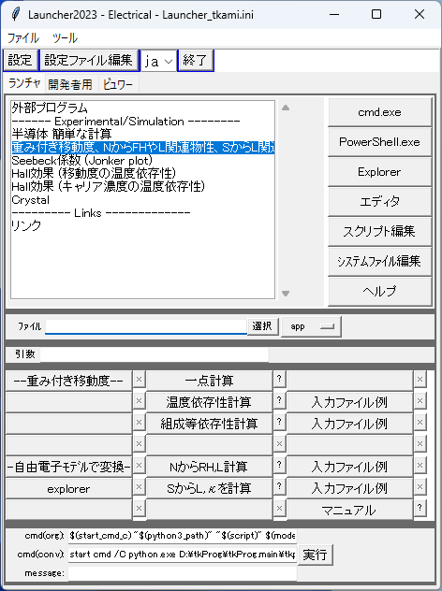
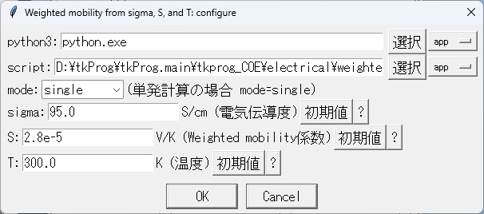
Eelctrical/Launcher.py
σ, S, T から移動度とキャリア濃度を計算
=> 重み付き移動度

Slide 2
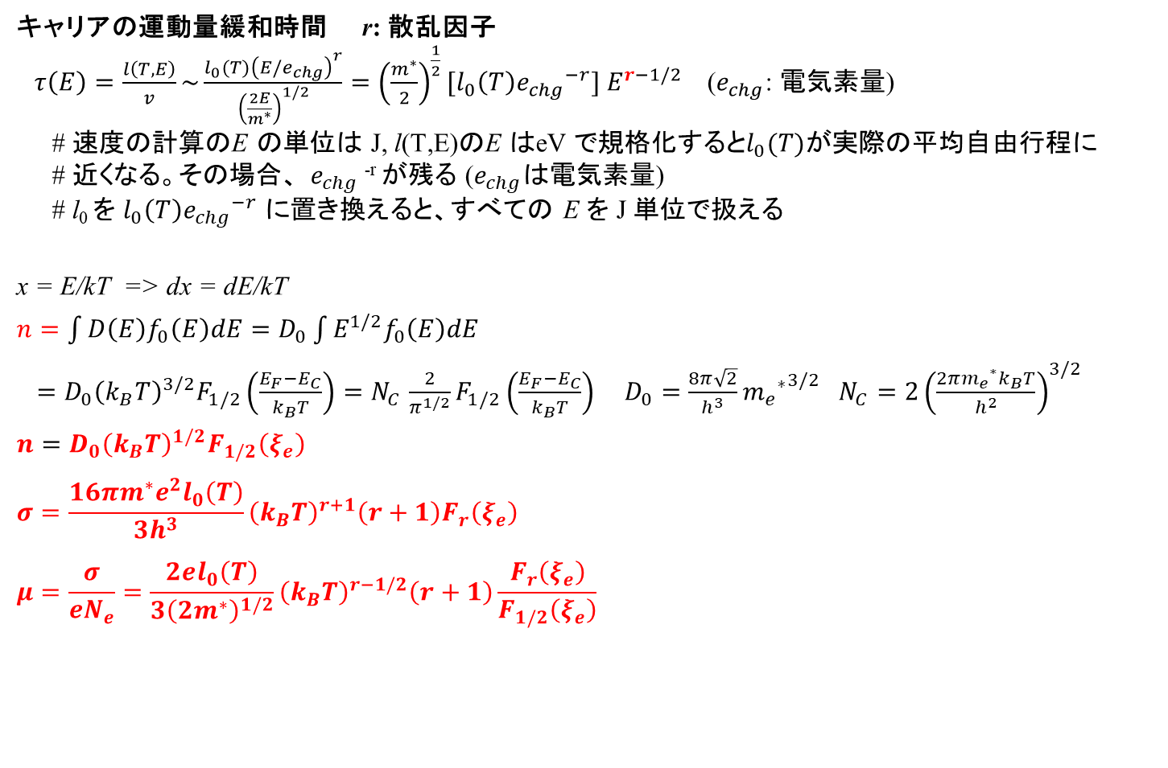
公式: 電気伝導度、移動度
  キャリアの運動量緩和時間 r: 散乱因子
  $τ\left(E\right)=\frac{l\left(T,E\right)}{v}\sim \frac{l_{0}(T){\left(E/e_{chg}\right)}^{r}}{{\left(\frac{2E}{m^{∗}}\right)}^{1/2}}={\left(\frac{m^{∗}}{2}\right)}^{\frac{1}{2}}[l_{0}\left(T\right){e_{chg}}^{−r}] E^{r−1/2}$ ($e_{chg}$: 電気素量)
  # 速度の計算のE の単位は J, l(T,E)のE はeV で規格化すると$l_{0}(T)$が実際の平均自由行程に
  # 近くなる。その場合、 $e_{chg}$^{-r} が残る ($e_{chg}$は電気素量)
  # l₀ を $l_{0}\left(T\right){e_{chg}}^{−r}$ に置き換えると、すべての E を J 単位で扱える
x = E/kT => dx = dE/kT
$n=\int{D\left(E\right)f_{0}\left(E\right)dE}=D_{0}\int{E^{1/2}f_{0}\left(E\right)dE}$
$=D_{0}{\left(k_{B}T\right)}^{3/2}F_{1/2}\left(\frac{E_{F}−E_{C}}{k_{B}T}\right){=N}_{C}\frac{2}{π^{1/2}}F_{1/2}\left(\frac{E_{F}−E_{C}}{k_{B}T}\right)$ $D_{0}=\frac{8π\sqrt{2}}{h^{3}}{{m_{e}}^{∗}}^{3/2}$ $N_{C}=2{\left(\frac{{2πm_{e}}^{∗}k_{B}T}{h^{2}}\right)}^{3/2}$
$n=D_{0}{\left(k_{B}T\right)}^{1/2}F_{1/2}\left(ξ_{e}\right)$
$$σ=\frac{16πm^{∗}e^{2}l_{0}\left(T\right)}{3h^{3}}{\left(k_{B}T\right)}^{r+1}\left(r+1\right)F_{r}\left(ξ_{e}\right)$$
$$μ=\frac{σ}{eN_{e}}=\frac{2el_{0}\left(T\right)}{3{\left(2m^{∗}\right)}^{1/2}}{\left(k_{B}T\right)}^{r−1/2}\left(r+1\right)\frac{F_{r}\left(ξ_{e}\right)}{F_{1/2}\left(ξ_{e}\right)}$$

Slide 3
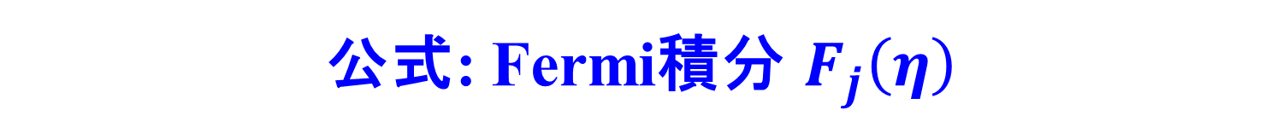
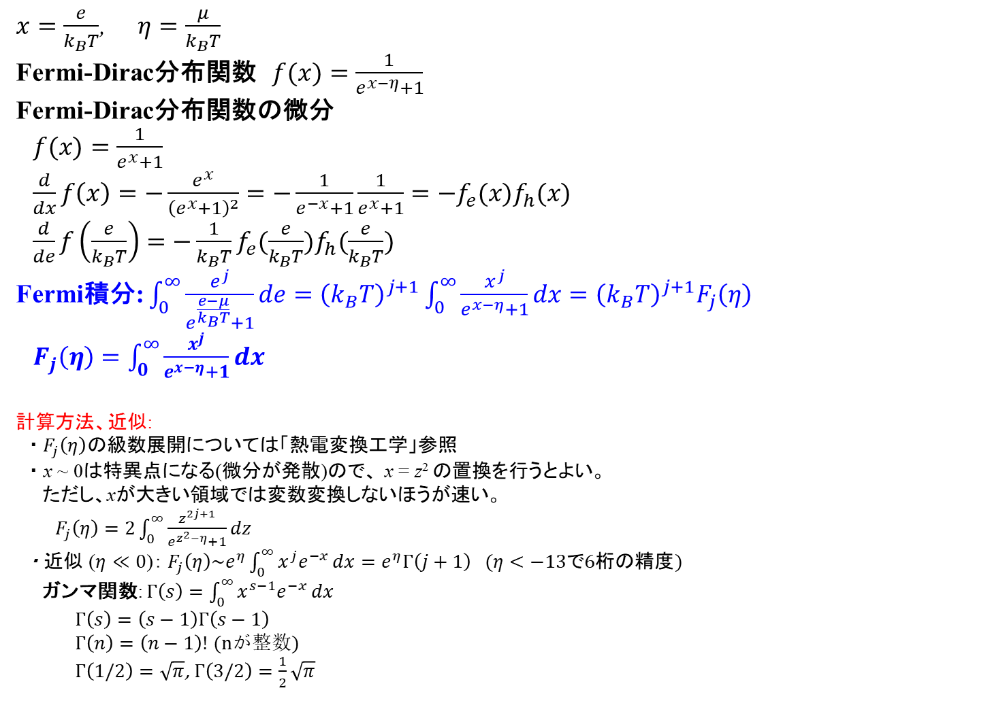
公式: Fermi積分 $F_{j}\left(η\right)$
  $x=\frac{e}{k_{B}T}$, $η=\frac{μ}{k_{B}T}$
  Fermi-Dirac分布関数 $f(x)=\frac{1}{e^{x−η}+1}$
  Fermi-Dirac分布関数の微分
  $f(x)=\frac{1}{e^{x}+1}$
  $\frac{d}{dx}f\left(x\right)=−\frac{e^{x}}{{\left(e^{x}+1\right)}^{2}}=−\frac{1}{e^{−x}+1}\frac{1}{e^{x}+1}=−f_{e}(x)f_{h}(x)$
  $\frac{d}{de}f\left(\frac{e}{k_{B}T}\right)=−\frac{1}{k_{B}T}f_{e}(\frac{e}{k_{B}T})f_{h}(\frac{e}{k_{B}T})$
  Fermi積分: $\int_{0}^{∞}{\frac{e^{j}}{e^{\frac{e−μ}{k_{B}T}}+1}}de={\left(k_{B}T\right)}^{j+1}\int_{0}^{∞}{\frac{x^{j}}{e^{x−η}+1}}dx={\left(k_{B}T\right)}^{j+1}F_{j}\left(η\right)$
  $F_{j}\left(η\right)=\int_{0}^{∞}{\frac{x^{j}}{e^{x−η}+1}}dx$
  計算方法、近似:
  ・$F_{j}\left(η\right)$の級数展開については「熱電変換工学」参照
  ・ x ~ 0は特異点になる(微分が発散)ので、 x = z² の置換を行うとよい。
  ただし、xが大きい領域では変数変換しないほうが速い。
  $F_{j}\left(η\right)=2\int_{0}^{∞}{\frac{z^{2j+1}}{e^{z^{2}−η}+1}}dz$
  ・ 近似 ($η≪0$)： $F_{j}\left(η\right)\sim e^{η}\int_{0}^{∞}{x^{j}e^{−x}}dx=e^{η}Γ\left(j+1\right) (η<−13で6桁の精度)$
  ガンマ関数: $Γ\left(s\right)=\int_{0}^{∞}{x^{s−1}e^{−x}}dx$
  $Γ\left(s\right)=\left(s−1\right)Γ\left(s−1\right)$
  $Γ\left(n\right)=\left(n−1\right)!$ (nが整数)
  $Γ\left(1/2\right)=\sqrt{π}$, $Γ\left(3/2\right)=\frac{1}{2}\sqrt{π}$

Slide 4
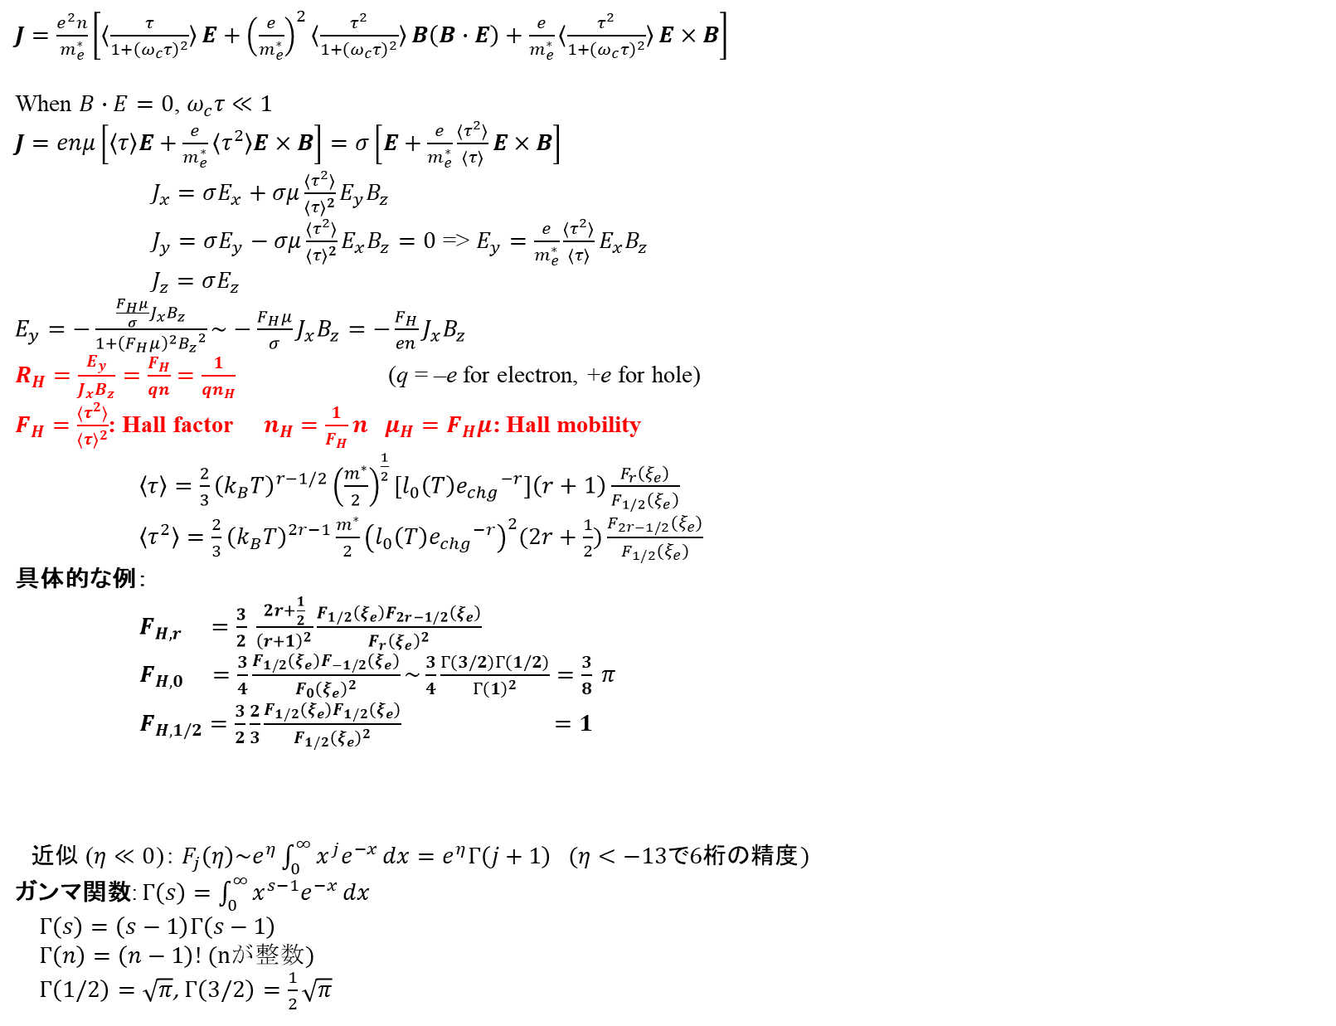
Hall effect
太田英二、坂田亮著、半導体の電子物性光学、培風館 (2005)
$J=\frac{e^{2}n}{m_{e}^{∗}}\left[〈\frac{τ}{1+{\left(ω_{c}τ\right)}^{2}}〉E+{\left(\frac{e}{m_{e}^{∗}}\right)}^{2}〈\frac{τ^{2}}{1+{\left(ω_{c}τ\right)}^{2}}〉B\left(B∙E\right)+\frac{e}{m_{e}^{∗}}〈\frac{τ^{2}}{1+{\left(ω_{c}τ\right)}^{2}}〉E×B\right]$
When $B∙E=0$, $ω_{c}τ≪1$
$J=enμ\left[〈τ〉E+\frac{e}{m_{e}^{∗}}〈τ^{2}〉E×B\right]=σ\left[E+\frac{e}{m_{e}^{∗}}\frac{〈τ^{2}〉}{〈τ〉}E×B\right]$
$J_{x}=σE_{x}+σμ\frac{〈τ^{2}〉}{{〈τ〉}^{2}}E_{y}B_{z}$
$J_{y}=σE_{y}−σμ\frac{〈τ^{2}〉}{{〈τ〉}^{2}}E_{x}B_{z}=0$ => $E_{y}=\frac{e}{m_{e}^{∗}}\frac{〈τ^{2}〉}{〈τ〉}E_{x}B_{z}$
$J_{z}=σE_{z}$
$E_{y}=−\frac{\frac{F_{H}μ}{σ}J_{x}B_{z}}{1+{\left(F_{H}μ\right)}^{2}{B_{z}}^{2}}\sim −\frac{F_{H}μ}{σ}J_{x}B_{z}=−\frac{F_{H}}{en}J_{x}B_{z}$
$R_{H}=\frac{E_{y}}{J_{x}B_{z}}=\frac{F_{H}}{qn}$ $=\frac{1}{qn_{H}}$ (q = –e for electron, +e for hole)
$F_{H}=\frac{〈τ^{2}〉}{{〈τ〉}^{2}}$: Hall factor $n_{H}$ $=\frac{1}{F_{H}}n$ $μ_{H}=F_{H}μ$: Hall mobility
$\left\langle τ\right\rangle =\frac{2}{3}{\left(k_{B}T\right)}^{r−1/2}{\left(\frac{m^{∗}}{2}\right)}^{\frac{1}{2}}[l_{0}\left(T\right){e_{chg}}^{−r}]\left(r+1\right)\frac{F_{r}\left(ξ_{e}\right)}{F_{1/2}\left(ξ_{e}\right)}$
$\left\langle τ^{2}\right\rangle =\frac{2}{3}{\left(k_{B}T\right)}^{2r−1}\frac{m^{∗}}{2}{\left(l_{0}\left(T\right){e_{chg}}^{−r}\right)}^{2}(2r+\frac{1}{2})\frac{F_{2r−1/2}\left(ξ_{e}\right)}{F_{1/2}\left(ξ_{e}\right)}$
具体的な例：
$F_{H,r} =\frac{3}{2} \frac{2r+\frac{1}{2}}{{\left(r+1\right)}^{2}}\frac{F_{1/2}\left(ξ_{e}\right)F_{2r−1/2}\left(ξ_{e}\right)}{{F_{r}\left(ξ_{e}\right)}^{2}}$
$F_{H,0} =\frac{3}{4}\frac{F_{1/2}\left(ξ_{e}\right)F_{−1/2}\left(ξ_{e}\right)}{{F_{0}\left(ξ_{e}\right)}^{2}}\sim \frac{3}{4}\frac{Γ\left(3/2\right)Γ\left(1/2\right)}{{Γ\left(1\right)}^{2}}=\frac{3}{8} π$
$F_{H,1/2}=\frac{3}{2}\frac{2}{3}\frac{F_{1/2}\left(ξ_{e}\right)F_{1/2}\left(ξ_{e}\right)}{{F_{1/2}\left(ξ_{e}\right)}^{2}} =1$
  近似 ($η≪0$)： $F_{j}\left(η\right)\sim e^{η}\int_{0}^{∞}{x^{j}e^{−x}}dx=e^{η}Γ\left(j+1\right) (η<−13で6桁の精度)$
  ガンマ関数: $Γ\left(s\right)=\int_{0}^{∞}{x^{s−1}e^{−x}}dx$
  $Γ\left(s\right)=\left(s−1\right)Γ\left(s−1\right)$
  $Γ\left(n\right)=\left(n−1\right)!$ (nが整数)
  $Γ\left(1/2\right)=\sqrt{π}$, $Γ\left(3/2\right)=\frac{1}{2}\sqrt{π}$

Slide 5
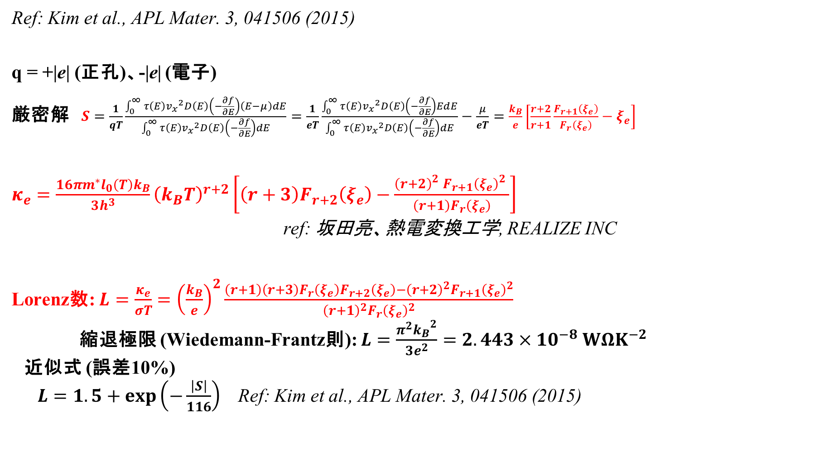
公式: 熱電関係
Ref: Kim et al., APL Mater. 3, 041506 (2015)
q = +|e| (正孔)、-|e| (電子)
厳密解 $S=\frac{1}{qT}\frac{\int_{0}^{∞}{τ\left(E\right){v_{x}}^{2}D\left(E\right)\left(−\frac{∂f}{∂E}\right)\left(E−μ\right)dE}}{\int_{0}^{∞}{τ\left(E\right){v_{x}}^{2}D\left(E\right)\left(−\frac{∂f}{∂E}\right)dE}}=\frac{1}{eT}\frac{\int_{0}^{∞}{τ\left(E\right){v_{x}}^{2}D\left(E\right)\left(−\frac{∂f}{∂E}\right)EdE}}{\int_{0}^{∞}{τ\left(E\right){v_{x}}^{2}D\left(E\right)\left(−\frac{∂f}{∂E}\right)dE}}−\frac{μ}{eT}=\frac{k_{B}}{e}\left[\frac{r+2}{r+1}\frac{F_{r+1}\left(ξ_{e}\right)}{F_{r}\left(ξ_{e}\right)}−ξ_{e}\right]$
$κ_{e}=\frac{16πm^{∗}l_{0}\left(T\right)k_{B}}{3h^{3}}{\left(k_{B}T\right)}^{r+2}\left[\left(r+3\right)F_{r+2}\left(ξ_{e}\right)−\frac{{\left(r+2\right)}_{}^{2}{F_{r+1}\left(ξ_{e}\right)}_{}^{2}}{{\left(r+1\right)F}_{r}\left(ξ_{e}\right)}\right]$
ref: 坂田亮、熱電変換工学, REALIZE INC
Lorenz数: $L=\frac{κ_{e}}{σT}={\left(\frac{k_{B}}{e}\right)}^{2}\frac{\left(r+1\right)\left(r+3\right)F_{r}\left(ξ_{e}\right)F_{r+2}\left(ξ_{e}\right)−{\left(r+2\right)}^{2}{F_{r+1}\left(ξ_{e}\right)}^{2}}{{\left(r+1\right)}^{2}{F_{r}\left(ξ_{e}\right)}^{2}}$
縮退極限 (Wiedemann-Frantz則): $L=\frac{π^{2}{k_{B}}^{2}}{3e^{2}}=2.443×{10}^{−8} WΩK^{−2}$
近似式 (誤差10%)
$L=1.5+exp\left(−\frac{\left|S\right|}{116}\right)$ Ref: Kim et al., APL Mater. 3, 041506 (2015)

Slide 6

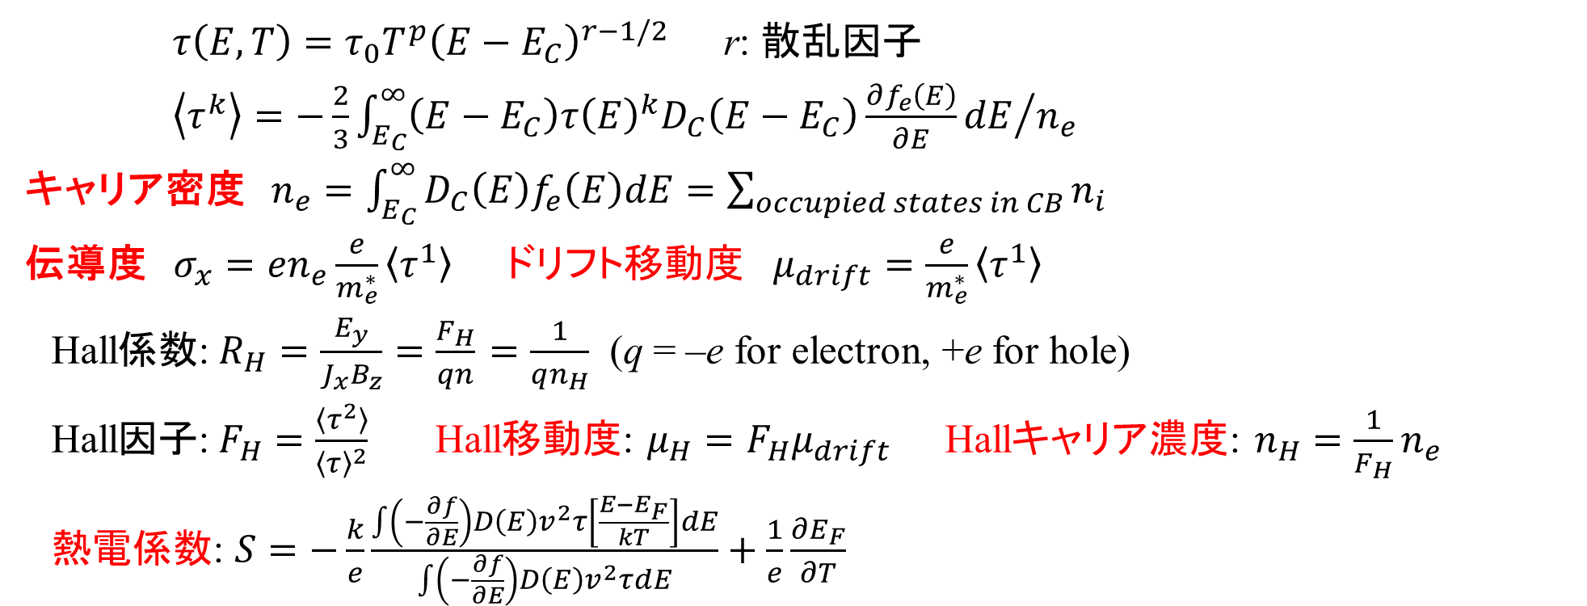
電子伝導度と移動度: Boltzmann方程式＋緩和時間近似
$τ\left(E,T\right)=τ_{0}T^{p}{\left(E−E_{C}\right)}^{r−1/2}$ r: 散乱因子
$\left\langle τ^{k}\right\rangle =−\frac{2}{3}{\int_{E_{C}}^{∞}{\left(E−E_{C}\right)τ{\left(E\right)}^{k}D_{C}\left(E−E_{C}\right)\frac{∂f_{e}\left(E\right)}{∂E}dE}}/{n_{e}}$
キャリア密度 $n_{e}=\int_{E_{C}}^{∞}{D_{C}\left(E\right)f_{e}\left(E\right)dE}=\sum_{occupied states in CB}{n_{i}}$
伝導度 $σ_{x}=en_{e}\frac{e}{m_{e}^{∗}}\left\langle τ^{1}\right\rangle$ ドリフト移動度 $μ_{drift}=\frac{e}{m_{e}^{∗}}\left\langle τ^{1}\right\rangle$
Hall係数:$R_{H}=\frac{E_{y}}{J_{x}B_{z}}=\frac{F_{H}}{qn}$ $=\frac{1}{qn_{H}}$ (q = –e for electron, +e for hole)
Hall因子:$F_{H}=\frac{〈τ^{2}〉}{{〈τ〉}^{2}}$ Hall移動度: $μ_{H}=F_{H}μ_{drift}$ Hallキャリア濃度: $n_{H}$ $=\frac{1}{F_{H}}n_{e}$
熱電係数: $S=−\frac{k}{e}\frac{\int{\left(−\frac{∂f}{∂E}\right)D\left(E\right)v^{2}τ\left[\frac{E−E_{F}}{kT}\right]dE}}{\int{\left(−\frac{∂f}{∂E}\right)D\left(E\right)v^{2}τdE}}+\frac{1}{e}\frac{∂E_{F}}{∂T}$
例えば、$τ(E)$ = 一定 という仮定をすると計算できる
実験値に合うように $τ$ を決めると、いろいろなキャリア輸送特性を計算できる
Sは $τ$ に依存しない

Slide 7
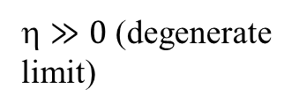
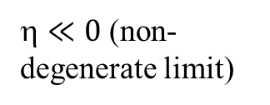
Weighted mobility
Weighted Mobility
G. Jeffrey Snyder,* Alemayouh H. Snyder, Maxwell Wood, Ramya Gurunathan,
Berhanu H. Snyder, and Changning Niu
Adv. Mater. 32 (2020) 2001537
Free electron model
Constant mean free path
$≪0$ (non-degenerate limit)
$≫0$ (degenerate limit)
3 % error for |S| > 20 μV/K
Notes:
7

Slide 8
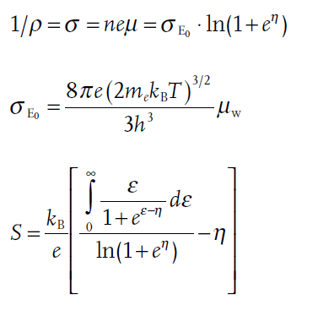
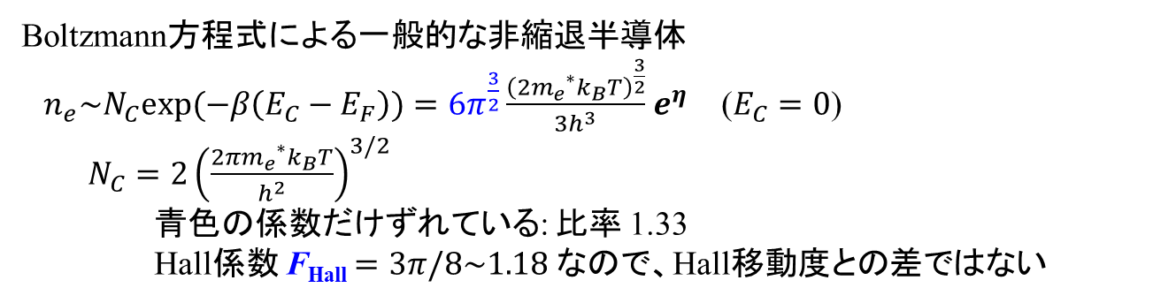
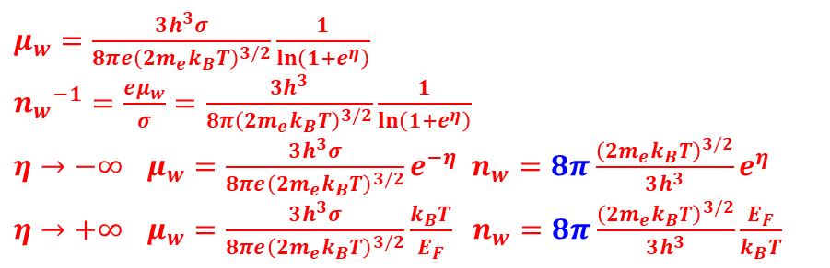
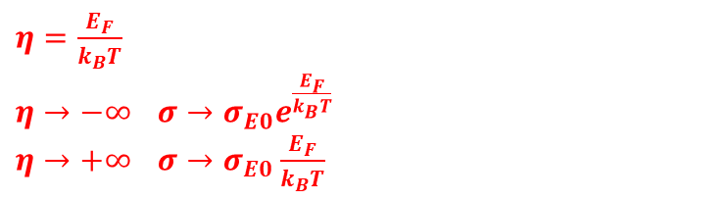
Weighted mobility: 導出
Weighted Mobility
G. Jeffrey Snyder,* Alemayouh H. Snyder, Maxwell Wood, Ramya Gurunathan,
Berhanu H. Snyder, and Changning Niu, Adv. Mater. 32 (2020) 2001537
Drude-Sommerfeld model (Free electron model)
  $η=\frac{E_{F}}{k_{B}T}$
  $η→−∞$ $σ→σ_{E0}e^{\frac{E_{F}}{k_{B}T}}$
  $η→+∞$ $σ→σ_{E0}\frac{E_{F}}{k_{B}T}$
  $μ_{w}=\frac{3h^{3}σ}{8πe{\left(2m_{e}k_{B}T\right)}^{3/2}}\frac{1}{ln\left(1+e^{η}\right)}$
  ${n_{w}}^{−1}=\frac{eμ_{w}}{σ}=\frac{3h^{3}}{8π{\left(2m_{e}k_{B}T\right)}^{3/2}}\frac{1}{ln\left(1+e^{η}\right)}$
  $η→−∞$ $μ_{w}=\frac{3h^{3}σ}{8πe{\left(2m_{e}k_{B}T\right)}^{3/2}}e^{−η}$ $n_{w}=8π\frac{{\left(2m_{e}k_{B}T\right)}^{3/2}}{3h^{3}}e^{η}$
  $η→+∞$ $μ_{w}=\frac{3h^{3}σ}{8πe{\left(2m_{e}k_{B}T\right)}^{3/2}}\frac{k_{B}T}{E_{F}}$ $n_{w}=8π\frac{{\left(2m_{e}k_{B}T\right)}^{3/2}}{3h^{3}}\frac{E_{F}}{k_{B}T}$
  Boltzmann方程式による一般的な非縮退半導体
  $n_{e}\sim N_{C}exp(−β\left(E_{C}−E_{F}\right))=6π^{\frac{3}{2}}\frac{{\left({2m_{e}}^{∗}k_{B}T\right)}^{\frac{3}{2}}}{3h^{3}}$ $e^{η}$ ($E_{C}=0$)
  $N_{C}=2{\left(\frac{{2πm_{e}}^{∗}k_{B}T}{h^{2}}\right)}^{3/2}$
  青色の係数だけずれている: 比率 1.33
  Hall係数 F_{Hall} $=3π/8\sim 1.18$ なので、Hall移動度との差ではない
Notes:
8

Slide 9
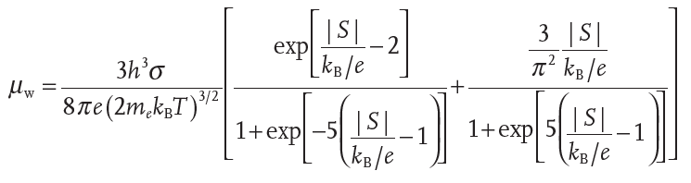
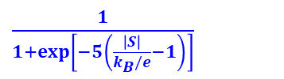

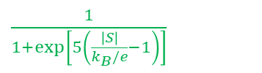

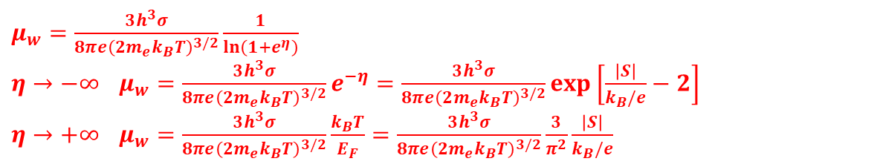

Weighted mobility: 導出
Weighted Mobility
G. Jeffrey Snyder,* Alemayouh H. Snyder, Maxwell Wood, Ramya Gurunathan,
Berhanu H. Snyder, and Changning Niu, Adv. Mater. 32 (2020) 2001537
  $μ_{w}=\frac{3h^{3}σ}{8πe{\left(2m_{e}k_{B}T\right)}^{3/2}}\frac{1}{ln\left(1+e^{η}\right)}$
  $η→−∞$ $μ_{w}=\frac{3h^{3}σ}{8πe{\left(2m_{e}k_{B}T\right)}^{3/2}}e^{−η}=\frac{3h^{3}σ}{8πe{\left(2m_{e}k_{B}T\right)}^{3/2}}exp\left[\frac{\left|S\right|}{k_{B}/e}−2\right]$
  $η→+∞$ $μ_{w}=\frac{3h^{3}σ}{8πe{\left(2m_{e}k_{B}T\right)}^{3/2}}\frac{k_{B}T}{E_{F}}=\frac{3h^{3}σ}{8πe{\left(2m_{e}k_{B}T\right)}^{3/2}}\frac{3}{π^{2}}\frac{\left|S\right|}{k_{B}/e}$
Sigmoid functions (縮退近似と非縮退近似をつなぐ。誤差を最小にするために 指数項に -1 が入っている)
  $\frac{1}{1+exp\left[5\left(\frac{\left|S\right|}{k_{B}/e}−1\right)\right]}$
$$deg.$$
$$non−deg.$$
  $\frac{1}{1+exp\left[−5\left(\frac{\left|S\right|}{k_{B}/e}−1\right)\right]}$
$$\frac{\left|S\right|}{k_{B}/e}$$
Notes:
9

Slide 10
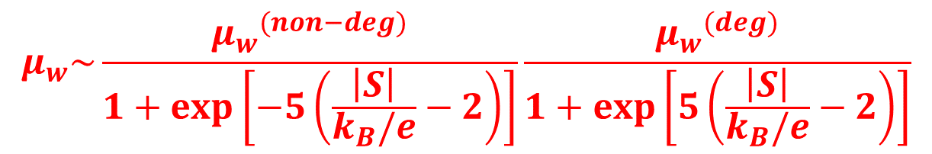

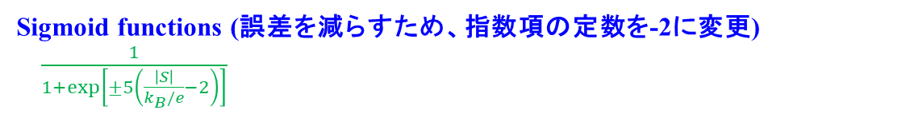
  Boltzmann方程式の非縮退近似
  $S\sim \frac{k_{B}}{q}\left(\frac{E_{C}−E_{F}}{k_{B}T}+r+2\right)=\frac{k_{B}}{q}\left(\ln{\frac{N_{C}}{N_{e}}}+r+2\right)$
  $\ln{\frac{1}{N_{e}}}=\frac{S}{k_{B}/e}−\ln{N_{C}}−r−2$ $N_{C}=2{\left(\frac{{2πm_{e}}^{∗}k_{B}T}{h^{2}}\right)}^{3/2}$
  $\frac{1}{N_{e}}=\frac{1}{N_{C}}\exp\left[\frac{S}{k_{B}/e}−r−2\right]=\frac{h^{3}}{2{\left({2πm_{e}}^{∗}k_{B}T\right)}^{3/2}}\exp\left[\frac{S}{k_{B}/e}−r−2\right]$
  ${μ_{w}}^{(non−deg)}\sim \frac{σ}{eN_{e}}=\frac{h^{3}σ}{2π^{3/2}e{\left({2m_{e}}^{∗}k_{B}T\right)}^{3/2}}\exp\left[\frac{S}{k_{B}/e}−r−2\right]$
  Boltzmann方程式の縮退近似
  $S\sim \frac{8π^{2}{k_{B}}^{2}}{3qh^{2}}{m_{de}}^{∗}T\left(1+r\right){\left(\frac{π}{3N_{e}}\right)}^{2/3}$
  $\frac{1}{N_{e}} \sim \frac{3h^{3}}{8π^{4}}{\left(\frac{S}{k_{B}/e}\frac{3}{2k_{B}{m_{de}}^{∗}T\left(1+r\right)}\right)}^{3/2}$
  ${μ_{w}}^{(deg)}=\frac{σ}{e}\frac{3h^{3}}{8π^{4}}{\left(\frac{S}{k_{B}/e}\frac{3}{2k_{B}{m_{de}}^{∗}T\left(1+r\right)}\right)}^{3/2}$
  $S\sim \frac{k_{B}}{e}\frac{π^{2}}{3}\left(1+r\right)\frac{k_{B}}{E_{F}}T=\frac{k_{B}}{q}\frac{π^{2}}{3}\left(1+r\right)\frac{k_{B}}{{\left(N_{e}/(\frac{8π\sqrt{2}}{h^{3}}{{m_{e}}^{∗}}^{\frac{3}{2}})\right)}^{2/3}}T$
  $N_{e}\sim D_{C0}k_{B}T{E_{F}}^{1/2}=\frac{8π\sqrt{2}}{h^{3}}{{m_{e}}^{∗}}^{3/2}k_{B}T{E_{F}}^{1/2}$
  $N_{e}\left(E_{F}\right)\sim {\frac{2}{3}D_{C0}E_{F}}^{3/2}$ $D_{C0}=\frac{8π\sqrt{2}}{h^{3}}{{m_{e}}^{∗}}^{3/2}$
  $S\sim \frac{k_{B}}{q}\frac{π^{2}}{3}\left(1+r\right)\frac{k_{B}}{E_{F}}T=\frac{k_{B}}{q}\frac{π^{2}}{3}\left(1+r\right)\frac{k_{B}}{{\left(N_{e}/(\frac{8π\sqrt{2}}{h^{3}}{{m_{e}}^{∗}}^{\frac{3}{2}})\right)}^{2/3}}T$
  ${N_{e}}^{\frac{2}{3}}=\frac{S}{\frac{k_{B}}{e}}{\left(\frac{1}{\frac{8π\sqrt{2}}{h^{3}}{{m_{e}}^{∗}}^{\frac{3}{2}}}\right)}^{\frac{2}{3}}\frac{1}{\frac{π^{2}}{3}\left(1+r\right)k_{B}T}$
  Sigmoid functions (誤差を減らすため、指数項の定数を-2に変更)
  $\frac{1}{1+exp\left[±5\left(\frac{\left|S\right|}{k_{B}/e}−2\right)\right]}$
  $$μ_{w}\sim \frac{{μ_{w}}^{(non−deg)}}{1+exp\left[−5\left(\frac{\left|S\right|}{k_{B}/e}−2\right)\right]}\frac{{μ_{w}}^{(deg)}}{1+exp\left[5\left(\frac{\left|S\right|}{k_{B}/e}−2\right)\right]}$$

Slide 11
Weighted mobility: T dependence
[tkprog_X] /electrical/weighted_mobility/LaTiO3-T-sigma-S.xlsx
σ, S, T から移動度とキャリア濃度を計算
=> 重み付き移動度

Slide 12
File format: T dependence
[tkprog_X] /electrical/weighted_mobility/LaTiO3-T-sigma-S.xlsx
T(K) | sigma (S/cm) | S (V/K) | sigma (S/m)
300 | 375.9398 | 3.20E-05 | 37593.98
295 | 375.9398 | 3.17E-05 | 37593.98
290 | 373.1343 | 3.08E-05 | 37313.43
285 | 371.7472 | 3.01E-05 | 37174.72
280 | 369.0037 | 2.93E-05 | 36900.37
275 | 367.6471 | 2.88E-05 | 36764.71
270 | 364.9635 | 2.84E-05 | 36496.35
265 | 363.6364 | 2.79E-05 | 36363.64
260 | 361.0108 | 2.69E-05 | 36101.08
255 | 359.7122 | 2.62E-05 | 35971.22
250 | 357.1429 | 2.54E-05 | 35714.29
245 | 354.6099 | 2.47E-05 | 35460.99
240 | 353.3569 | 2.44E-05 | 35335.69
235 | 352.1127 | 2.40E-05 | 35211.27
230 | 349.6503 | 2.34E-05 | 34965.03

Slide 13
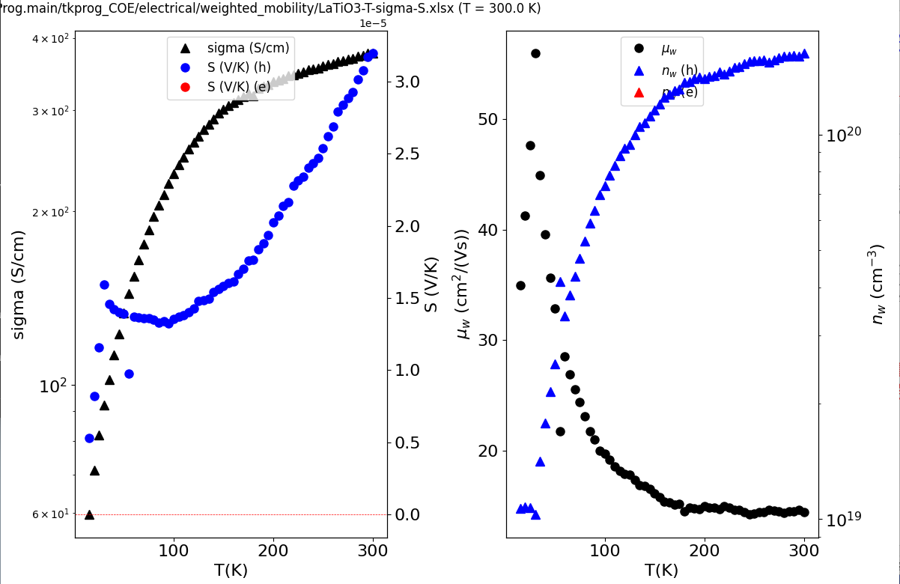
Weighted mobility: T dependence

Slide 14
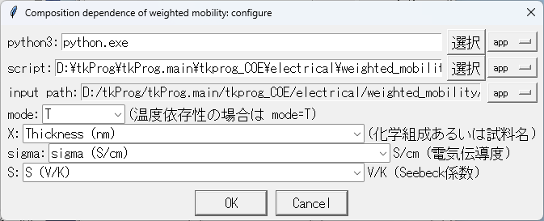
Weighted mobility: x dependence
[tkprog_X] /electrical/weighted_mobility/LaTiO3-sigma-S.xlsx
“組成” だけでなく、
“試料名“ などでもいい

Slide 15
File format: x dependence
[tkprog_X] /electrical/weighted_mobility/LaTiO3-sigma-S.xlsx
“組成” だけでなく、
“試料名“ や "膜厚” などでもいい
Thickness (nm) | sigma (S/cm) | S (V/K)
8.7 | 94.68863 | -2.80E-05
4 | 2919.879 | -3.20E-05
10 | 101.7294 | -2.50E-05
40 | 48.16956 | 1.85E-06
93 | 12.5 | 3.00E-05
70 | 24.74145 | 2.02E-05
8 | 229.8586 | -2.78E-05
6 | 992.0635 | -3.12E-05
100 | 11.6901 | 3.00E-05

Slide 16
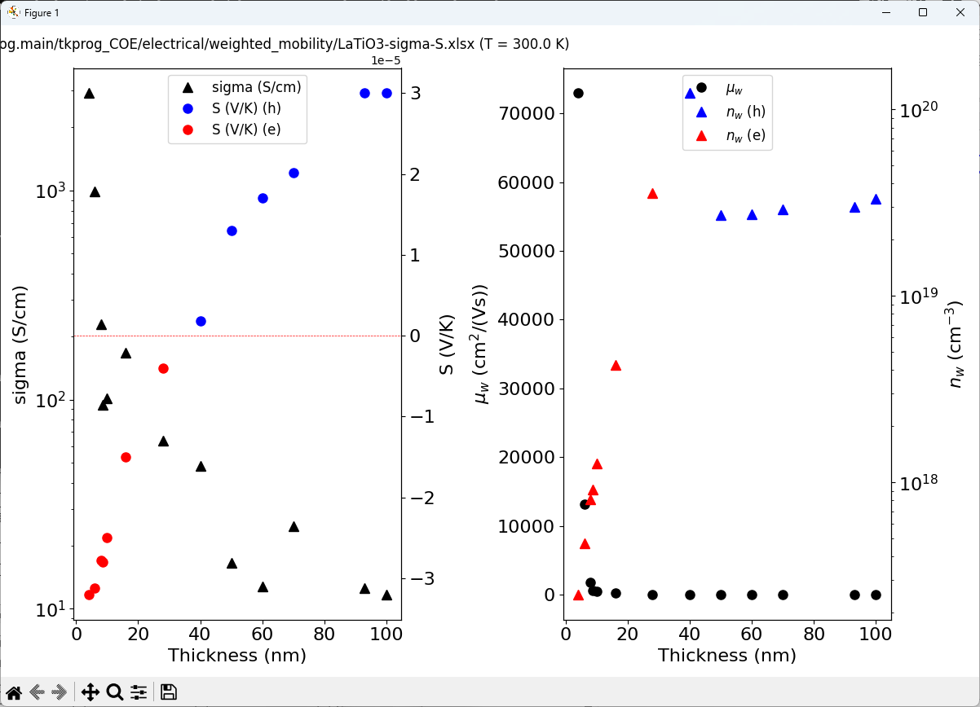
Weighted mobility: x dependence

Slide 17
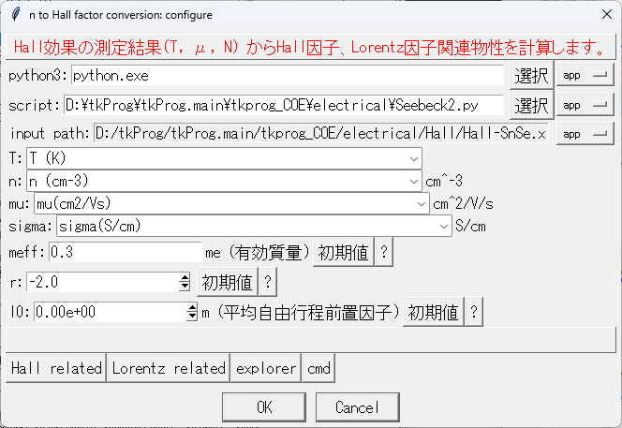
Calculate F_{Hall} and L from N
[tkprog_X]/electrical/Hall/Hall-SnSe.xlsx

Slide 18
File format: Calculate RH and L from N
[tkprog_X]/electrical/Hall/Hall-SnSe.xlsx
T (K) | n (cm-3) | mu(cm2/Vs) | sigma(S/cm)
249.8715 | 1.02E+14 | 3.76297 | 1.44E+09
274.44749 | 3.66E+14 | 4.06679 | 2.26E+10
297 | 1.00E+15 | 4 | 1.89E+11
325 | 2.00E+15 | 5 | 1.76E+12
370 | 8.00E+15 | 5.5 | 3.12596E+13
428 | 3.00E+16 | 5.3 | 5.21E+14
472 | 8.50E+16 | 4.7 | 2.77E+15
NからE_{F}を計算
=> Hall因子 F_{Hall},
Lorentz因子 L を計算
Meff: 有効質量
R: 散乱因子
l0: 平均自由行程の前置因子
=> 移動度μ
F_{Hall} => Hall因子 RH
L => κ_{ele}

Slide 19
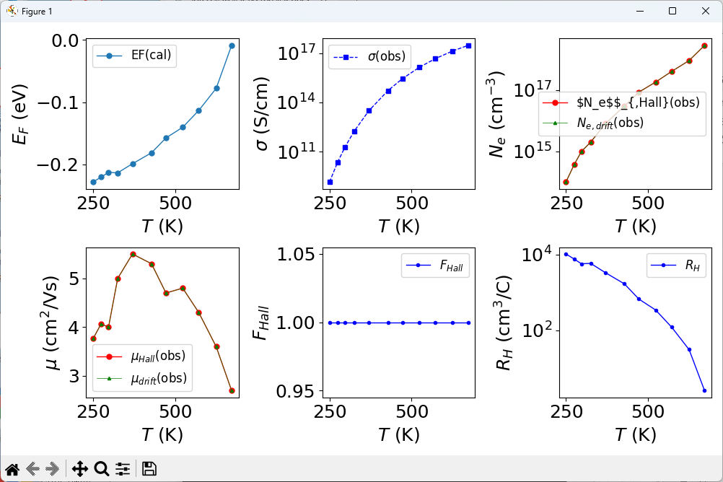
Hall-related properties

Slide 20
Hall-related properties

Slide 21
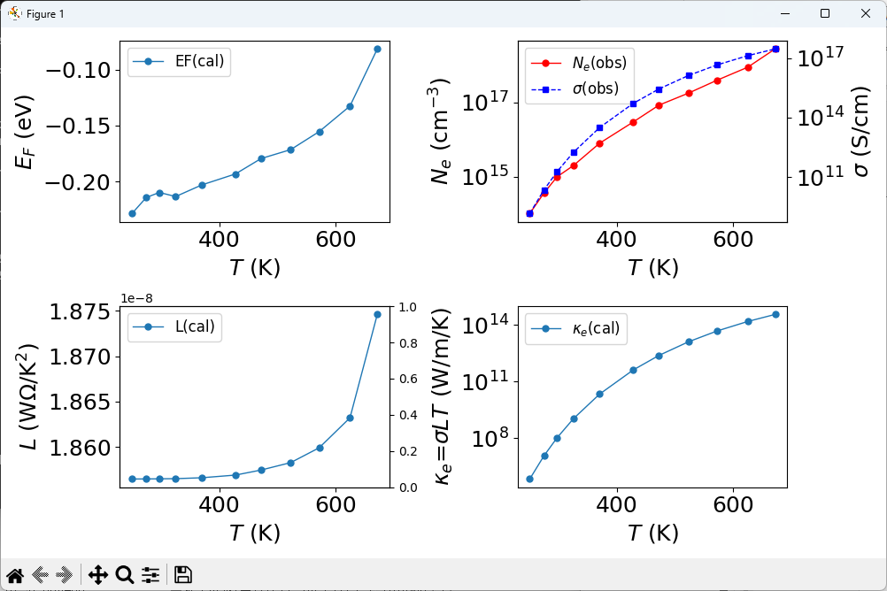
Lorentz-related properties

Slide 22
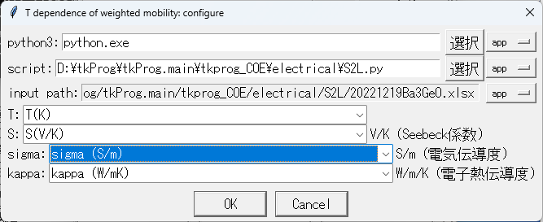
Calculate L and κ_{ele} from S
[tkprog_X]/electrical/S2L/
20221219Ba3GeO.xlsx

Slide 23
Calculate L and κ_{ele} from S
[tkprog_X]/electrical/S2L/
20221219Ba3GeO.xlsx
T(K) | S(V/K) | sigma (S/m) | kappa (W/mK)
305.45 | 0.000255 | 15100 | 0.8245
327.55 | 0.000278 | 14000 | 0.77225
347.05 | 0.000288 | 12900 | 0.73425
371.15 | 0.000296 | 11100 | 0.68825
395.15 | 0.000311 | 9050 | 0.6405
419.15 | 0.000313 | 7810 | 0.596
442.15 | 0.000323 | 6980 | 0.5675

Slide 24
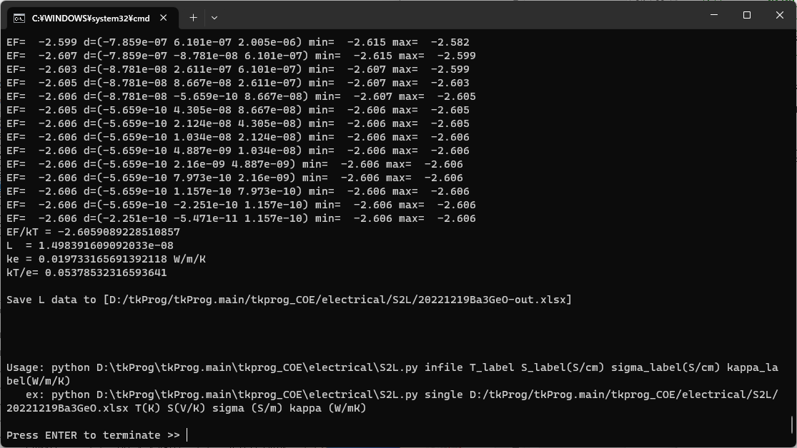
Calculate L and κ_{ele} from S

Slide 25
Calculate L and κ_{ele} from S
20221219Ba3SiO-out.xlsx
T(K) | S(V/K) | simga(S/m) | kappa(W/m/K) | EF/kBT | EF(eV) | L | kappa_e(W/m/K)
300.35 | 0.000444 | 2780 | 1.0163 | -3.13093 | -0.08104 | 1.49E-08 | 0.012467
320.65 | 0.000452 | 3270 | 0.95924 | -3.22568 | -0.08913 | 1.49E-08 | 0.015648
345.55 | 0.000468 | 3640 | 0.87775 | -3.41468 | -0.10168 | 1.49E-08 | 0.018756
366.55 | 0.000472 | 3950 | 0.866 | -3.46184 | -0.10935 | 1.49E-08 | 0.021586
392.15 | 0.000482 | 4100 | 0.85 | -3.57959 | -0.12097 | 1.49E-08 | 0.023961
416.15 | 0.000493 | 4190 | 0.8325 | -3.70889 | -0.13301 | 1.49E-08 | 0.025975
440.15 | 0.000506 | 4270 | 0.81675 | -3.86145 | -0.14646 | 1.49E-08 | 0.027985
464.15 | 0.000504 | 4550 | 0.8025 | -3.838 | -0.15351 | 1.49E-08 | 0.031449
488.15 | 0.000492 | 4720 | 0.78975 | -3.69715 | -0.15552 | 1.49E-08 | 0.034324
510.15 | 0.00049 | 4720 | 0.777 | -3.67365 | -0.1615 | 1.49E-08 | 0.035874
535.15 | 0.000493 | 4490 | 0.7595 | -3.70889 | -0.17104 | 1.49E-08 | 0.035794
559.15 | 0.000496 | 4190 | 0.731 | -3.74412 | -0.18041 | 1.49E-08 | 0.034897
583.15 | 0.000497 | 3950 | 0.70725 | -3.75586 | -0.18874 | 1.49E-08 | 0.034309
606.15 | 0.000503 | 3730 | 0.7025 | -3.82627 | -0.19986 | 1.49E-08 | 0.033669
630.15 | 0.000507 | 3500 | 0.696 | -3.87318 | -0.21032 | 1.49E-08 | 0.03284

Slide 26
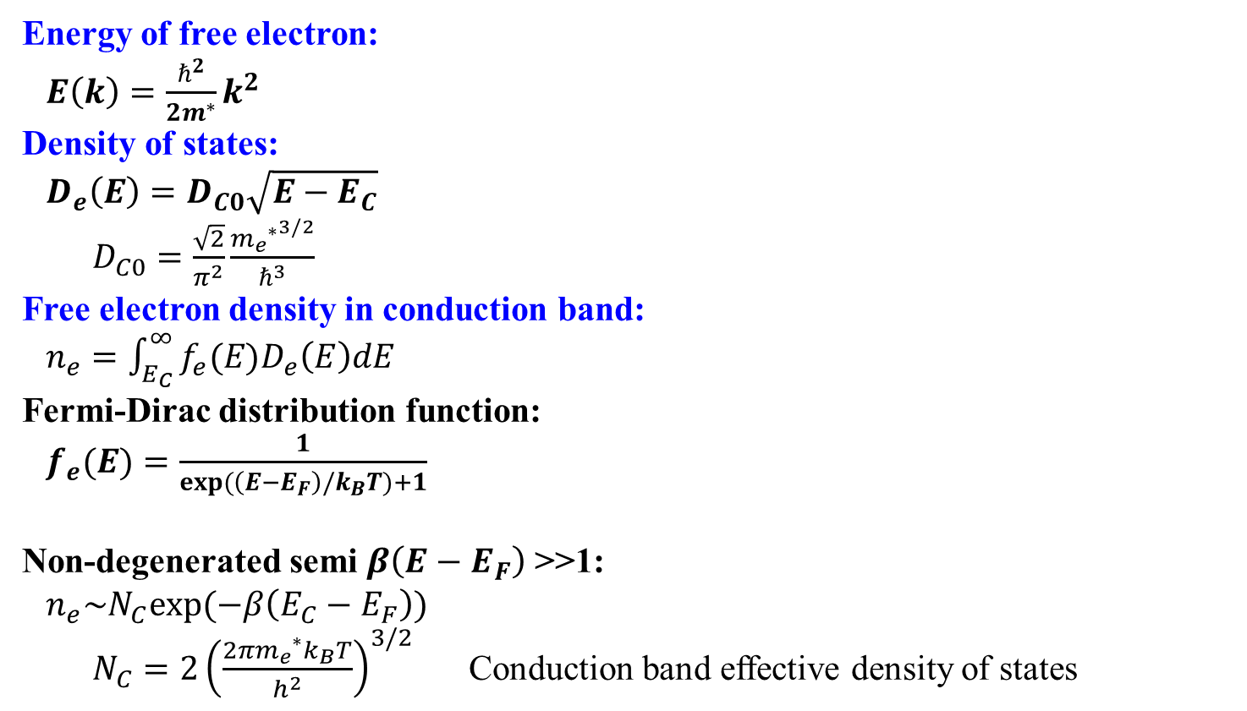
Electron-only Free electron model
E_{F}
  Energy of free electron:
  $E\left(k\right)=\frac{ℏ^{2}}{2m^{∗}}k^{2}$
  Density of states:
  $D_{e}\left(E\right)=D_{C0}\sqrt{E−E_{C}}$
  $D_{C0}=\frac{\sqrt{2}}{π^{2}}\frac{{{m_{e}}^{∗}}^{3/2}}{ℏ^{3}}$
  Free electron density in conduction band:
  $n_{e}=\int_{E_{C}}^{∞}{f_{e}(E)D_{e}\left(E\right)dE}$
  Fermi-Dirac distribution function:
  $f_{e}(E)=\frac{1}{exp(\left(E−E_{F}\right)/k_{B}T)+1}$
  Non-degenerated semi $β\left(E−E_{F}\right)$ >>1:
  $n_{e}\sim N_{C}exp(−β\left(E_{C}−E_{F}\right))$
  $N_{C}=2{\left(\frac{{2πm_{e}}^{∗}k_{B}T}{h^{2}}\right)}^{3/2}$ Conduction band effective density of states
f_{e}(E)
状態密度
D_{C}(E)
伝導帯
E_{C}
E
1
f(E)
DOS (cm⁻³/eV)
E_{F} = 0.3 eV
E (eV)

Slide 27
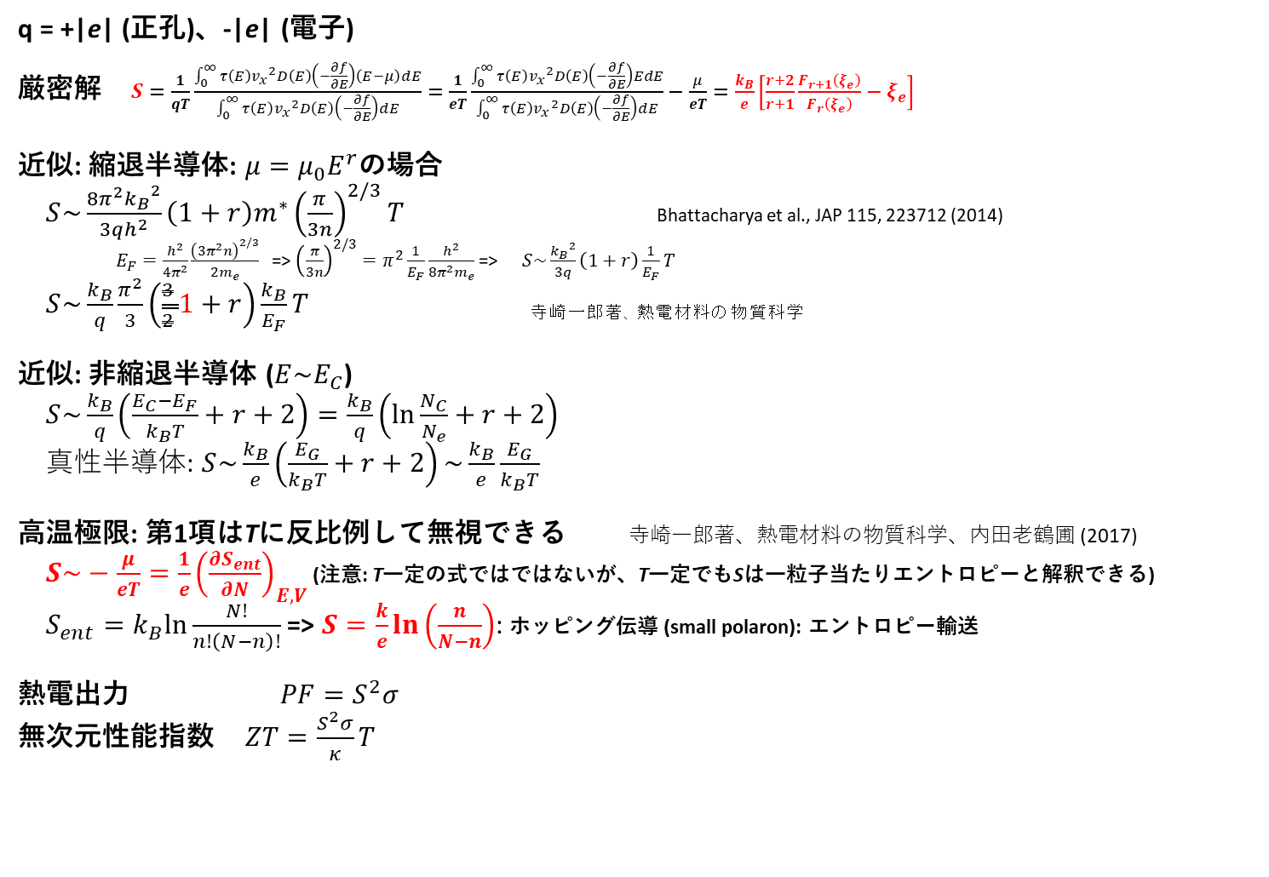
公式: 熱電関係
q = +|e| (正孔)、-|e| (電子)
厳密解 $S=\frac{1}{qT}\frac{\int_{0}^{∞}{τ\left(E\right){v_{x}}^{2}D\left(E\right)\left(−\frac{∂f}{∂E}\right)\left(E−μ\right)dE}}{\int_{0}^{∞}{τ\left(E\right){v_{x}}^{2}D\left(E\right)\left(−\frac{∂f}{∂E}\right)dE}}=\frac{1}{eT}\frac{\int_{0}^{∞}{τ\left(E\right){v_{x}}^{2}D\left(E\right)\left(−\frac{∂f}{∂E}\right)EdE}}{\int_{0}^{∞}{τ\left(E\right){v_{x}}^{2}D\left(E\right)\left(−\frac{∂f}{∂E}\right)dE}}−\frac{μ}{eT}=\frac{k_{B}}{e}\left[\frac{r+2}{r+1}\frac{F_{r+1}\left(ξ_{e}\right)}{F_{r}\left(ξ_{e}\right)}−ξ_{e}\right]$
近似: 縮退半導体: $μ=μ_{0}E^{r}$の場合
$S\sim \frac{8π^{2}{k_{B}}^{2}}{3qh^{2}}\left(1+r\right)m^{∗}{\left(\frac{π}{3n}\right)}^{2/3}T$ Bhattacharya et al., JAP 115, 223712 (2014)
$E_{F}=\frac{h^{2}}{4π^{2}}\frac{{\left(3π^{2}n\right)}^{2/3}}{2m_{e}}$ => ${\left(\frac{π}{3n}\right)}^{2/3}=π^{2}\frac{1}{E_{F}}\frac{h^{2}}{8π^{2}m_{e}}$ => $S\sim \frac{{k_{B}}^{2}}{3q}\left(1+r\right)\frac{1}{E_{F}}T$
$S\sim \frac{k_{B}}{q}\frac{π^{2}}{3}\left(\frac{3}{2}1+r\right)\frac{k_{B}}{E_{F}}T$ _{寺崎一郎著、熱電材料の物質科学}
近似: 非縮退半導体 ($E\sim E_{C}$)
$S\sim \frac{k_{B}}{q}\left(\frac{E_{C}−E_{F}}{k_{B}T}+r+2\right)=\frac{k_{B}}{q}\left(\ln{\frac{N_{C}}{N_{e}}}+r+2\right)$
真性半導体: $S\sim \frac{k_{B}}{e}\left(\frac{E_{G}}{k_{B}T}+r+2\right)\sim \frac{k_{B}}{e}\frac{E_{G}}{k_{B}T}$
高温極限: 第1項はTに反比例して無視できる 寺崎一郎著、熱電材料の物質科学、内田老鶴圃 (2017)
$S\sim −\frac{μ}{eT}={\frac{1}{e}\left(\frac{∂S_{ent}}{∂N}\right)}_{E,V}$ (注意: T一定の式ではではないが、T一定でもSは一粒子当たりエントロピーと解釈できる)
$S_{ent}=k_{B}ln\frac{N!}{n!\left(N−n\right)!}$ => $S=\frac{k}{e}\ln\left(\frac{n}{N−n}\right)$: ホッピング伝導 (small polaron): エントロピー輸送
熱電出力 $PF=S^{2}σ$
無次元性能指数 $ZT=\frac{S^{2}σ}{κ}T$

Slide 28

公式: 半導体・金属の熱伝導率
$κ_{e}=\frac{16πm^{∗}l_{0}\left(T\right)k_{B}}{3h^{3}}{\left(k_{B}T\right)}^{r+2}\left[\left(r+3\right)F_{r+2}\left(ξ_{e}\right)−\frac{{\left(r+2\right)}_{}^{2}{F_{r+1}\left(ξ_{e}\right)}_{}^{2}}{{\left(r+1\right)F}_{r}\left(ξ_{e}\right)}\right]$
ref: 坂田亮、熱電変換工学, REALIZE INC
Lorenz数: $L=\frac{κ_{e}}{σT}={\left(\frac{k_{B}}{e}\right)}^{2}\frac{\left(r+1\right)\left(r+3\right)F_{r}\left(ξ_{e}\right)F_{r+2}\left(ξ_{e}\right)−{\left(r+2\right)}^{2}{F_{r+1}\left(ξ_{e}\right)}^{2}}{\left(r+1\right){F_{r}\left(ξ_{e}\right)}^{2}}$
縮退極限 (Wiedemann-Frantz則): $L=\frac{π^{2}{k_{B}}^{2}}{3e^{2}}=2.443×{10}^{−8} WΩK^{−2}$
近似式 (誤差10%)
$L=1.5+exp\left(−\frac{\left|S\right|}{116}\right)$ Ref: Kim et al., APL Mater. 3, 041506 (2015)

Slide 29
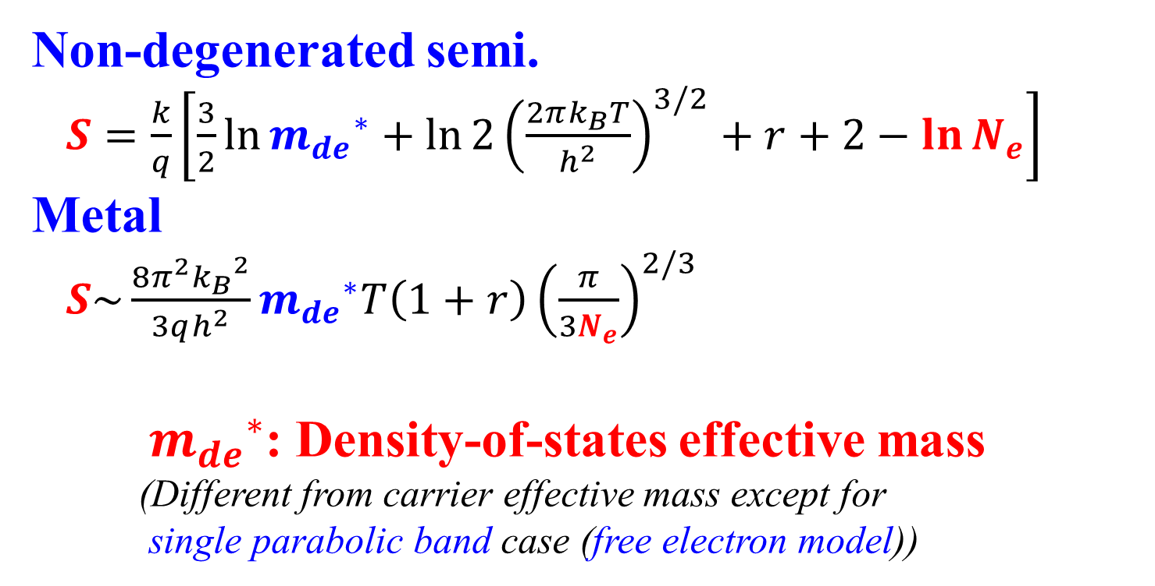
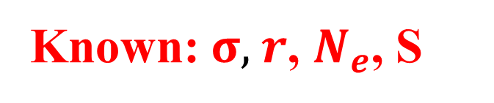
What we can know from Seebeck measurement?
Known: $σ$, $r$, $N_{e}$, S
  Non-degenerated semi.
  $S=\frac{k}{q}\left[\frac{3}{2}\ln{{m_{de}}^{∗}}+ln{2{\left(\frac{2πk_{B}T}{h^{2}}\right)}^{3/2}}+r+2−\ln{N_{e}}\right]$
  Metal
  $S\sim \frac{8π^{2}{k_{B}}^{2}}{3qh^{2}}{m_{de}}^{∗}T\left(1+r\right){\left(\frac{π}{3N_{e}}\right)}^{2/3}$
  ${m_{de}}^{∗}$: Density-of-states effective mass
  (Different from carrier effective mass except for
  single parabolic band case (free electron model))
General case: Need simulation and fitting

Slide 30
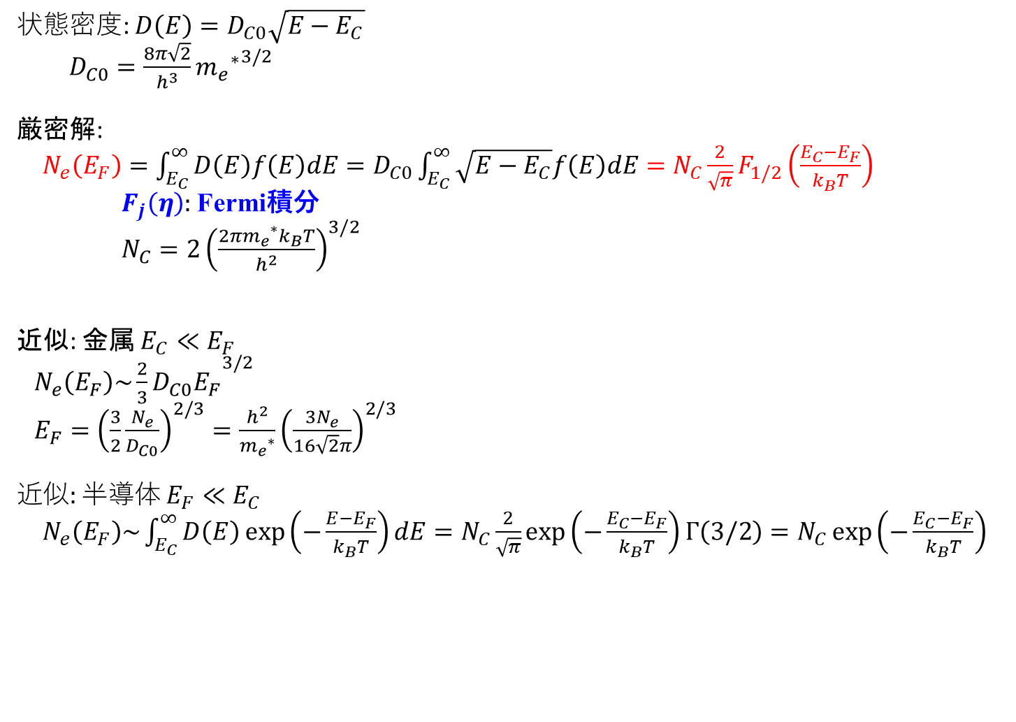
公式: キャリア密度 (自由電子近似)
  状態密度: $D\left(E\right)=D_{C0}\sqrt{E−E_{C}}$
  $D_{C0}=\frac{8π\sqrt{2}}{h^{3}}{{m_{e}}^{∗}}^{3/2}$
  厳密解:
  $N_{e}\left(E_{F}\right)=\int_{E_{C}}^{∞}{D\left(E\right)f\left(E\right)dE}=D_{C0}\int_{E_{C}}^{∞}{\sqrt{E−E_{C}}f\left(E\right)dE}=N_{C}\frac{2}{\sqrt{π}}F_{1/2}\left(\frac{E_{C}−E_{F}}{k_{B}T}\right)$
  $F_{j}\left(η\right)$: Fermi積分
  $N_{C}=2{\left(\frac{{2πm_{e}}^{∗}k_{B}T}{h^{2}}\right)}^{3/2}$
  近似: 金属 $E_{C}≪E_{F}$
  $N_{e}\left(E_{F}\right)\sim {\frac{2}{3}D_{C0}E_{F}}^{3/2}$
  $E_{F}={\left(\frac{3}{2}\frac{N_{e}}{D_{C0}}\right)}^{2/3}=\frac{h^{2}}{{m_{e}}^{∗}}{\left(\frac{3N_{e}}{16\sqrt{2}π}\right)}^{2/3}$
  近似: 半導体 $E_{F}≪E_{C}$
  $N_{e}\left(E_{F}\right)\sim \int_{E_{C}}^{∞}{D\left(E\right)\exp\left(−\frac{E−E_{F}}{k_{B}T}\right)dE}=N_{C}\frac{2}{\sqrt{π}}exp\left(−\frac{E_{C}−E_{F}}{k_{B}T}\right)Γ\left(3/2\right)=N_{C}\exp\left(−\frac{E_{C}−E_{F}}{k_{B}T}\right)$

Slide 31
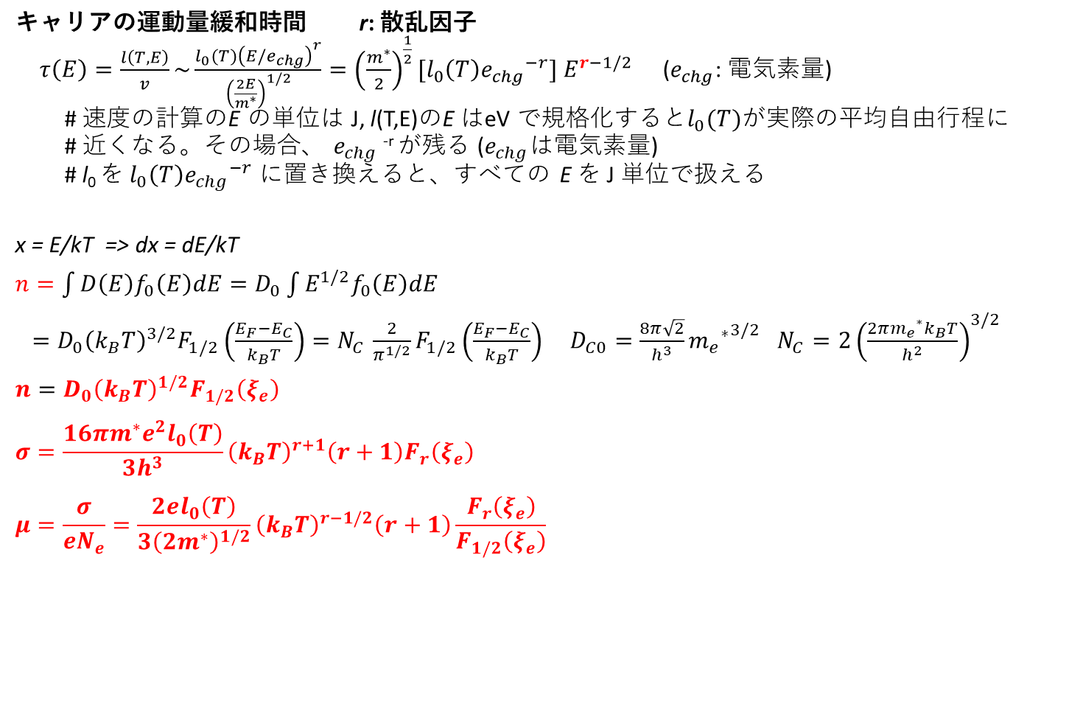
公式: 電気伝導度、移動度
  キャリアの運動量緩和時間 r: 散乱因子
  $τ\left(E\right)=\frac{l\left(T,E\right)}{v}\sim \frac{l_{0}(T){\left(E/e_{chg}\right)}^{r}}{{\left(\frac{2E}{m^{∗}}\right)}^{1/2}}={\left(\frac{m^{∗}}{2}\right)}^{\frac{1}{2}}[l_{0}\left(T\right){e_{chg}}^{−r}] E^{r−1/2}$ ($e_{chg}$: 電気素量)
  # 速度の計算のE の単位は J, l(T,E)のE はeV で規格化すると$l_{0}(T)$が実際の平均自由行程に
  # 近くなる。その場合、 $e_{chg}$^{-r} が残る ($e_{chg}$は電気素量)
  # l₀ を $l_{0}\left(T\right){e_{chg}}^{−r}$ に置き換えると、すべての E を J 単位で扱える
x = E/kT => dx = dE/kT
$n=\int{D\left(E\right)f_{0}\left(E\right)dE}=D_{0}\int{E^{1/2}f_{0}\left(E\right)dE}$
$=D_{0}{\left(k_{B}T\right)}^{3/2}F_{1/2}\left(\frac{E_{F}−E_{C}}{k_{B}T}\right){=N}_{C}\frac{2}{π^{1/2}}F_{1/2}\left(\frac{E_{F}−E_{C}}{k_{B}T}\right)$ $D_{C0}=\frac{8π\sqrt{2}}{h^{3}}{{m_{e}}^{∗}}^{3/2}$ $N_{C}=2{\left(\frac{{2πm_{e}}^{∗}k_{B}T}{h^{2}}\right)}^{3/2}$
$n=D_{0}{\left(k_{B}T\right)}^{1/2}F_{1/2}\left(ξ_{e}\right)$
$$σ=\frac{16πm^{∗}e^{2}l_{0}\left(T\right)}{3h^{3}}{\left(k_{B}T\right)}^{r+1}\left(r+1\right)F_{r}\left(ξ_{e}\right)$$
$$μ=\frac{σ}{eN_{e}}=\frac{2el_{0}\left(T\right)}{3{\left(2m^{∗}\right)}^{1/2}}{\left(k_{B}T\right)}^{r−1/2}\left(r+1\right)\frac{F_{r}\left(ξ_{e}\right)}{F_{1/2}\left(ξ_{e}\right)}$$

Slide 32
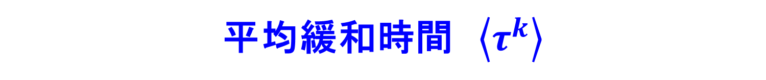
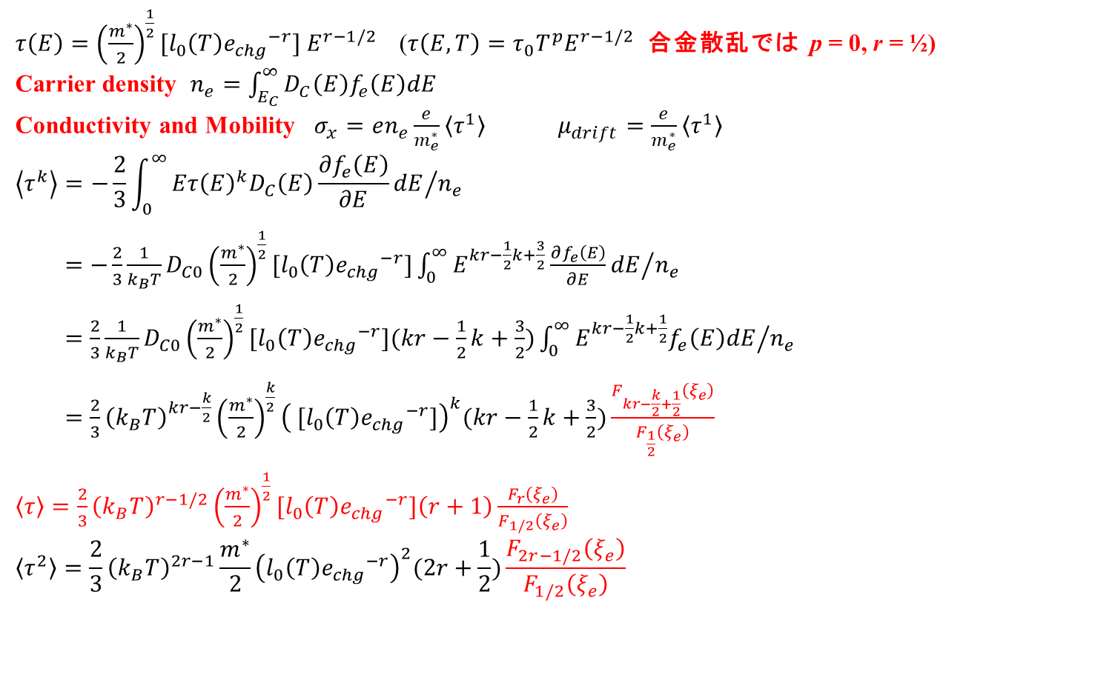
平均緩和時間 $\left\langle τ^{k}\right\rangle$
$τ\left(E\right)={\left(\frac{m^{∗}}{2}\right)}^{\frac{1}{2}}[l_{0}\left(T\right){e_{chg}}^{−r}] E^{r−1/2}$ ($τ\left(E,T\right)=τ_{0}T^{p}E^{r−1/2}$ 合金散乱では p = 0, r = ½)
Carrier density $n_{e}=\int_{E_{C}}^{∞}{D_{C}\left(E\right)f_{e}\left(E\right)dE}$
Conductivity and Mobility $σ_{x}=en_{e}\frac{e}{m_{e}^{∗}}\left\langle τ^{1}\right\rangle$ $μ_{drift}=\frac{e}{m_{e}^{∗}}\left\langle τ^{1}\right\rangle$
$$\left\langle τ^{k}\right\rangle =−\frac{2}{3}{\int_{0}^{∞}{Eτ{\left(E\right)}^{k}D_{C}\left(E\right)\frac{∂f_{e}\left(E\right)}{∂E}dE}}/{n_{e}}$$
$=−\frac{2}{3}\frac{1}{k_{B}T}D_{C0}{\left(\frac{m^{∗}}{2}\right)}^{\frac{1}{2}}[l_{0}\left(T\right){e_{chg}}^{−r}]{\int_{0}^{∞}{E^{kr−\frac{1}{2}k+\frac{3}{2}}\frac{∂f_{e}\left(E\right)}{∂E}dE}}/{n_{e}}$
$=\frac{2}{3}\frac{1}{k_{B}T}D_{C0}{\left(\frac{m^{∗}}{2}\right)}^{\frac{1}{2}}[l_{0}\left(T\right){e_{chg}}^{−r}](kr−\frac{1}{2}k+\frac{3}{2}){\int_{0}^{∞}{E^{kr−\frac{1}{2}k+\frac{1}{2}}f_{e}\left(E\right)dE}}/{n_{e}}$
$=\frac{2}{3}{\left(k_{B}T\right)}^{kr−\frac{k}{2}}{\left(\frac{m^{∗}}{2}\right)}^{\frac{k}{2}}{\left( [l_{0}\left(T\right){e_{chg}}^{−r}]\right)}^{k}(kr−\frac{1}{2}k+\frac{3}{2})\frac{F_{kr−\frac{k}{2}+\frac{1}{2}}\left(ξ_{e}\right)}{F_{\frac{1}{2}}\left(ξ_{e}\right)}$
$\left\langle τ\right\rangle =\frac{2}{3}{\left(k_{B}T\right)}^{r−1/2}{\left(\frac{m^{∗}}{2}\right)}^{\frac{1}{2}}[l_{0}\left(T\right){e_{chg}}^{−r}]\left(r+1\right)\frac{F_{r}\left(ξ_{e}\right)}{F_{1/2}\left(ξ_{e}\right)}$
$$\left\langle τ^{2}\right\rangle =\frac{2}{3}{\left(k_{B}T\right)}^{2r−1}\frac{m^{∗}}{2}{\left(l_{0}\left(T\right){e_{chg}}^{−r}\right)}^{2}(2r+\frac{1}{2})\frac{F_{2r−1/2}\left(ξ_{e}\right)}{F_{1/2}\left(ξ_{e}\right)}$$

Slide 33
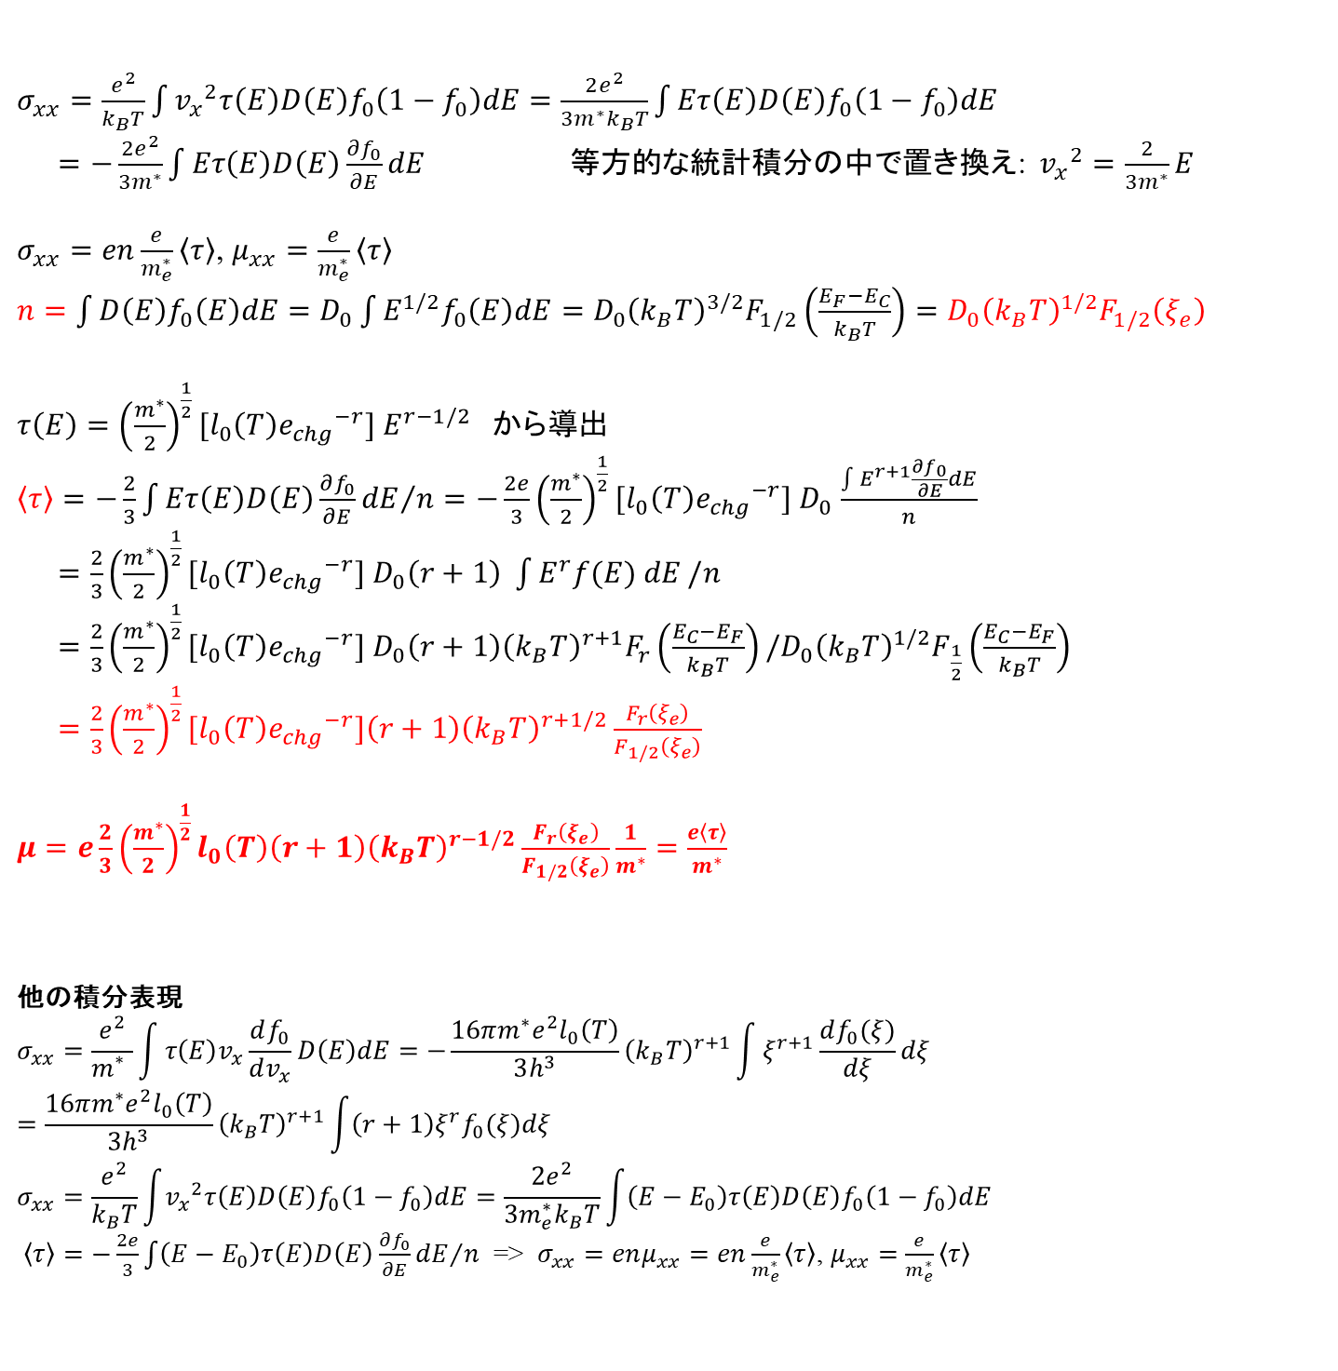
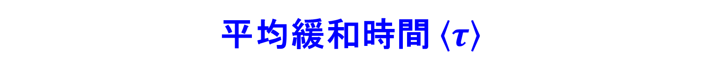
平均緩和時間 $\left\langle τ\right\rangle$
$σ_{xx}=\frac{e^{2}}{k_{B}T}\int{{v_{x}}^{2}τ\left(E\right)D\left(E\right)f_{0}\left(1−f_{0}\right)dE}=\frac{2e^{2}}{3m^{∗}k_{B}T}\int{Eτ\left(E\right)D\left(E\right)f_{0}\left(1−f_{0}\right)dE}$
$=−\frac{2e^{2}}{3m^{∗}}\int{Eτ\left(E\right)D\left(E\right)\frac{∂f_{0}}{∂E}dE}$ 等方的な統計積分の中で置き換え: ${v_{x}}^{2}=\frac{2}{3m^{∗}}E$
$σ_{xx}=en\frac{e}{m_{e}^{∗}}\left\langle τ\right\rangle$, $μ_{xx}=\frac{e}{m_{e}^{∗}}\left\langle τ\right\rangle$
$n=\int{D\left(E\right)f_{0}\left(E\right)dE}=D_{0}\int{E^{1/2}f_{0}\left(E\right)dE}=D_{0}{\left(k_{B}T\right)}^{3/2}F_{1/2}\left(\frac{E_{F}−E_{C}}{k_{B}T}\right)=D_{0}{\left(k_{B}T\right)}^{1/2}F_{1/2}\left(ξ_{e}\right)$
$τ\left(E\right)={\left(\frac{m^{∗}}{2}\right)}^{\frac{1}{2}}[l_{0}\left(T\right){e_{chg}}^{−r}] E^{r−1/2}$ から導出
$\left\langle τ\right\rangle ={−\frac{2}{3}\int{Eτ\left(E\right)D\left(E\right)\frac{∂f_{0}}{∂E}dE}}/n=−\frac{2e}{3}{\left(\frac{m^{∗}}{2}\right)}^{\frac{1}{2}}[l_{0}\left(T\right){e_{chg}}^{−r}] D_{0}$ $\frac{\int{E^{r+1}\frac{∂f_{0}}{∂E}dE}}{n}$
$=\frac{2}{3}{\left(\frac{m^{∗}}{2}\right)}^{\frac{1}{2}}[l_{0}\left(T\right){e_{chg}}^{−r}] D_{0}\left(r+1\right) \int{E^{r}f(E) dE}/n$
$=\frac{2}{3}{\left(\frac{m^{∗}}{2}\right)}^{\frac{1}{2}}[l_{0}\left(T\right){e_{chg}}^{−r}] D_{0}\left(r+1\right){\left(k_{B}T\right)}^{r+1}F_{r}\left(\frac{E_{C}−E_{F}}{k_{B}T}\right)/D_{0}{\left(k_{B}T\right)}^{1/2}F_{\frac{1}{2}}\left(\frac{E_{C}−E_{F}}{k_{B}T}\right)$
$=\frac{2}{3}{\left(\frac{m^{∗}}{2}\right)}^{\frac{1}{2}}[l_{0}\left(T\right){e_{chg}}^{−r}]\left(r+1\right){\left(k_{B}T\right)}^{r+1/2}\frac{F_{r}\left(ξ_{e}\right)}{F_{1/2}\left(ξ_{e}\right)}$
$μ=e\frac{2}{3}{\left(\frac{m^{∗}}{2}\right)}^{\frac{1}{2}}l_{0}\left(T\right)\left(r+1\right){\left(k_{B}T\right)}^{r−1/2}\frac{F_{r}\left(ξ_{e}\right)}{F_{1/2}\left(ξ_{e}\right)}\frac{1}{m^{∗}}=\frac{e\left\langle τ\right\rangle }{m^{∗}}$
他の積分表現
$$σ_{xx}=\frac{e^{2}}{m_{}^{∗}}\int{τ\left(E\right)v_{x}\frac{df_{0}}{dv_{x}}D\left(E\right)dE}=−\frac{16πm^{∗}e^{2}l_{0}\left(T\right)}{3h^{3}}{\left(k_{B}T\right)}^{r+1}\int{ξ^{r+1}\frac{df_{0}(ξ)}{dξ}dξ}=\frac{16πm^{∗}e^{2}l_{0}\left(T\right)}{3h^{3}}{\left(k_{B}T\right)}^{r+1}\int{\left(r+1\right)ξ^{r}f_{0}(ξ)dξ}$$
$$σ_{xx}=\frac{e^{2}}{k_{B}T}\int{{v_{x}}^{2}τ\left(E\right)D\left(E\right)f_{0}\left(1−f_{0}\right)dE}=\frac{2e^{2}}{3m_{e}^{∗}k_{B}T}\int{\left(E−E_{0}\right)τ\left(E\right)D\left(E\right)f_{0}\left(1−f_{0}\right)dE}$$
$\left\langle τ\right\rangle ={−\frac{2e}{3}\int{\left(E−E_{0}\right)τ\left(E\right)D\left(E\right)\frac{∂f_{0}}{∂E}dE}}/n$ => $σ_{xx}=enμ_{xx}=en\frac{e}{m_{e}^{∗}}\left\langle τ\right\rangle$, $μ_{xx}=\frac{e}{m_{e}^{∗}}\left\langle τ\right\rangle$

Slide 34
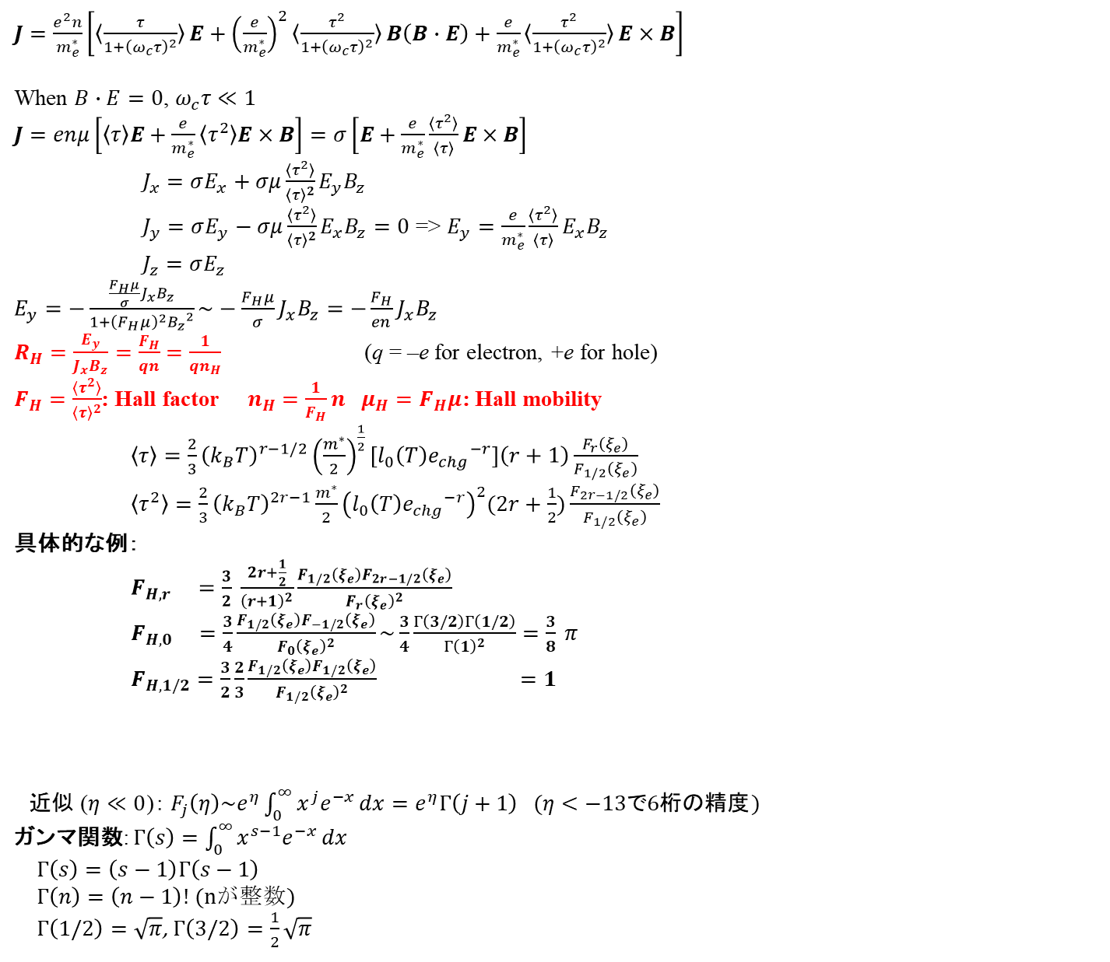
Hall effect
太田英二、坂田亮著、半導体の電子物性光学、培風館 (2005)
$J=\frac{e^{2}n}{m_{e}^{∗}}\left[〈\frac{τ}{1+{\left(ω_{c}τ\right)}^{2}}〉E+{\left(\frac{e}{m_{e}^{∗}}\right)}^{2}〈\frac{τ^{2}}{1+{\left(ω_{c}τ\right)}^{2}}〉B\left(B∙E\right)+\frac{e}{m_{e}^{∗}}〈\frac{τ^{2}}{1+{\left(ω_{c}τ\right)}^{2}}〉E×B\right]$
When $B∙E=0$, $ω_{c}τ≪1$
$J=enμ\left[〈τ〉E+\frac{e}{m_{e}^{∗}}〈τ^{2}〉E×B\right]=σ\left[E+\frac{e}{m_{e}^{∗}}\frac{〈τ^{2}〉}{〈τ〉}E×B\right]$
$J_{x}=σE_{x}+σμ\frac{〈τ^{2}〉}{{〈τ〉}^{2}}E_{y}B_{z}$
$J_{y}=σE_{y}−σμ\frac{〈τ^{2}〉}{{〈τ〉}^{2}}E_{x}B_{z}=0$ => $E_{y}=\frac{e}{m_{e}^{∗}}\frac{〈τ^{2}〉}{〈τ〉}E_{x}B_{z}$
$J_{z}=σE_{z}$
$E_{y}=−\frac{\frac{F_{H}μ}{σ}J_{x}B_{z}}{1+{\left(F_{H}μ\right)}^{2}{B_{z}}^{2}}\sim −\frac{F_{H}μ}{σ}J_{x}B_{z}=−\frac{F_{H}}{en}J_{x}B_{z}$
$R_{H}=\frac{E_{y}}{J_{x}B_{z}}=\frac{F_{H}}{qn}$ $=\frac{1}{qn_{H}}$ (q = –e for electron, +e for hole)
$F_{H}=\frac{〈τ^{2}〉}{{〈τ〉}^{2}}$: Hall factor $n_{H}$ $=\frac{1}{F_{H}}n$ $μ_{H}=F_{H}μ$: Hall mobility
$\left\langle τ\right\rangle =\frac{2}{3}{\left(k_{B}T\right)}^{r−1/2}{\left(\frac{m^{∗}}{2}\right)}^{\frac{1}{2}}[l_{0}\left(T\right){e_{chg}}^{−r}]\left(r+1\right)\frac{F_{r}\left(ξ_{e}\right)}{F_{1/2}\left(ξ_{e}\right)}$
$\left\langle τ^{2}\right\rangle =\frac{2}{3}{\left(k_{B}T\right)}^{2r−1}\frac{m^{∗}}{2}{\left(l_{0}\left(T\right){e_{chg}}^{−r}\right)}^{2}(2r+\frac{1}{2})\frac{F_{2r−1/2}\left(ξ_{e}\right)}{F_{1/2}\left(ξ_{e}\right)}$
具体的な例：
$F_{H,r} =\frac{3}{2} \frac{2r+\frac{1}{2}}{{\left(r+1\right)}^{2}}\frac{F_{1/2}\left(ξ_{e}\right)F_{2r−1/2}\left(ξ_{e}\right)}{{F_{r}\left(ξ_{e}\right)}^{2}}$
$F_{H,0} =\frac{3}{4}\frac{F_{1/2}\left(ξ_{e}\right)F_{−1/2}\left(ξ_{e}\right)}{{F_{0}\left(ξ_{e}\right)}^{2}}\sim \frac{3}{4}\frac{Γ\left(3/2\right)Γ\left(1/2\right)}{{Γ\left(1\right)}^{2}}=\frac{3}{8} π$
$F_{H,1/2}=\frac{3}{2}\frac{2}{3}\frac{F_{1/2}\left(ξ_{e}\right)F_{1/2}\left(ξ_{e}\right)}{{F_{1/2}\left(ξ_{e}\right)}^{2}} =1$
  近似 ($η≪0$)： $F_{j}\left(η\right)\sim e^{η}\int_{0}^{∞}{x^{j}e^{−x}}dx=e^{η}Γ\left(j+1\right) (η<−13で6桁の精度)$
  ガンマ関数: $Γ\left(s\right)=\int_{0}^{∞}{x^{s−1}e^{−x}}dx$
  $Γ\left(s\right)=\left(s−1\right)Γ\left(s−1\right)$
  $Γ\left(n\right)=\left(n−1\right)!$ (nが整数)
  $Γ\left(1/2\right)=\sqrt{π}$, $Γ\left(3/2\right)=\frac{1}{2}\sqrt{π}$

Slide 35
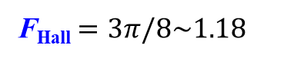
Hall因子 F_{Hall}
R_{H} = F_{Hall} / en
F_{Hall}: 散乱機構に依存
N_{C} = 5.3×10¹⁸ cm⁻³
F_{Hall} $=3π/8\sim 1.18$

